Slide 1
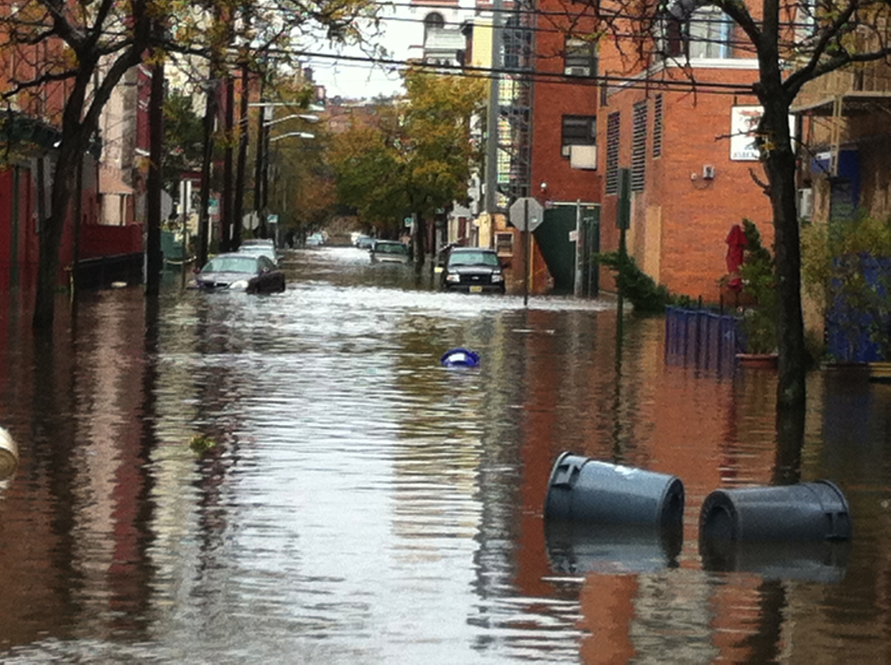
Improving Storm Surge Forecasts and Adapting Our Urban Coasts
Alan Blumberg
Nickitas Georgas and Philip Orton
June 5, 2013
Notes:
regional integrated sciences and assessments

Slide 2
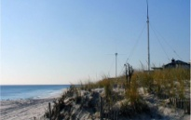
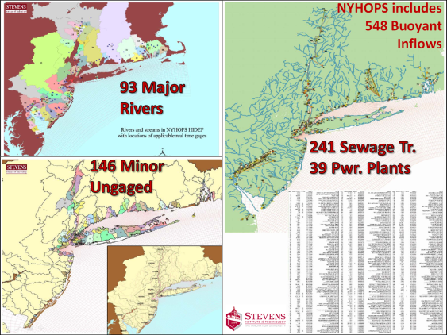
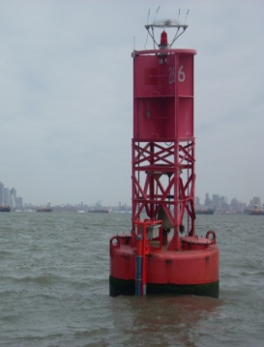
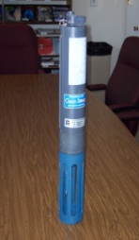
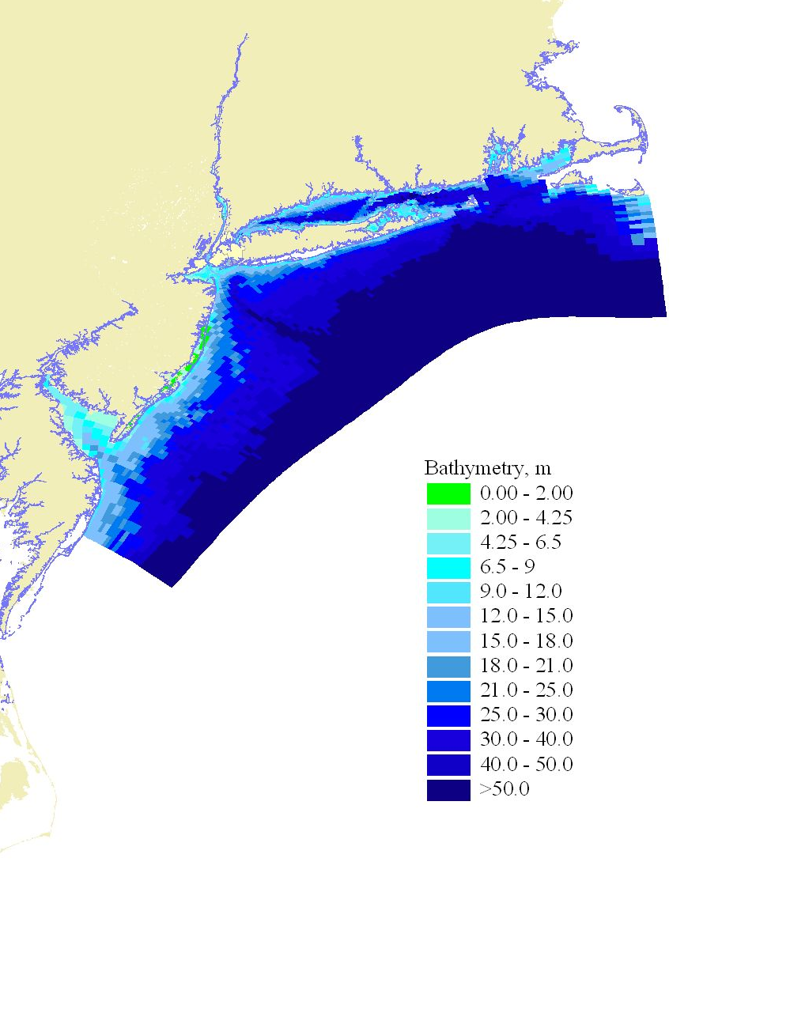
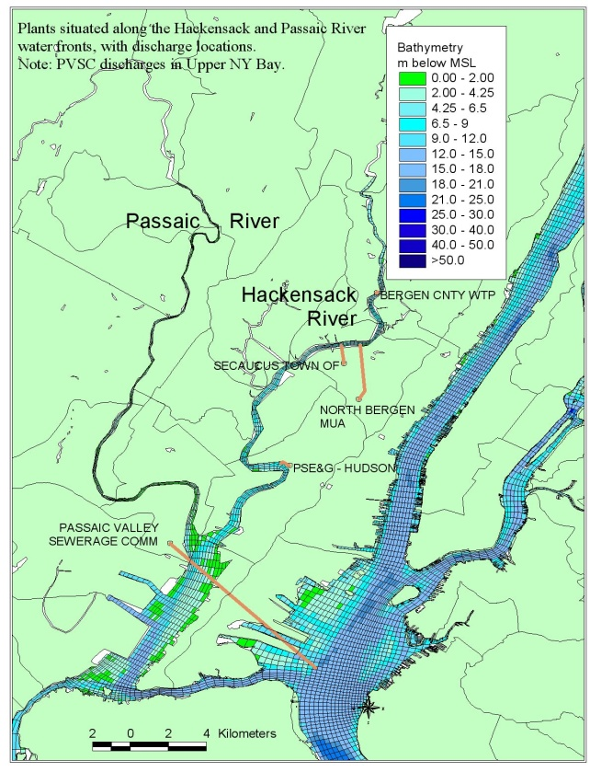
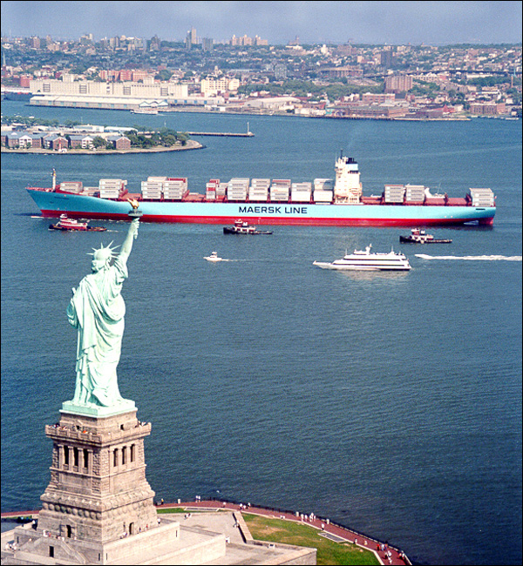
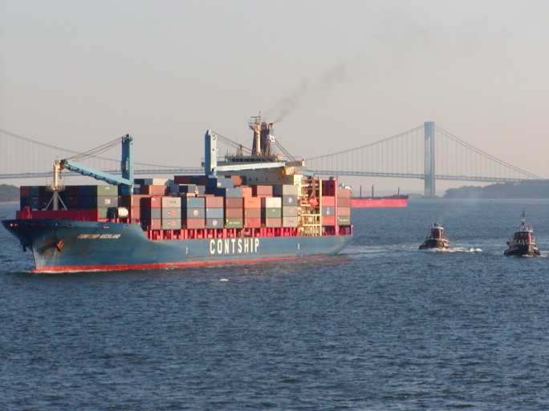
Davidson Laboratory Ocean Modeling and Forecasting
NYHOPS: New York Harbor Observing and Prediction System
Integrated system
of observing sensors
and forecast models
TO OBSERVE
TO PREDICT
TO COMMUNICATE
Weather
Currents
Flooding/Groundings
Waves
Temperature
Salinity
Water Quality
+
+
Real time
Observations
External data
and models
Distributed Inflows and Effluents
1967
2011
Notes:
A group with a vision.

Slide 3
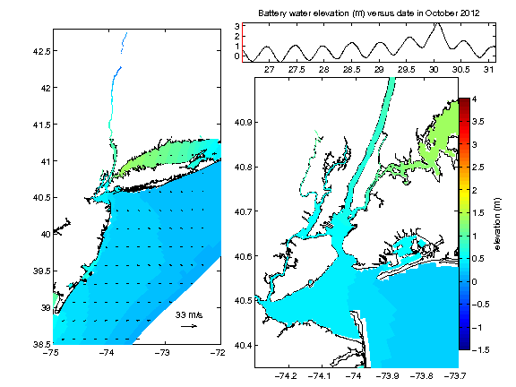

Slide 4
t₁
t₂
t₃
Total Water Elevation (m above MSL)
t₁
t₂
t₃

Slide 5
Validation Versus Observations: Surge Run Using RU-WRF

Slide 6
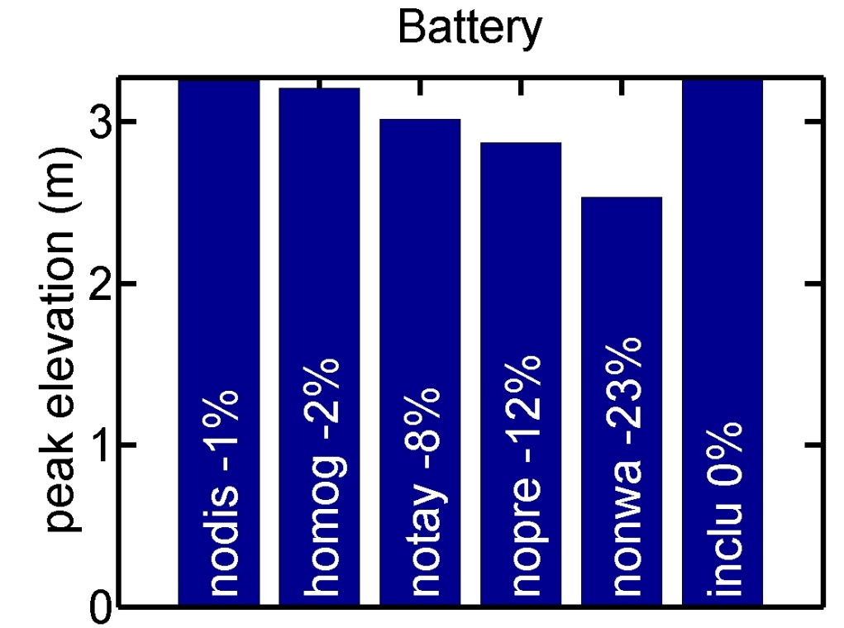
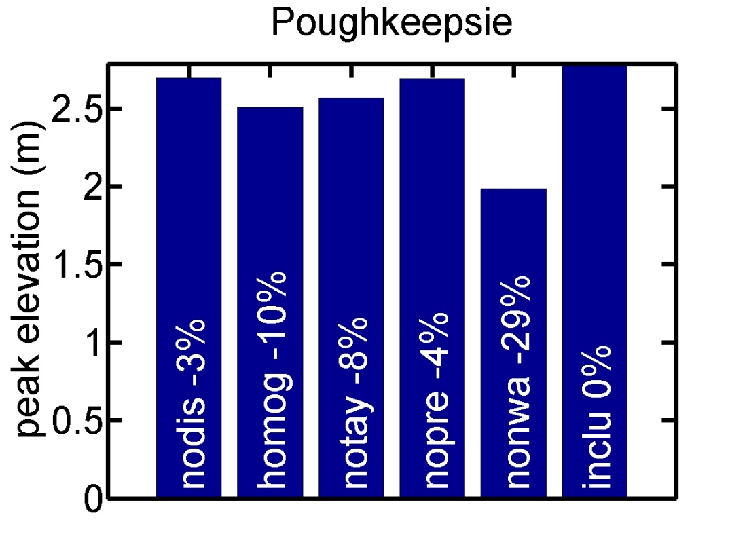
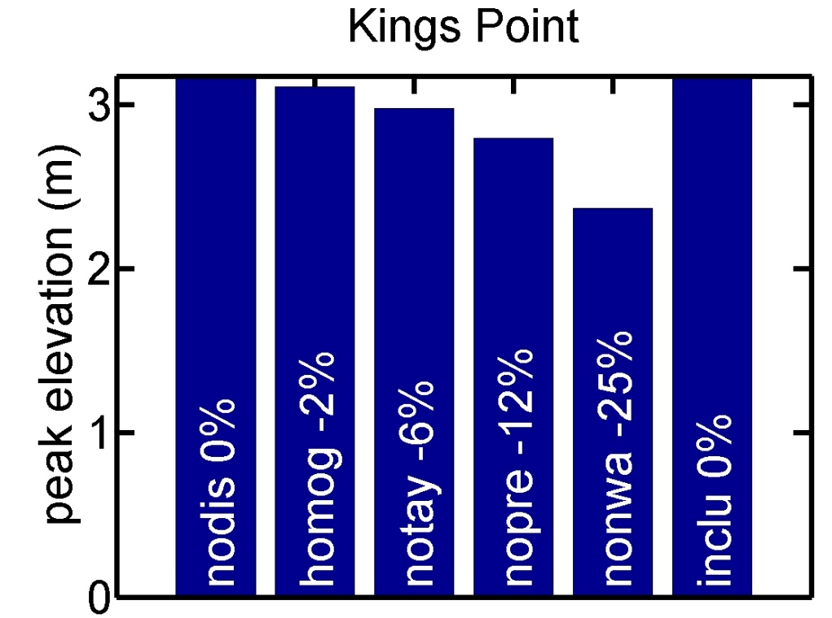
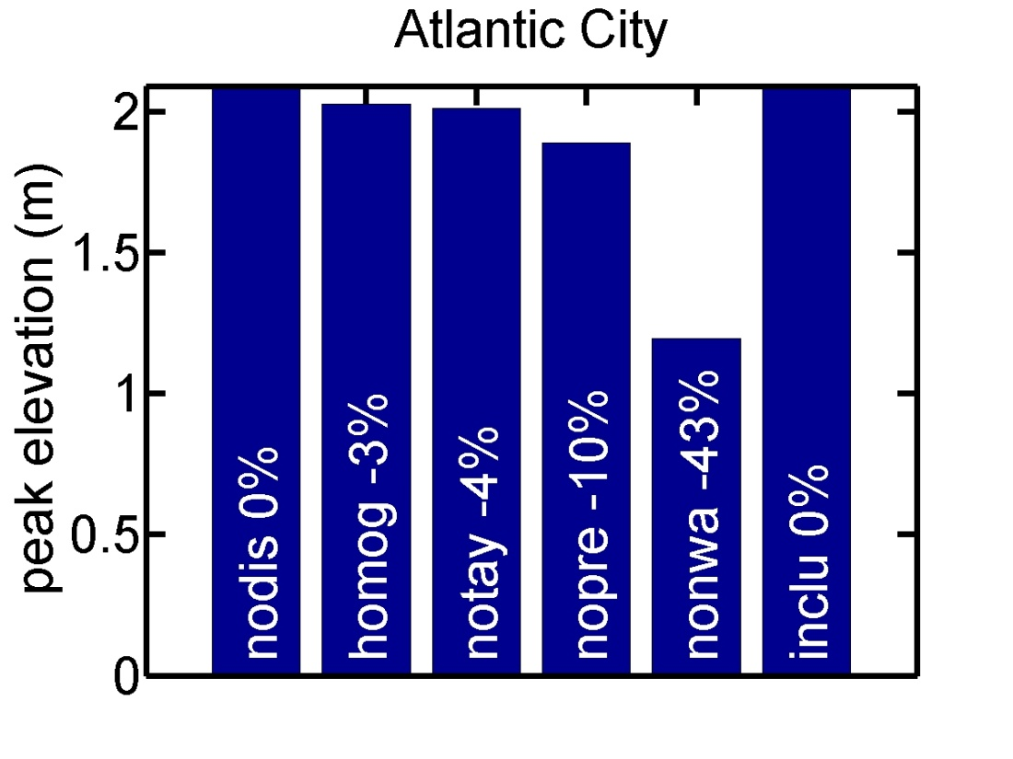
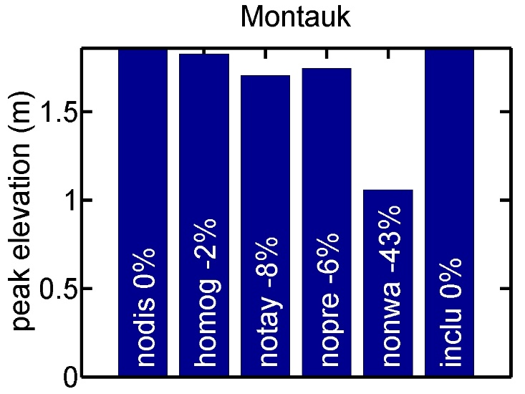
Sandy - Process Omission Experiments
nodis | no freshwater discharge
homog | homogeneous water
notay | no wave steepness
nopre | no atmospheric pressure
nonwa | no remote forcing
inclu | control run

Slide 7
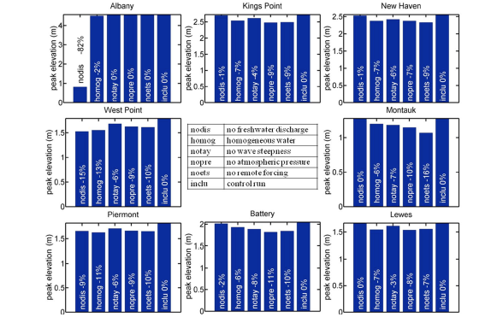
Irene - Process Omission Experiments

Slide 8
What if Sandy had come 9 hours earlier? (HW at UER/WLIS)

Slide 9
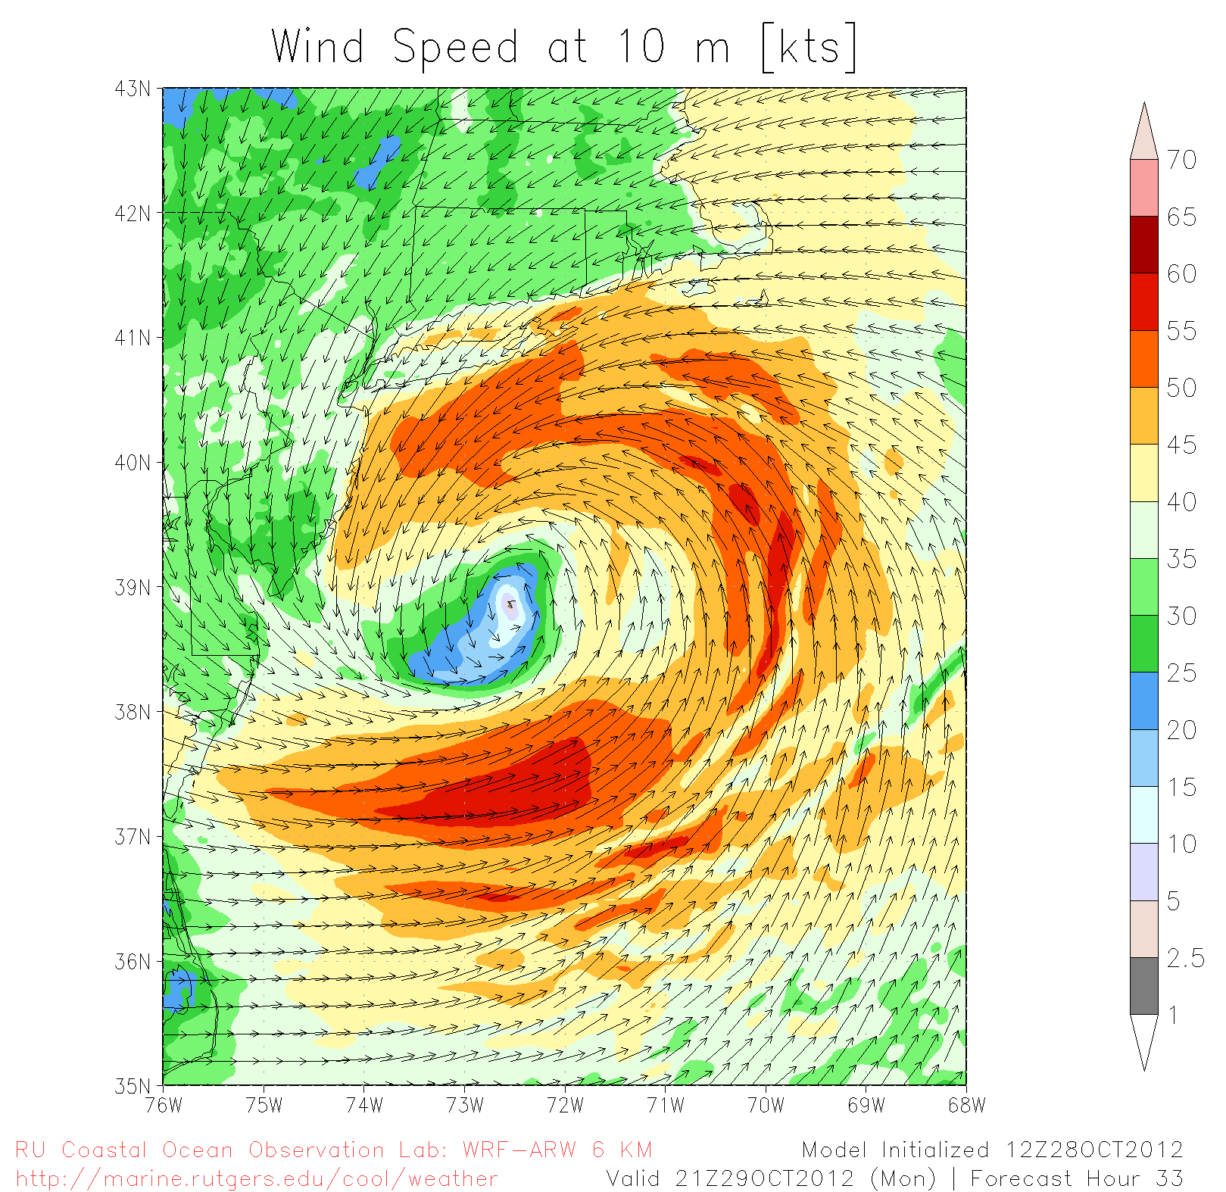
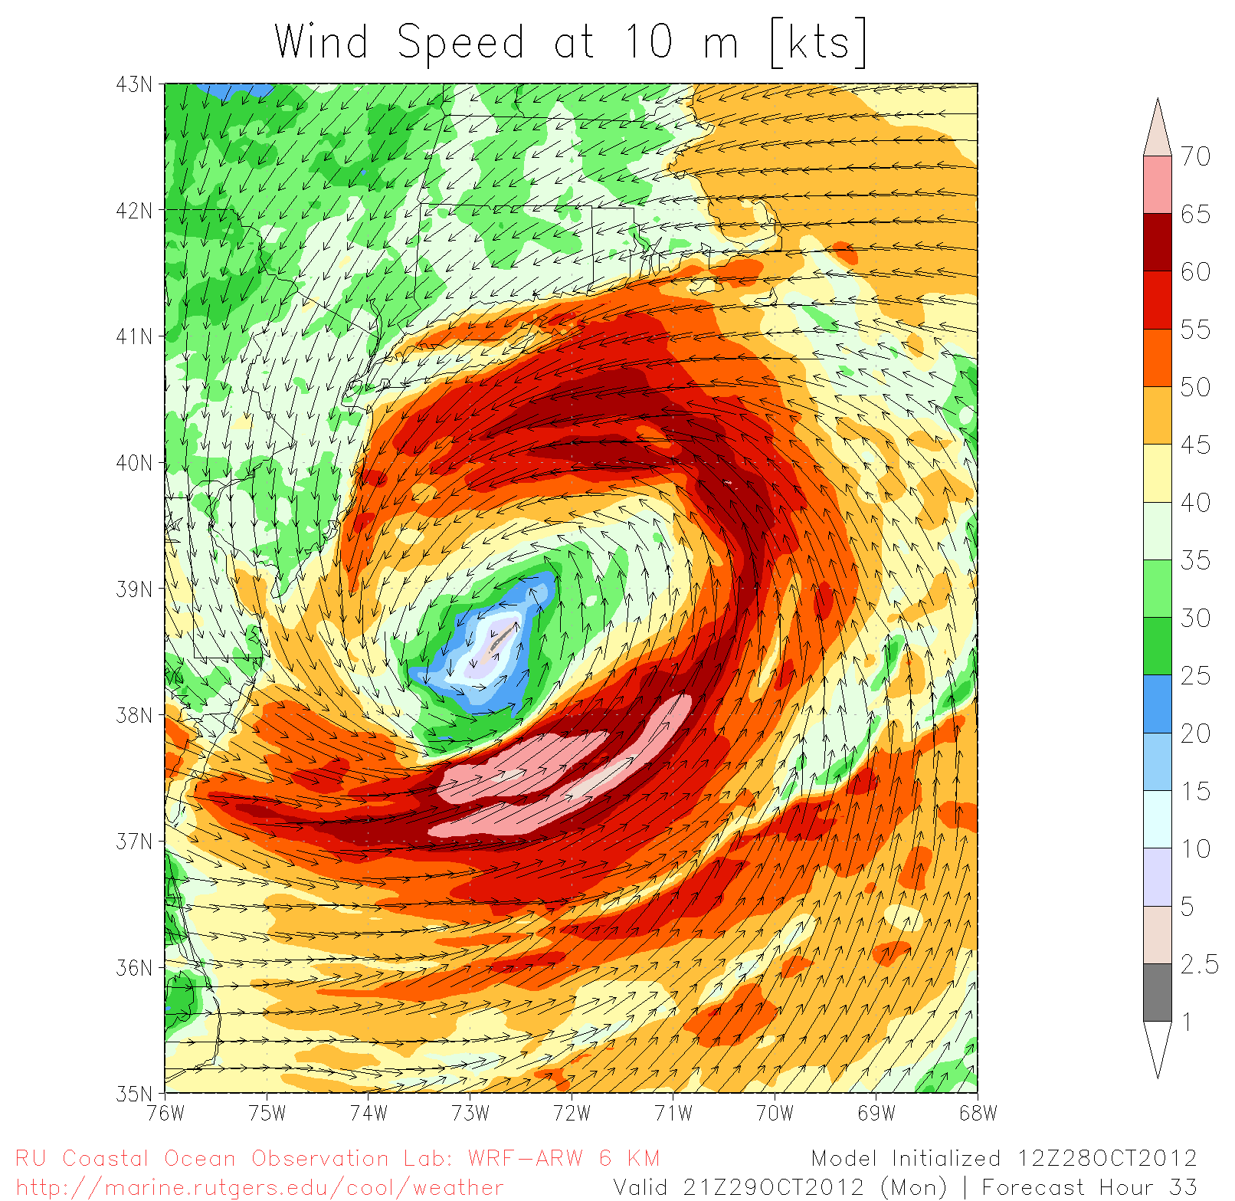
Sandy on Steroids
(Sandy with Irene’s SST)
with 8˚ warmer SST ==> 3ft more surge at battery

Slide 10
Sandy flood data –> the human scale

Slide 11
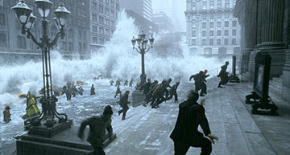
Translating Flood Information
Day After Tomorrow

Slide 12
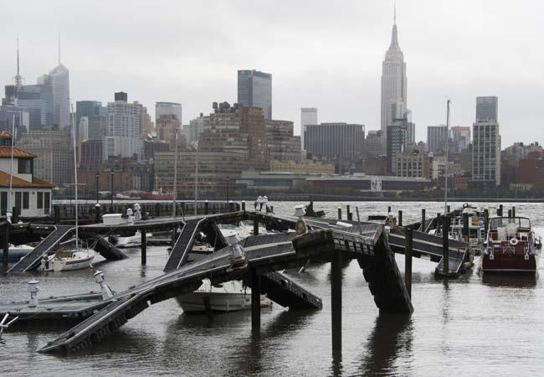
Alan Blumberg
ablumberg@stevens.edu
www.stevens.edu/maritimeforecast/
AP PHOTO/CHARLES SYKES

