Slide 1
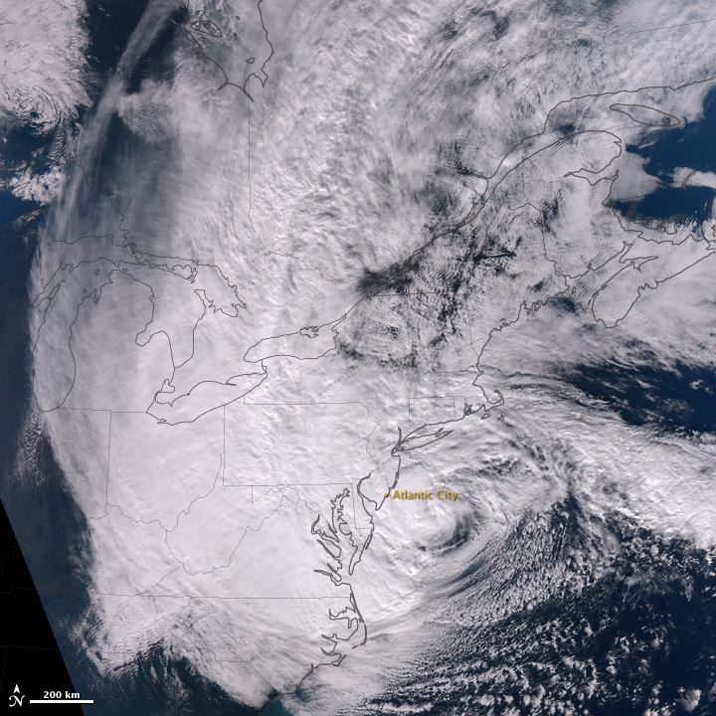
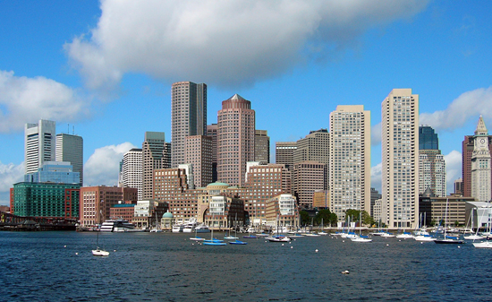
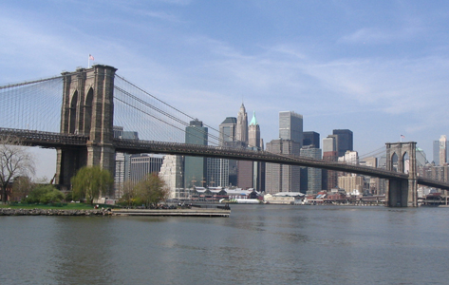
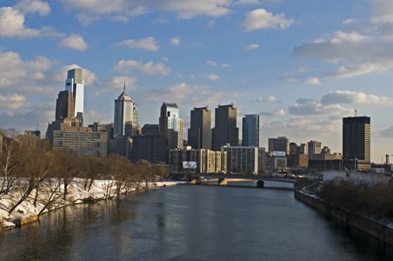
Climate Science, Impacts, and Adaptation at the Consortium for Climate Risk in the Urban Northeast (CCRUN): Science for Hurricane Sandy Recovery
Boston
New York
Philadelphia
Radley Horton
8th Annual NOAA‐CREST Symposium
Steinman Hall Auditorium, The City College of New York, NY
June 5, 2013
Notes:
Photo credits: Philadelphia, © 2009, J. Britton (Drexel); Boston and NYC, public domain photos from Wikimedia Commons

Slide 2
CCRUN Project Sphere
Coordination & Outreach
Water
Coasts
Health
Climate
Indicators, Monitoring & Evaluation
Opportunities • Vulnerability • Adaptation • Management
Urban Areas
2
Notes:
2

Slide 3
Hurricane Sandy as Tipping Point
Leadership in responding to climate change
Municipal, state, and federal alignment
Science in place and in time

Slide 4
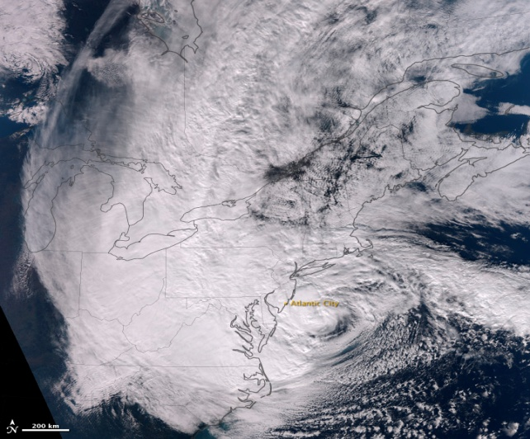
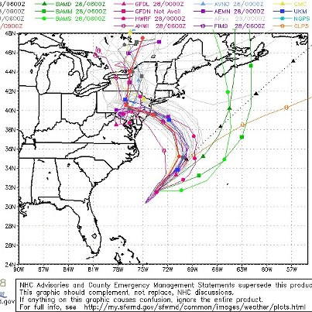
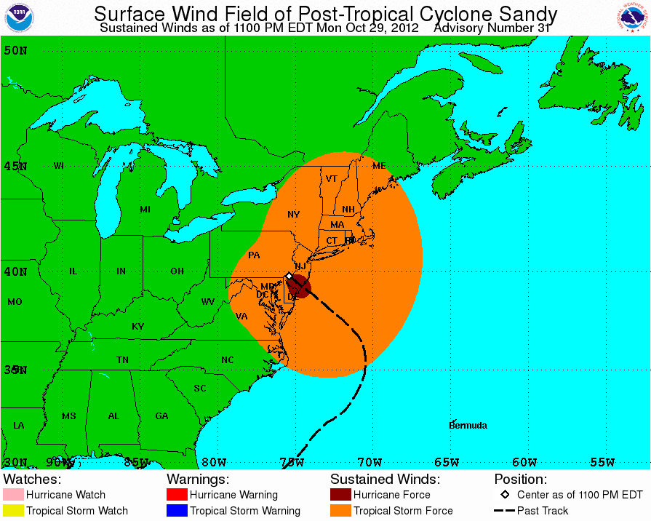
Hurricane Sandy
Lowest recorded central pressure north of Cape Hatteras, NC at 943 mb
Coastal flood elevations in New York Harbor were the highest in all ~300 years of New York City (and New Amsterdam) history
The storm tide (total water elevation) at The Battery was 13.9 ft, with a peak storm surge of 9.2 ft coming close to high tide
This is about 5 ft above many of the area’s lower sea walls.
Storm track forecasts
Exceptionally large wind field tropical storm force winds over ~500 miles from the center
Storm forecast
well in advance

Slide 5
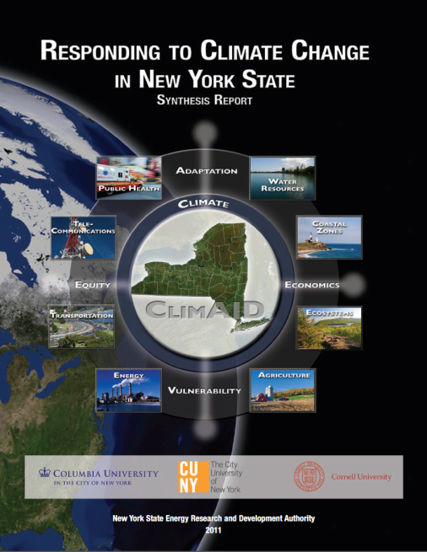
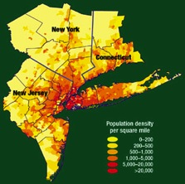
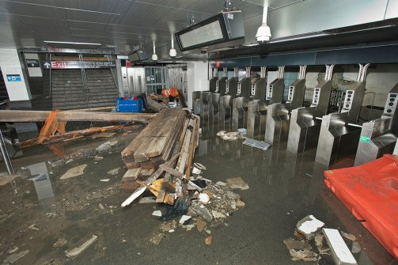
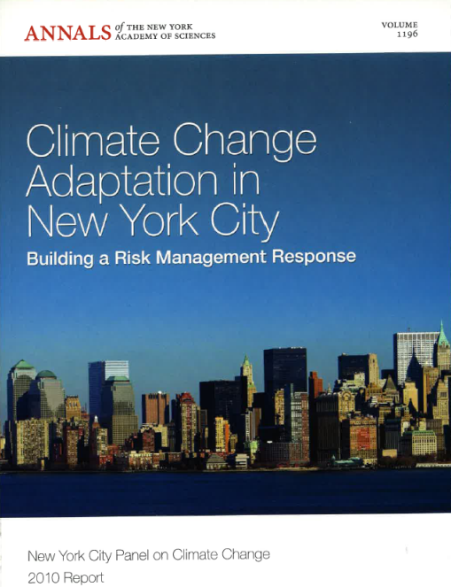
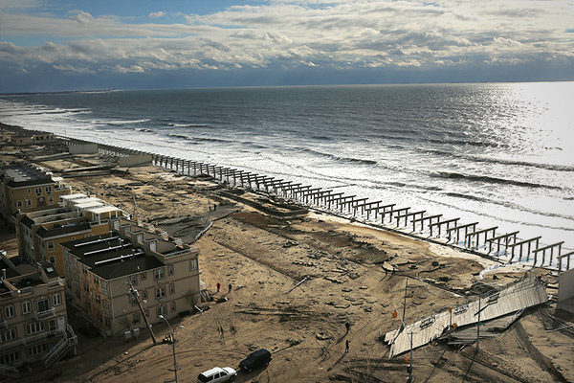
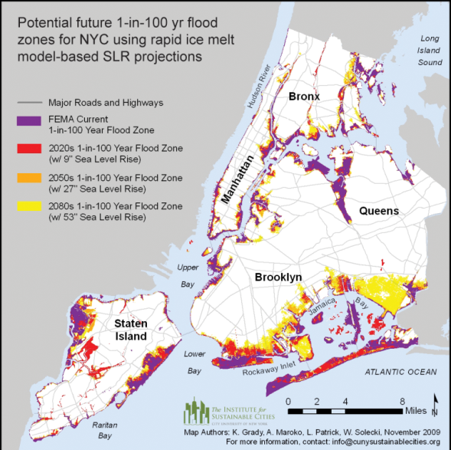
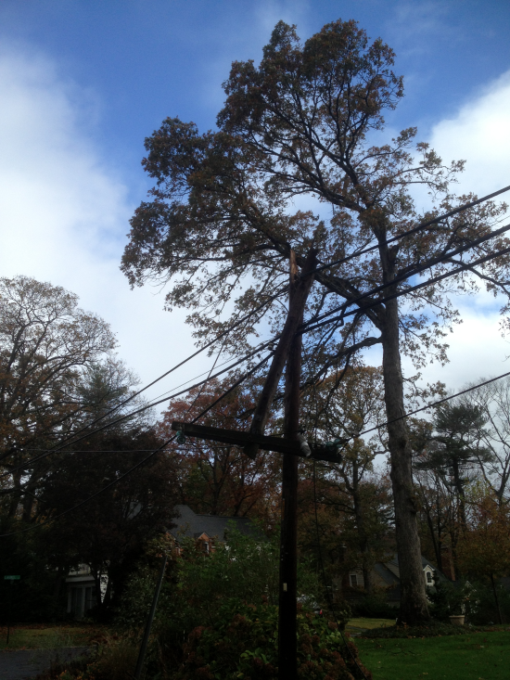
Hurricane Sandy Forecasting the Impacts
Climate Change and a Global City 2001
The Potential Consequences of Climate Variability and Change
Metro East Coast (MEC) July 2001
Interdependent Critical Infrastructure Systems and
Vulnerable Communities
South Ferry Subway Station
Beach erosion and boardwalk damage in the Rockaways
Spencer Platt Getty Images
Extensive power outages
Hardest hit areas
Many impacts forecast
well in advance

Slide 6
New York City Adaptation Process 2008 - 2011
Mayor
Leadership
Implementation
City-wide Sustainability Office
OLTPS
Coordination
City Agencies
Regional Authorities
Private Stakeholders
E
University scholars and private sector experts
Social, biological, and physical scientists
Legal and insurance experts
Risk management professionals
Stakeholder Task Force
CCATF
T
Expert Panel
NPCC
P
C
W
W
Integration across Sector-specific Working Groups
Energy (E) - Transportation (T)
Policy (P) -Water & Waste (WW)
- Communications (C)
Climate Science
Source: NPCC, 2010
6

Slide 7
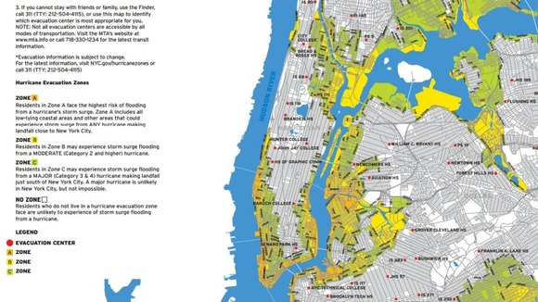
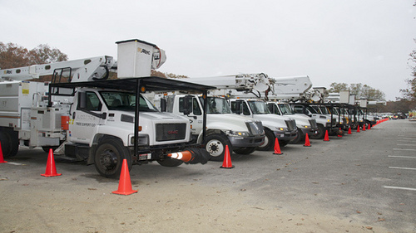
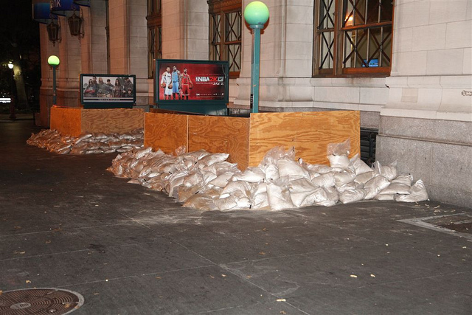
Hurricane Sandy
Immediate Preparations
New York City issued mandatory evacuation of
Zone A on October 28, 2012
Out-of-state utility crews brought in before the storm
Evacuation – Not complete
43 people died in NYC
Utilities – Not prepared
4 million without power
MTA/DOT – Major flooding
7 subway lines under East River,
3 tunnels closed
MTA closed down operations and boarded and placed sandbags at subway entrances to protect against flooding
Notes:
Cause of death: drowning; falling trees; electocution
Utilities: Management of multiple crews
7

Slide 8
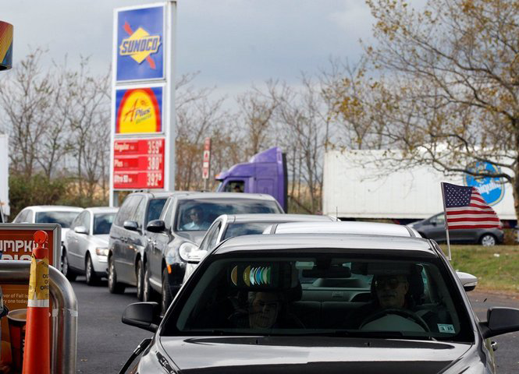
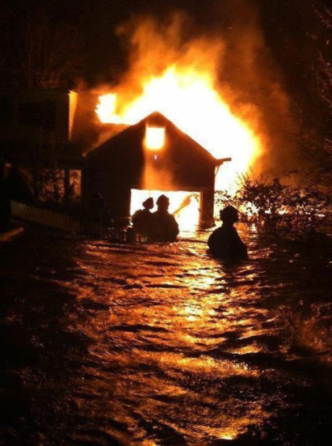
Hurricane Sandy Less-Anticipated Impacts
Gas shortages
Hospital evacuations
Fires
William Perlman/The Star-Ledger
John Minchillo, AP
Jon Eiseman
Notes:
Gas lines - William Perlman/The Star-Ledger; retrieved from: http://photos.nj.com/star-ledger/2012/10/long_gas_lines_across_nj_after_13.html
Breezy Point fires - @Jon_Eiseman; retrieved from: http://animalnewyork.com/2012/hurricane-sandy-the-aftermath-in-photos/
Hospital evac - John Minchillo, AP; retrieved from: http://news.nationalgeographic.com/news/2012/10/pictures/hurricane-sandy-pictures-floods-fire-snow-in-the-aftermath/#/hurricane-superstorm-sandy-hits-hospital_60726_600x450.jpg

Slide 9
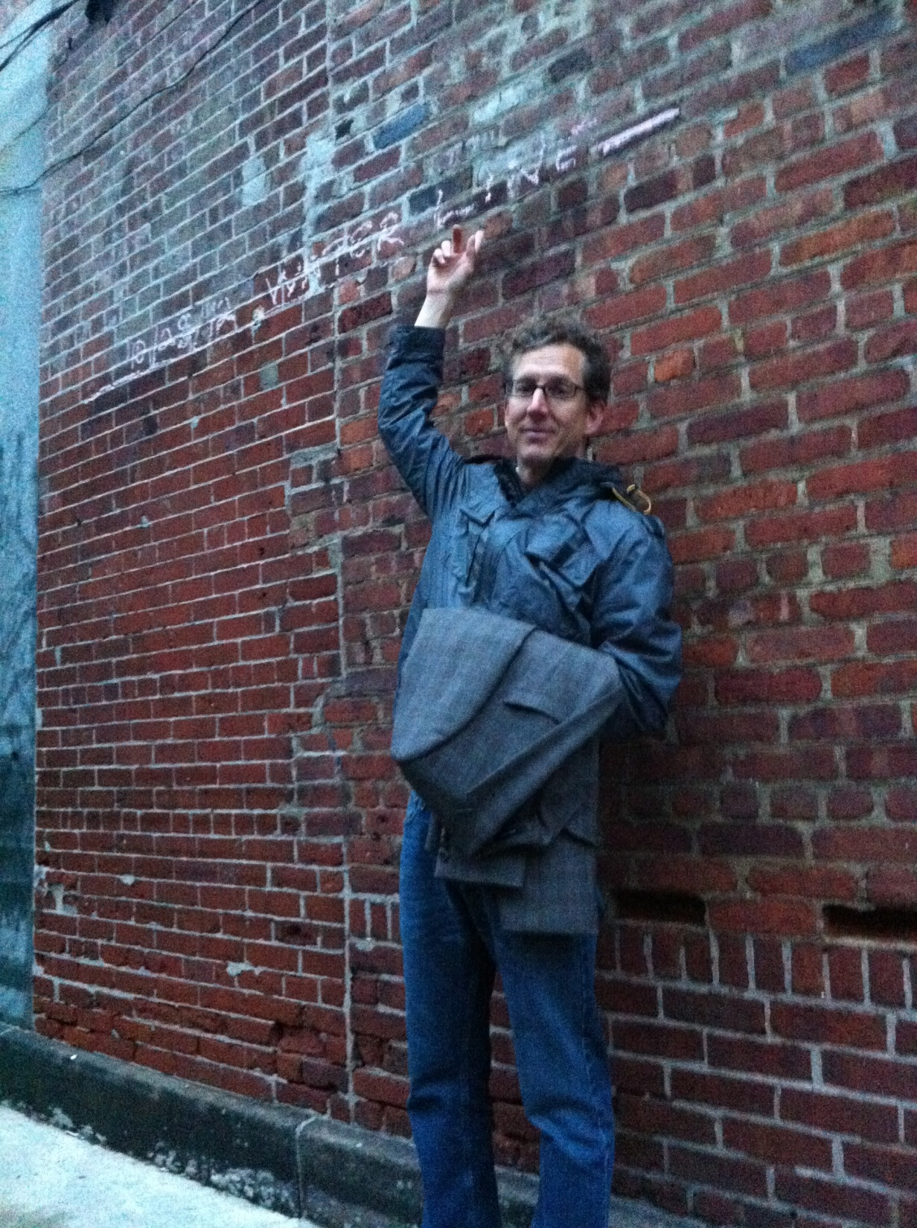
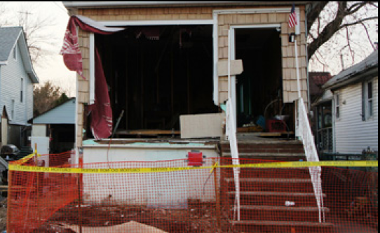
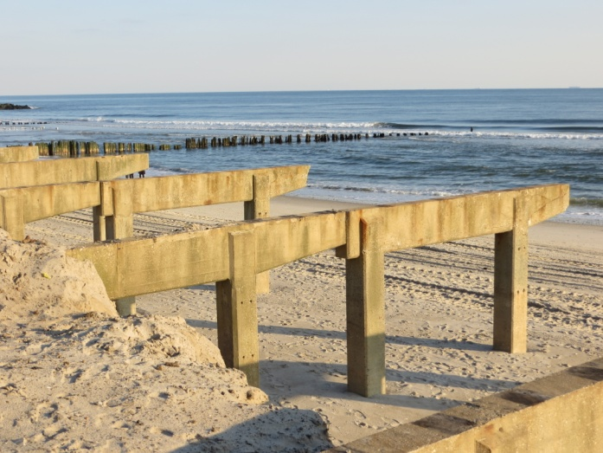
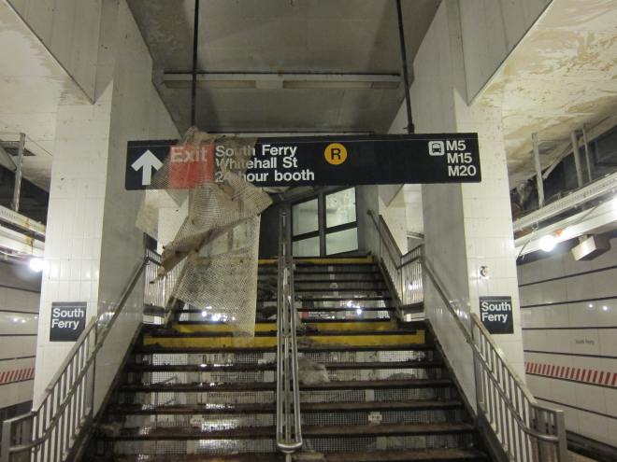
High Water Mark at South Street Seaport
Documenting and Studying the Impacts
Damaged Home in Staten Island
Phil Orton, Stevens Institute of Technology
Somayya Ali, Columbia University
Boardwalk and Beach Damage in Rockaway Park, Queens, NY
South Ferry Subway Station in Manhattan
Gary Monitz, Columbia University
Daniel Bader, Columbia University

Slide 10
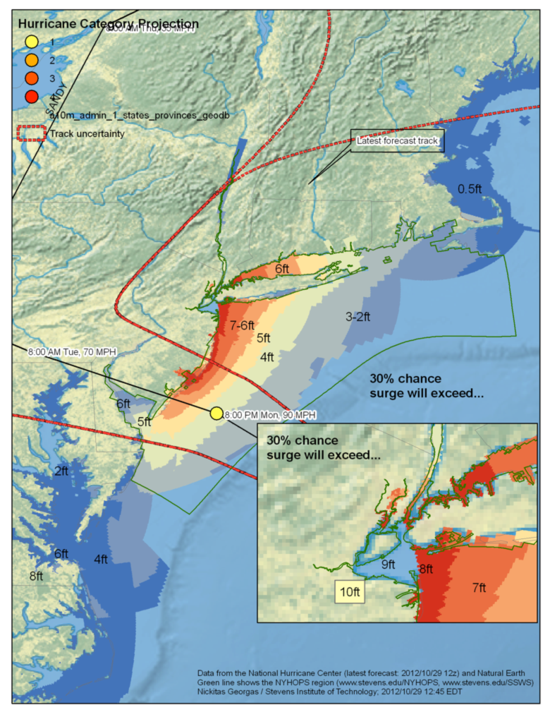
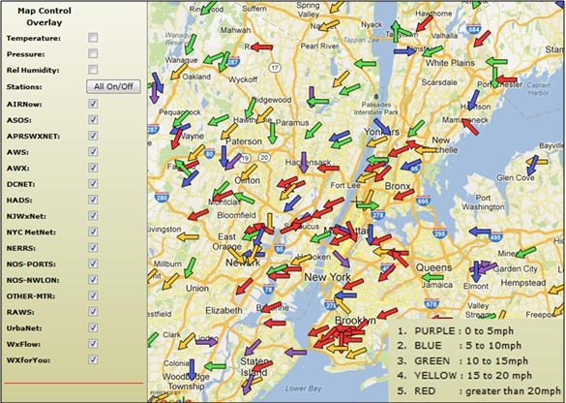
CCRUN Tracked the Storm
New York Harbor Observing and Prediction System
(NYHOPS Model), Stevens Institute of Technology
Storm surge forecast
Wind speed observations from NYCMetNet
CUNY/ NOAA Cooperative Remote Sensing Science and Technology Center (CREST)

Slide 11
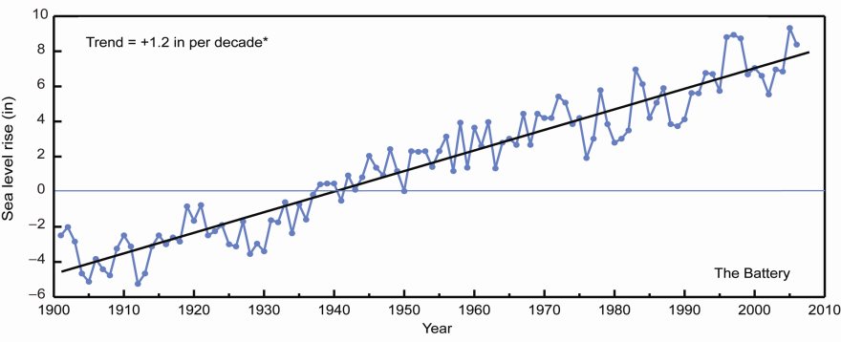
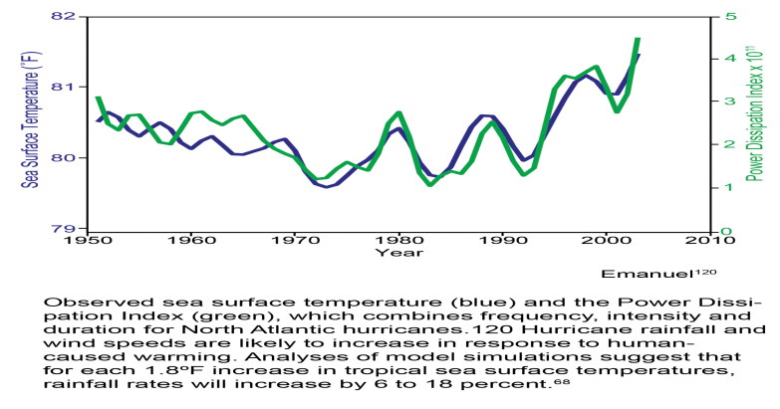
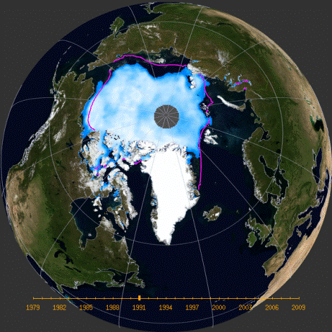
Hurricane Sandy
Links to Climate Change Science
Sea level rise at Battery, NYC 1900-2009, NPCC
~1 ft of sea level rise in past 100 years in New York metropolitan region, due to local land subsidence, global thermal expansion of ocean water, melting of land-based ice, and local surface elevation
Hurricane Sandy is defined as a 1 in
multi-century event in current climate –
Coastal flooding projected to occur more frequently and to greater extent in future due to sea-level rise alone
Frequency of intense hurricanes in the North Atlantic may increase in future*
Arctic sea-ice may influencing the jet stream, possibly making westward-turning storm tracks more likely**
**Areas of active research
North Atlantic SSTs and Hurricane Power Dissipation Index 1950-2005, Emmanuel
Median Minimum Sea Ice Extent 1979-2009

Slide 12
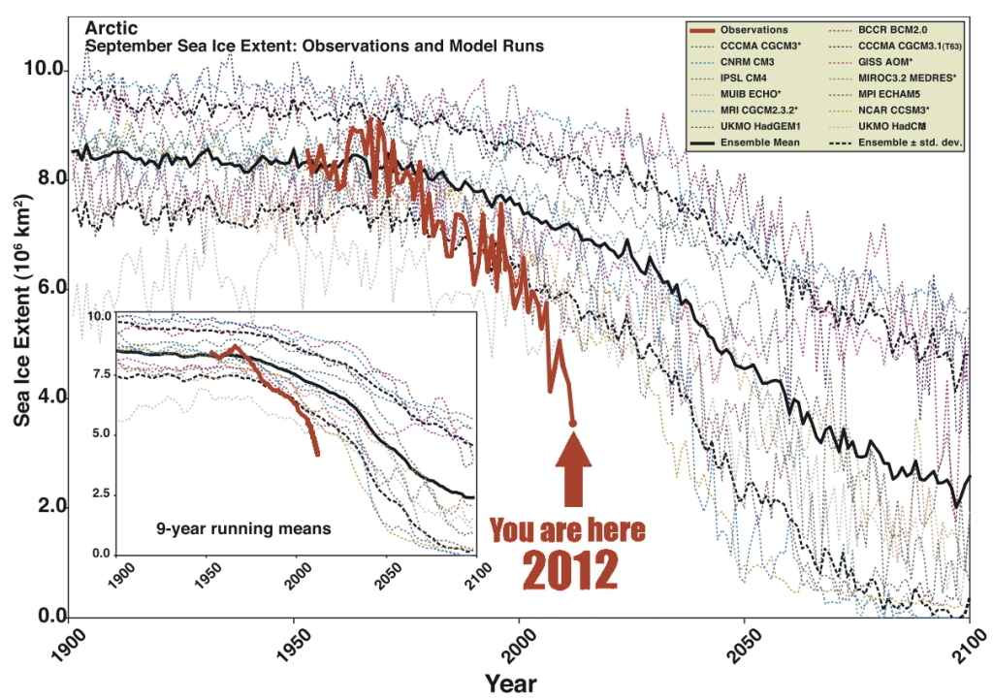
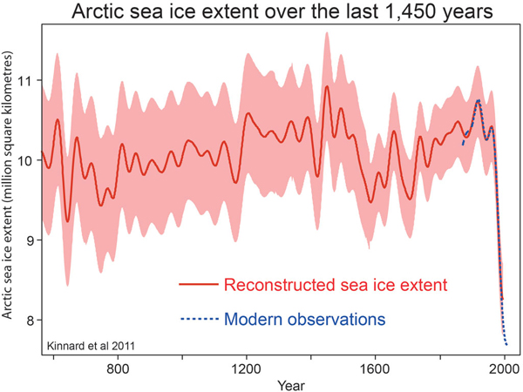
Arctic Sea Ice has been decreasing rapidly; more rapidly than projected by climate models
Change in winter snow cover (%) corresponding to a 1 million square km decrease in autumn arctic sea ice area
Source: NPCC, 2010
Liu et al., PNAS 2012

Slide 13
Horton, Liu, and Tillinger, in preparation

Slide 14
CCRUN Post-Hurricane Sandy Research Agenda Weather and Climate
Key areas to research include:
Assess progress in forecast skill.
Evaluate historical flood heights, including those of Hurricane Sandy, to see if 1/100 storm height needs to be revised.
Research the influence of large-scale changes on hurricane strength and path (e.g., changes in North Atlantic Ocean temperatures, interactions with mid-latitude storms, and changes in large-scale steering patterns).
Investigate how climate change may affect future storms and their impacts as sea levels rise.

Slide 15
CCRUN Post-Hurricane Sandy Integrated Research Agenda Vulnerability and Adaptation
Study the determinants of social resilience to coastal flooding in urban neighborhoods and why vulnerability and resilience differ across communities that experience the same flood levels.
Research whether poorer people suffer larger impacts and are less able to recover than the less poor, and whether poverty magnifies vulnerability only in some contexts, such as in public housing with its complexity of exacerbating factors.
Examine the interactions between characteristics of households, communities, and institutions that create different patterns of vulnerability in different communities and how city and neighborhood agencies can help to build resilience in communities that experience different types of vulnerability.
Collect data within communities that document why people did or did not evacuate, why they did or did not prepare, how and why coping strategies and assistance received differed across neighborhoods, how obstacles faced differed across neighborhoods, and how and why the economic impacts differed across neighborhoods.
Monitor how and why the recovery process proceeds differently in different neighborhoods.

Slide 16
CCRUN Post-Hurricane Sandy Research Agenda Coastal Zones
Key research topics include:
Develop new metrics of coastal storm risk that communicate danger better, e.g., how can we translate ‘storm-surge height’ into ‘flood danger’ or other human-scale metrics; include danger from waves in communications as well as surge.
Create high-fidelity web-based models of street-level flooding.
Evaluate role and extent required of wetlands and other ecologically-based adaptation approaches in absorbing coastal flooding and wave damage.
Conduct assessment of storm-surge barriers, in regard to feasibility and economic, environmental, and social costs and benefits.
Design and assess protective measures such as subway and tunnel closures; raising of power stations, etc.
Evaluate role of policies, planning, design, and insurance in developing resilient coastal communities.
Develop and test geoengineering approaches to reducing intensity of hurricanes.

Slide 17
CCRUN Post-Hurricane Sandy Research Agenda Water Resources
With the occurrence of extreme precipitation events associated with hurricanes and storms, new analysis is needed to improve and update the Intensity – Duration – Frequency (IDF) curves used to design stormwater and sewer systems. Innovative approaches include:
Analyze high-resolution data to update exposure to extreme precipitation events over the storm sewer network.
Stochastic simulations of potential simultaneous or discrete exceedences of a specified rainfall intensity-duration can be generated to facilitate several scenario analyses.

Slide 18
CCRUN Post-Hurricane Sandy Research Agenda Public Health
Hurricane Sandy caused over 110 deaths spread over 9 northeastern states.
These figures do not account for longer term health problems that are likely to emerge over time: mold-related respiratory disease, gastrointestinal infections from contaminated water, and a range of mental health outcomes, to name a few. Research is urgently needed into measures that can reduce both the immediate and longer term health impacts of future storm events in the NE. This research will be enhanced by partnerships between health and climate scientists, along stakeholder organizations and the public.
Epidemiology of the immediate deaths that occurred, as well as the evacuation of the hospitals

Slide 19
CCRUN Post-Hurricane Sandy Research Agenda Green Infrastructure
Research the effectiveness of the northeast region’s portfolio of green infrastructure. Questions include:
Can real damages associated with hurricane Sandy be correlated with the degree to which green infrastructure was interspersed within or surrounded specific regional development clusters?
What types of damages were averted due explicitly to the presence of green infrastructure?
Did the placement, density, or type of green infrastructure relative to the position both of the coastline and specific urban clusters play a role in the extent to which GI was able to provide damage reduction?
What kind of impacts did Hurricane Sandy have on regional green infrastructure? How long will it take for the green infrastructure to rebound?
Did the presence of green infrastructure actually increase any risks to human communities, for example falling trees?

Slide 20
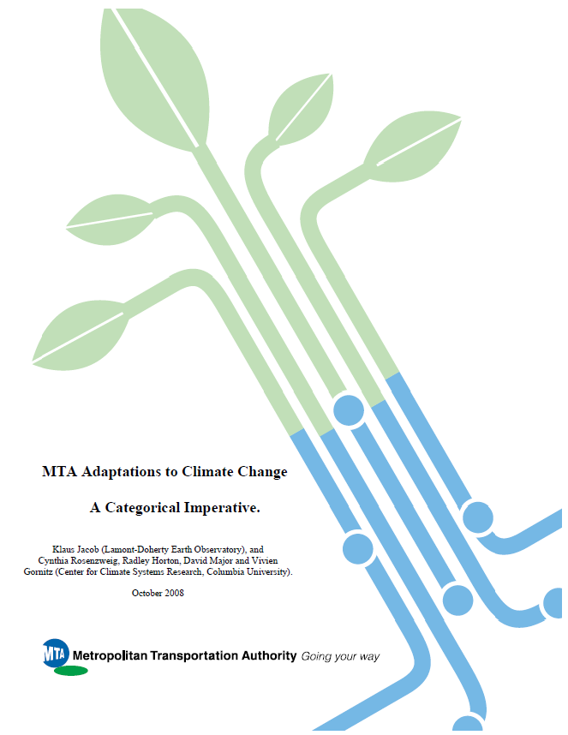
CCRUN Policy Interactions
CCRUN is providing New York City with
updated climate change scenarios for rebuilding
Mayor’s Special Initiative on Rebuilding
Hardest Hit Areas
Commission on Buildings; climate
information for new regulations
Metropolitan Transportation Authority; Chief Engineers
CCRUN extended ClimAID projections to 2100 for New York State Commissions convened by Governor Cuomo
Emergency Readiness, 2100 Infrastructure, Interactive Systems Response,
Coordination efforts underway to link Federal coastal mapping with local sea level rise information

Slide 21
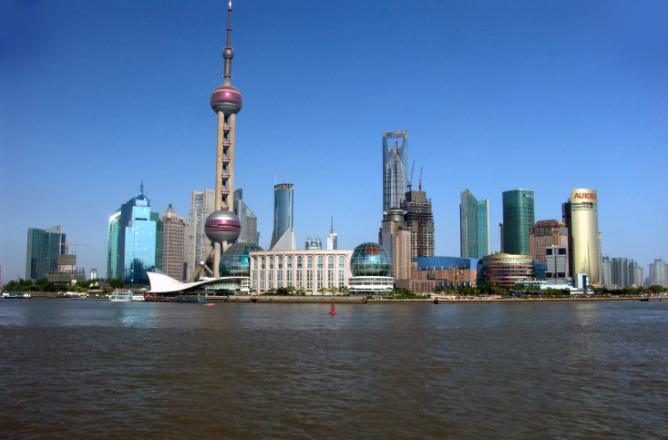
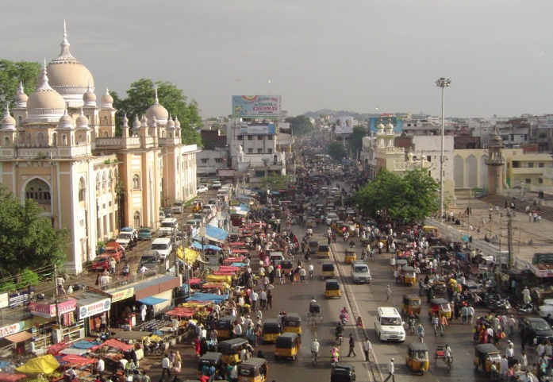
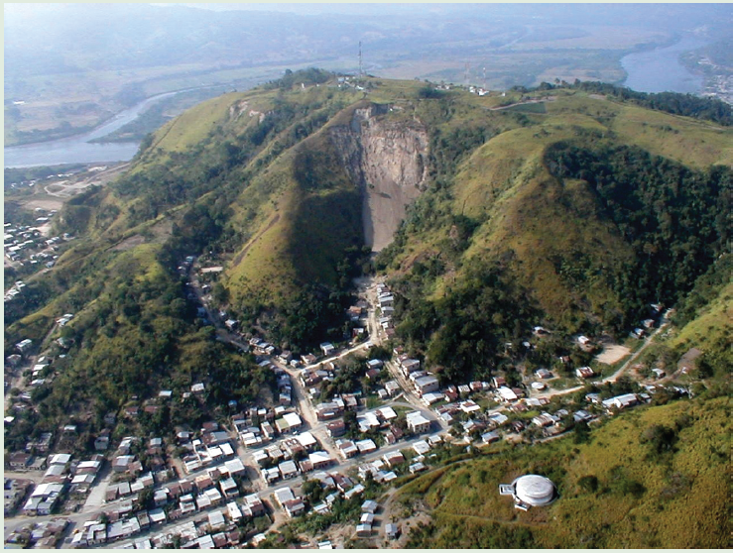
Cities and Climate Change Moving Forward – At Doha and Beyond
Shanghai, China
Hyderabad, India
Esmeraldas, Ecuador
Embed cities first responders role in climate change mitigation and adaptation into international agreements
Enhance science base
Link to emerging Sustainable Development Goals
Develop and implement common sets of standards for reporting – Greenhouse gas emissions and reductions (underway); Impacts of climate on cities; Adaptations
Develop innovative multi-jurisdiction financing measures for mitigation and adaptation
Engage citizens – Bottom-up approach
Especially those from the poorest and most vulnerable urban neighborhoods who are already suffering the most from climate change
Notes:
Shangahi - http://commons.wikimedia.org/wiki/File:PudongBW.jpg
Hyderabad - http://wikitravel.org/shared/Image:Hyderabad_from_Char_Minar.jpg
Esmeraldas – ARC3
Doha Conference is particularly important in terms of ensuring clarity on the second commitment period of Kyoto Protocol, institutionalization of new mechanisms on climate finance, adaptation technology transfer and advancing main elements of a new global climate regime that is expected to enter into force by 2020. In Doha, ICLEI will primarily focus on engagement of direct action potential of local governments in the global efforts on raising level of ambition, which is crucial to prevent further escalation of causes and impacts of global climate change while international negotiations continue.
21

Slide 22
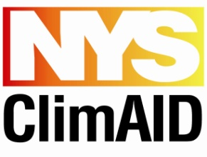
References and Links
Consortium for Climate Risk in the Urban Northeast (www.ccrun.org)
NYSERDA ClimAID (www.nyserda.ny.gov/climaid)
New York City Panel on Climate Change report available online at (www.nyas.org)
NPCC

