Slide 1



GOES-R ABI Sounding Algorithm Development:
“ABI+PHS” Approach and Processing of Cloudy Observations
Stanislav Kireev¹ and William L. Smith^{1,2}
¹Center for Atmospheric Sciences, Hampton University, VA
²University of Wisconsin - Madison, WI
8th NOAA-CREST Annual Symposium, New York, 5-6 June, 2013

Slide 2
HU participates in NOAA GOES-R preparation and risk reduction activities (GOES-R ABI Algorithm Working Group)
Two main focuses of the HU research:
Develop ABI+PHS approach to improve the accuracy of ABI retrievals;
Enhance retrieval algorithm with ability to process all-sky (clear and cloudy) observation conditions.

Slide 3
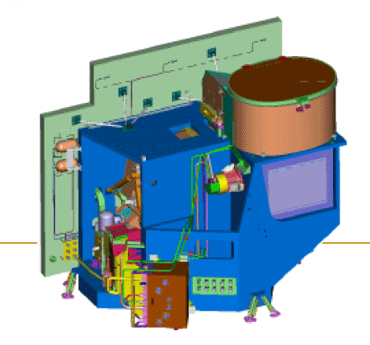
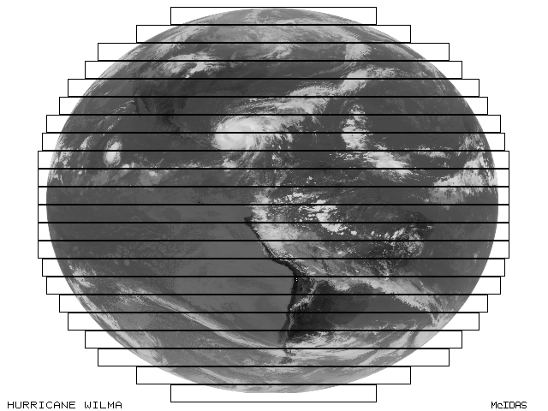
What is Advanced Baseline Imager (ABI):
The primary instrument on GOES-R satellite
Broad-band visible & IR spectrometer
Imaging Earth’s weather
High spatial and temporal resolution
Scheduled for flight in 2015
Retrieve products include:
      Air temperature
      Water vapor
      Ozone
      Surface properties
      Cloud properties
      …
Figure credit: ITT Industries
ABI Full Disk Scan

Slide 4
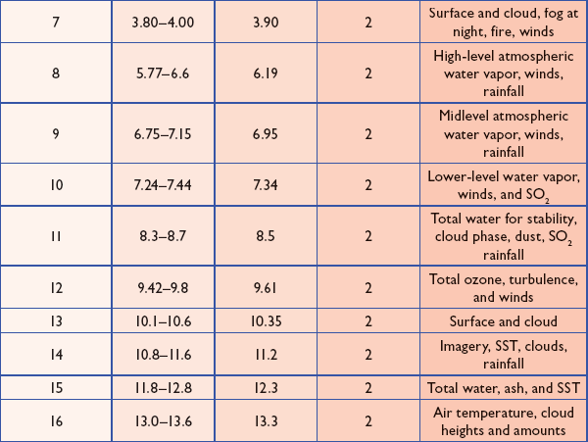
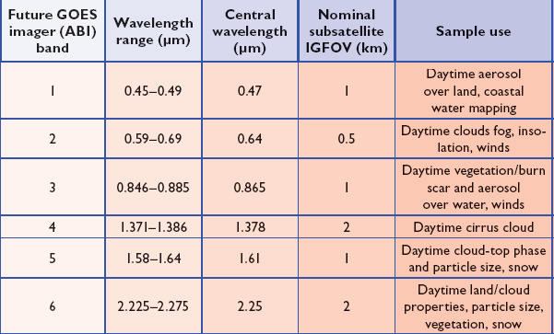
10 ABI IR Bands:
6 ABI Vis/Near-IR Bands:
Polar Hyperspectral Satellite (PHS)
1000s of spectral channels =>
  Higher actual retrieval SNR
  Higher vertical resolution
  Higher accuracy of retrieved products
But…
Lower spatial resolution (12-15 km footprint)
Lower temporal resolution (twice per day over the same area)

Slide 5
The primary goal of ABI+PHS approach is to combine high spatial and temporal resolution of ABI observations with high vertically resolved and accurate retrievals that can be obtained with hyperspectral instrument.
The combination of both instruments is especially important for observations of rapidly developing hazardous weather conditions (severe storms, hurricanes, flooding, tornadoes, etc.)
Latest approaches to incorporate PHS soundings into ABI retrievals:
Temporal difference:
X_{ABI+PHS}(t₁) = X_{PHS}(t₀) + X_{ABI}(t₁) - X_{ABI}(t₀)
Center retrieval around PHS state:
X_{ABI+PHS}(t₁) - X_{PHS}(t₀) = G [R_{ABI}(t₁) – R_{ABI/PHS}(t₀)]

Slide 6
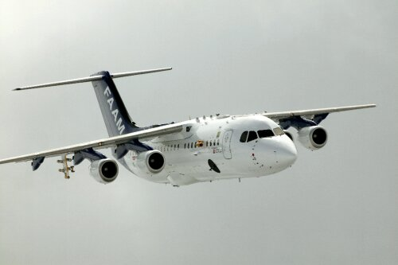
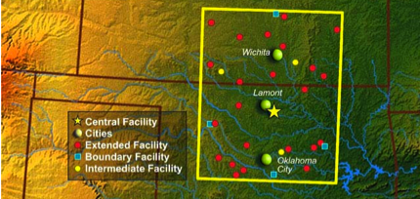
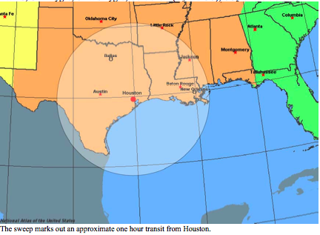
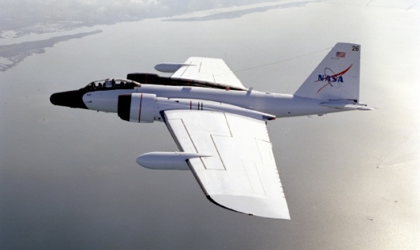
Joint Airborne IASI Validation Experiment (JAIVEx):
the perfect Cal/Val campaign to test ABI+PHS
BAe-146-301
WB-57
US-European collaboration focusing on the validation of radiance and geophysical products from MetOp-A
(1st advanced sounder in the Joint Polar Satellite System)
Location/dates
  Houston, TX, DOE ARM CART site, OK, Gulf of Mexico
  14 Apr–4 May, 2007
Aircrafts
  NASA WB-57 (NAST-I, NAST-M, S-HIS)
  UK BAe146-301 (ARIES, MARSS, Deimos, SWS; dropsondes)
Satellites
  MetOp-A (IASI, AMSU, MHS, AVHRR, HIRS, GOME, SBUV, ACAT)
  A-train (Aqua AIRS, AMSU, HSB, MODIS; Aura TES; CloudSat; and Calipso)

Slide 7
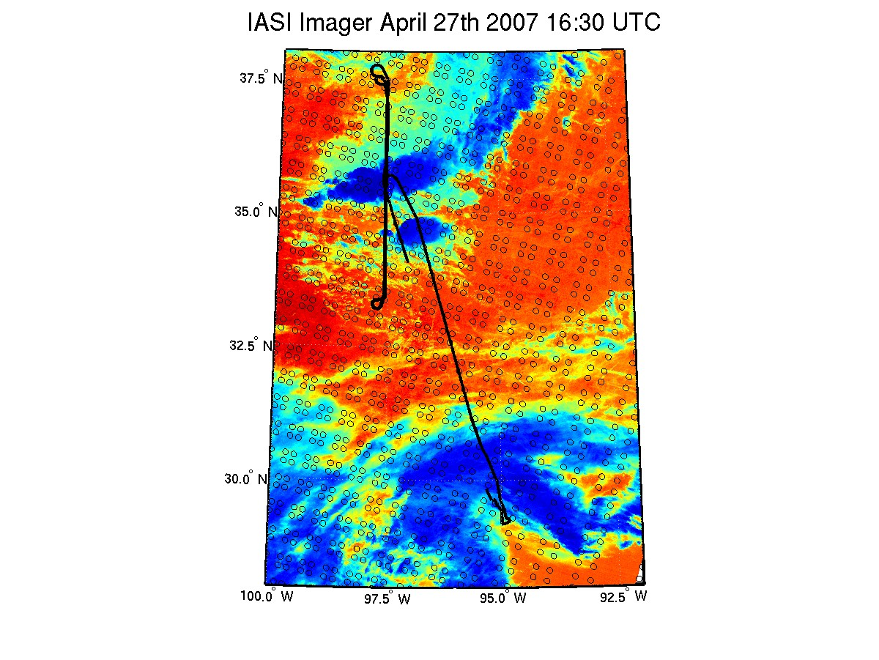
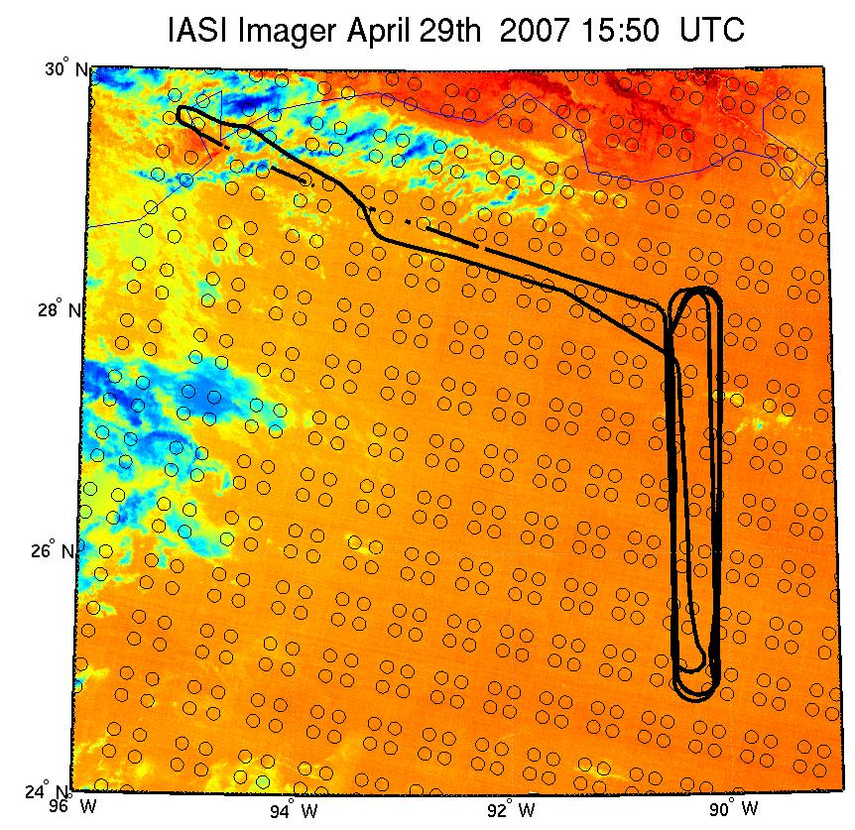
Two JAIVEx Cal/Val Flights Selected for Analysis:
JAIVEx case April 27th, 2007:
over CART site, nighttime
(cloudy)
JAIVEx case April 29th, 2007
Over Gulf of Mexico, daytime
(~clear)
CART site
Background: IASI IR-imager; circles – IASI IFOVs; black line – NASA WB-57/NAST-I track

Slide 8
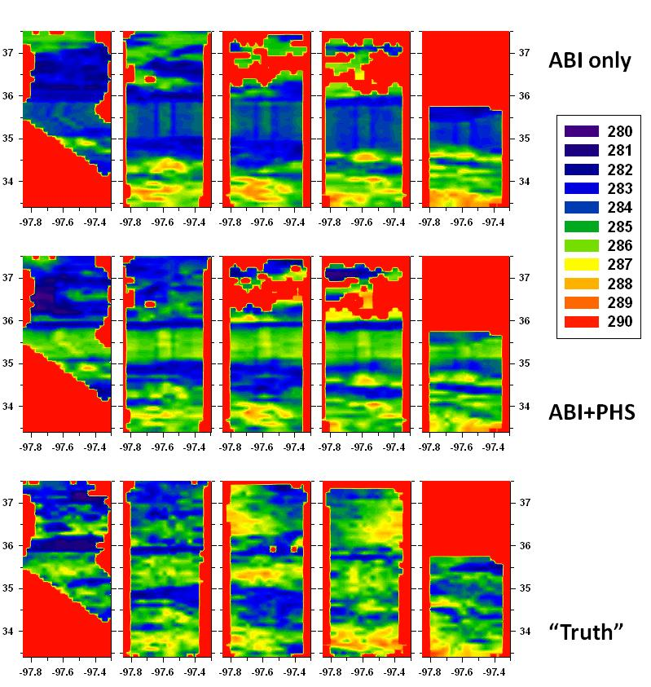
Horizontal cross-section of T_{AIR}(P=850 mb), JAIVEx case Apr 27, 2007.
Five panels in each row correspond to 5 laps of NAST-I flight.
Retrievals are done for three instrument configuration.
“ABI+PHS” retrieval is much closer to the “Truth” than “ABI only”.

Slide 9
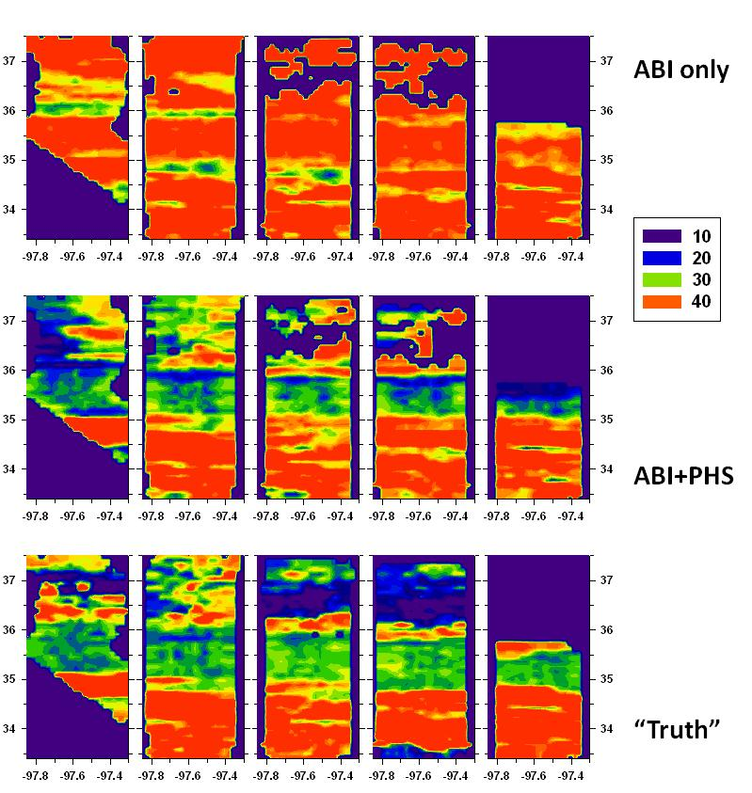
Horizontal cross-section of relative humidity, P=500 mb, JAIVEx case Apr 27, 2007.
Five panels in each row correspond to 5 laps of NAST-I flight.
Retrievals are done for three instrument configuration.

Slide 10
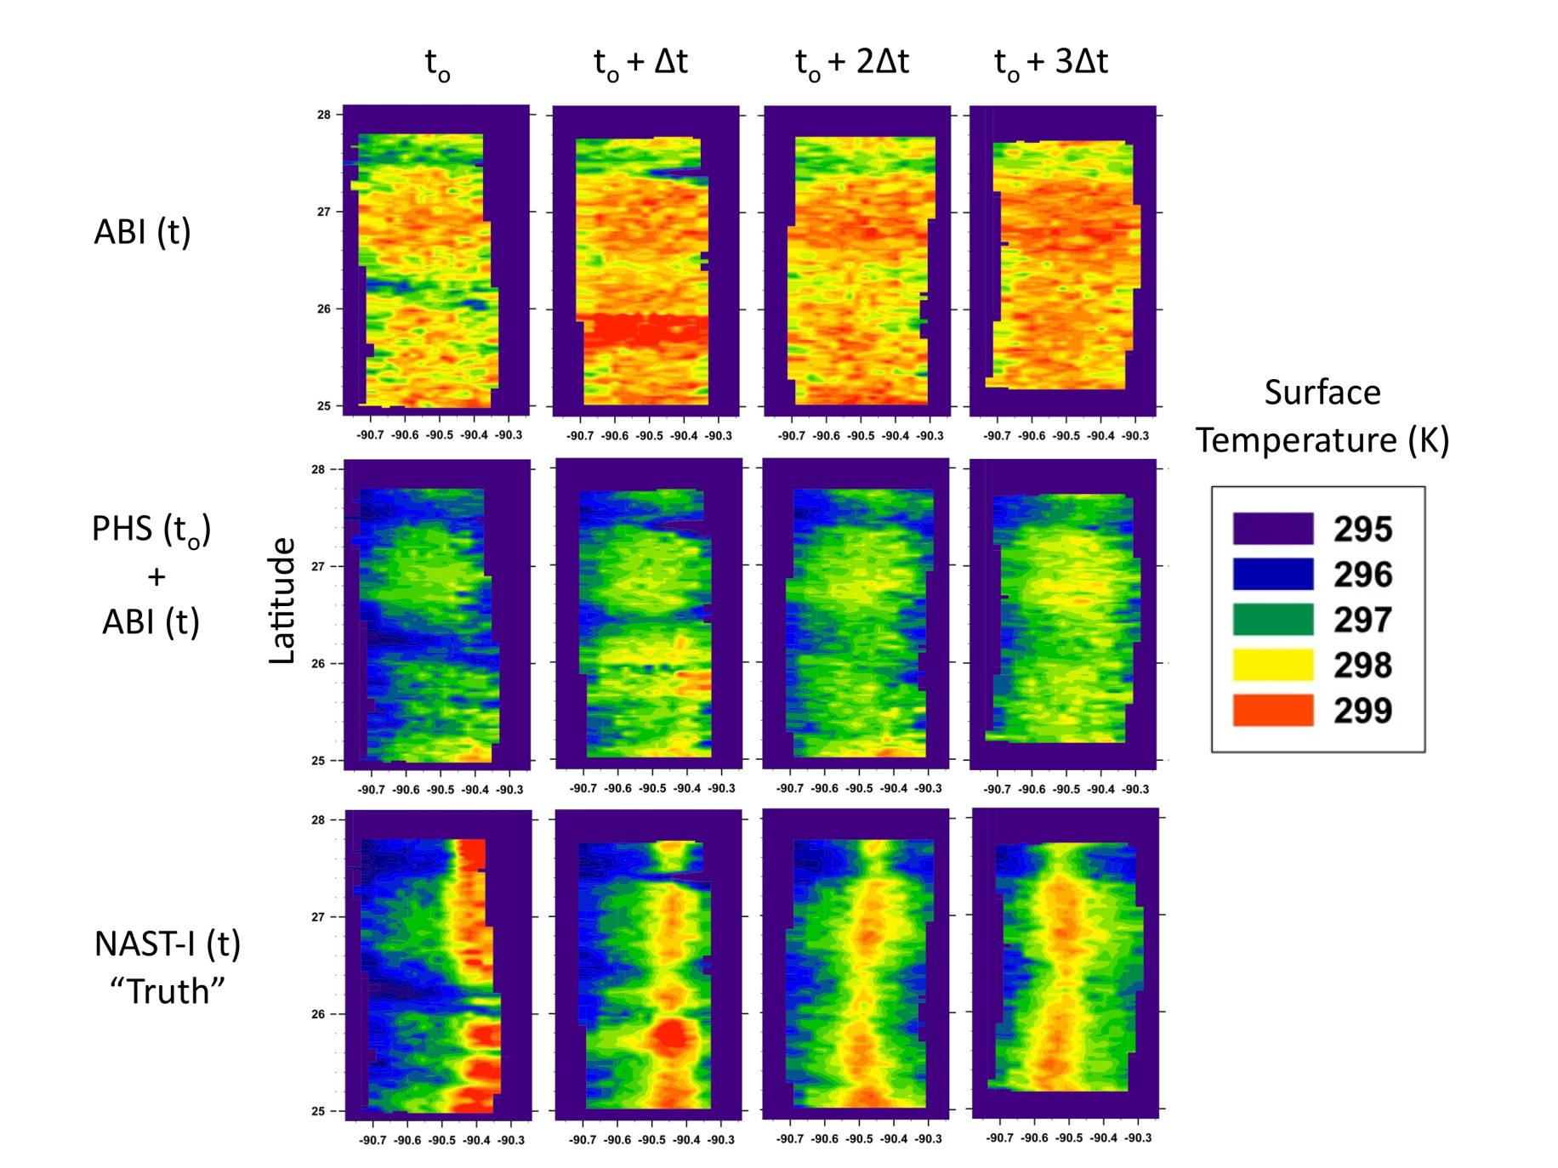
Horizontal cross-section for surface temperature, JAIVEx clear case Apr 29, 2007.

Slide 11
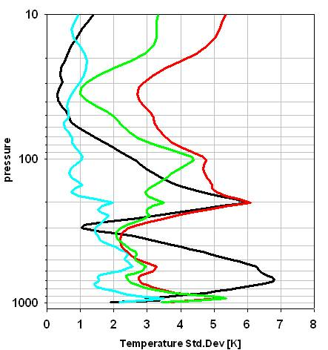
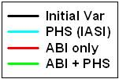
ALOSE-1 validation experiment
  DOE ARM CART site, OK
  Dec 11-14, 2012
IASI, CrIS, AIRS overpasses (4-5 hours time difference) are accompanied with ground-based observations (ASSIST, AERI, sondes).
ABI radiances are simulated from all three hyperspectral instruments. IASI is chosen as referenced moment t₀; then ABI/CrIS and ABI/AIRS are used as ABI observations at moments t₁ and t₂. After, ABI+PHS and ABI only retrievals are compared with retrievals from full resolution CrIS and AIRS.
ABI + PHS approach has a potential to improve the accuracy of ABI atmospheric soundings (but can not totally replace hyperspectral instruments!)

Slide 12
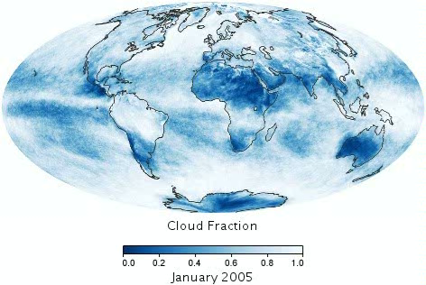
Part II: Clouds: why are they so important?
Monthly Averaged Global Cloud Fraction 2005 – 2013:
Movie credit: http://www.earthobservatory.nasa.gov

Slide 13
All-sky Dual Regression Retrieval Algorithm
(in collaboration with University of Wisconsin – Madison)
Ultimate Goal: to make retrieval algorithm for clear and cloudy sky conditions.
Main features:
Two training sets of atmospheric states and corresponding radiances: clear and cloudy
Cloudy sets are divided to 9 bins depending on P_{CLD} in 1000-100 mb pressure range;
Retrieved products:
    T(p), H₂O(p), O₃(p)
    Surface characteristics: T_{SFC}, ε_{SFC}(ν)
    Cloud parameters: P_{CLD}, H_{CLD}, T_{CLD}, ε∗(ν) = effective cloud emissivity
Latest development:
Four methods for cloud bin classification:
    Residual fit of observed radiance with radiance EOFs;
    T-split
    CO2 – slicing
    Fit to referenced atmosphere (GDAS, ECMWF)
Effective cloud emissivity (product of cloud emissivity and cloud fraction)
Comprehensive quality control

Slide 14
Dual Regression Algorithm Technique:
Step I: get “Clear” retrieval
Step II: get “Cloud” retrieval
Step III: compare with sonde

Slide 15
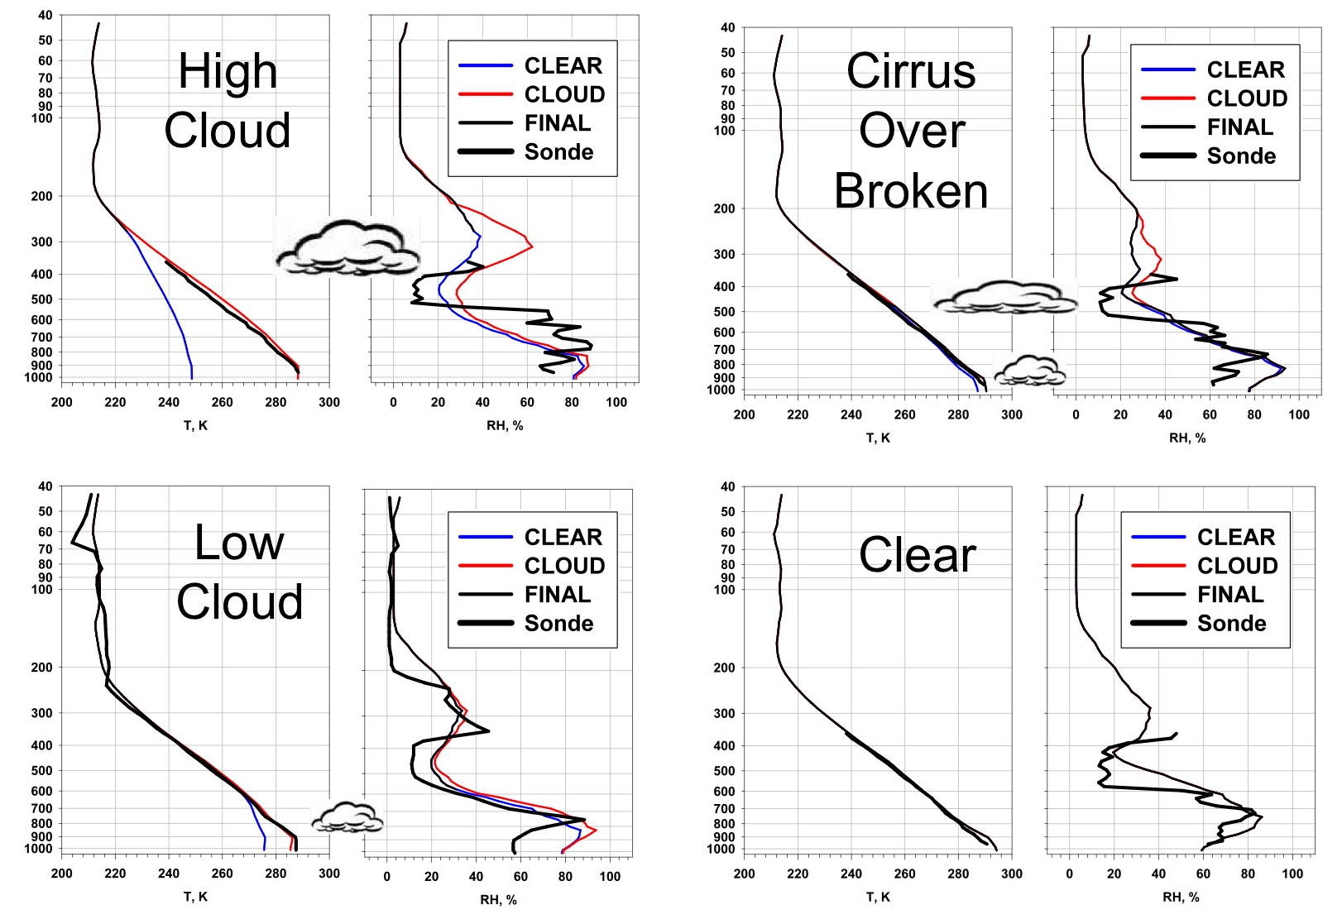
Comparison with Dropsondes, JAIVEx case Apr. 27

Slide 16
Retrieved Cloud Altitude, Apr. 27, 2007: Laps 1 to 5

Slide 17
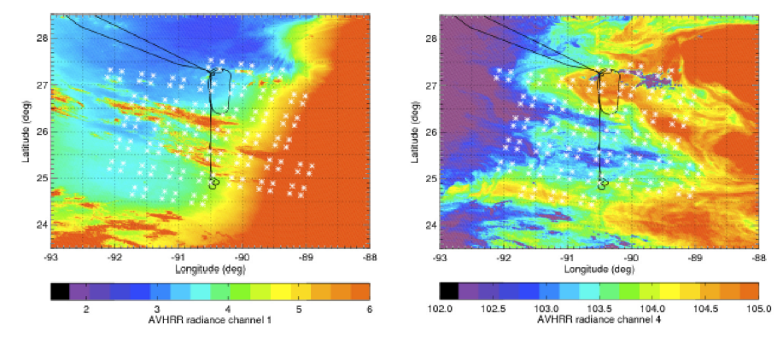
Retrieved Cloud Altitude, Apr. 29, 2007: Laps 1 to 7
MetOp AVHRR channel 1 (left, 0.58-0.68 μm) and channel 4 (right, 10.3-11.3 μm). Sunglint seriously contaminates the eastern part of the channel 1 image while SST variations and low level cloud influence the IR channel 4.

Slide 18
The effective cloud emissivity retrieval:
NOAA Cal/Val data set for the “Focus Day” Oct 19, 2007 is used:
  236 granules of IASI radiances, 22-23 scans in each (total ~650,000 IFOVs)
  Corresponding ECMWF atmospheric states (T(p), 6 gases, surface)
The eff. cloud emissivity ε*(ν) = Cld_Frc ∗ ε_{CLD}(ν) is obtained with CO₂ slicing method
Empirical model of the eff. cloud emissivity is created on this basis as a function of P_{CLD}
Retrieval of the ε*(ν) PC-scores is incorporated into DR algorithm

Slide 19
Effective cloud Emissivity ε∗ (ν): TRUE vs RETR (9 P_{CLD} classes)
P_{CLD} 1
P_{CLD} 2
P_{CLD} 3
P_{CLD} 4
P_{CLD} 5
P_{CLD} 6
P_{CLD} 7
P_{CLD} 8
P_{CLD} 9

Slide 20
Summary:
Fast and accurate regression algorithm to retrieve atmospheric thermodynamic state, cloud and surface characteristics for GOES-R ABI is under development and intensive validation
The algorithm can process both, clear and cloudy, observation conditions and shows consistent retrievals of cloud parameters: cloud top altitude, pressure, and cloud fraction
GOES-R ABI has a potential for mesoscale atmospheric soundings in combination with JPSS observations, although can not fully replace having hyperspectral sounder on a geostationary satellite.

