Slide 1
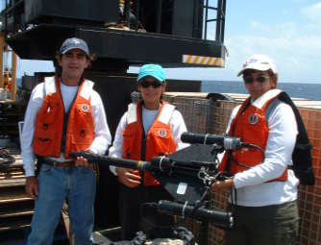
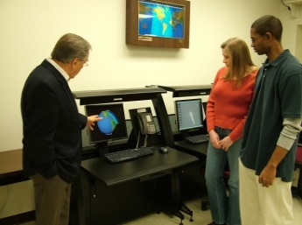
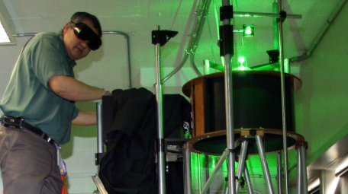
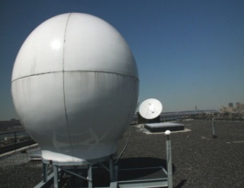
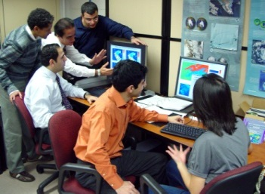
CREST Sciences address Extreme Weather and Climate issues
Reza Khanbilvardi
NOAA-CREST
8th Annual NOAA-CREST Symposium
June 5-6, 2013
Notes:
Custom animation effects: text rebound
(Intermediate)
To reproduce the text effects on this slide, do the following:
On the Home tab, in the Slides group, click Layout, and then click Blank.
On the Insert tab, in the Text group, click Text Box. Drag to draw a text box on the slide.
In the text box, enter text and select it. On the Home tab, in the Font group, do the following:
In the Font list, select Corbel.
In the Font Size box, enter 50.
Click Bold.
On the Home tab, in the Paragraph group, click Center.
Select the text box on the slide. Under Drawing Tools, on the Format tab, in the WordArt Styles group, click More WordArt, and then under Applies to All Text in Shape click Fill - Accent 1, Plastic Bevel, Reflection (first row, fifth option from the left).
To reproduce the animation effects on this slide, do the following:
On the View tab, in the Zoom group, click Zoom, and then in the Zoom dialog box, select 66%.
On the Animations tab, in the Animations group, click Custom Animation.
On the slide, select the text box. In the Custom Animation task pane, do the following:
Click Add Effect, point to Entrance, and then click More Effects. In the Add Entrance Effects dialog box, under Subtle, click Fade.
Select the animation effect (fade effect for the text box). Under Modify: Fade, do the following:
In the Start list, select With Previous.
In the Speed list, select Fast.
Click Add Effect, point to Motion Path, point to Draw Custom Path, and then click Freeform.
Press and hold SHIFT, and then do the following to draw the freeform line on the slide:
Click the first point in the center of the text box.
Click the second point on the right edge of the text box.
Double-click the third and final point 2” beyond the left edge of the slide.
In the Custom Animation task pane, select the custom path effect. Under Modify: Custom Path, do the following:
In the Start list, select With Previous.
In the Speed list, select Medium.
On the slide, right-click the motion path on the slide, and select Reverse Path Direction.
To reproduce the background effects on this slide, do the following:
Right-click the slide background area, and then click Format Background. In the Format Background dialog box, click Fill in the left pane, select Gradient fill in the Fill pane, and then do the following:
In the Type list, select Radial.
Click the button next to Direction, and then click From Center (first row, second option from the left).
Under Gradient stops, click Add or Remove until two stops appear in the drop-down list.
Also under Gradient stops, customize the gradient stops that you added as follows:
Select Stop 1 from the list, and then do the following:
In the Stop position box, enter 0%.
Click the button next to Color, and then under Theme Colors click White, Background 1 (first row, first option from the left).
Select Stop 2 from the list, and then do the following:
In the Stop position box, enter 100%.
Click the button next to Color, click More Colors, and then in the Colors dialog box, on the Custom tab, enter values for Red: 200, Green: 209, and Blue: 218.

Slide 2
CREST (Established in 2001) Goals & Objectives
Build institutional capacity and conduct cutting edge research in Remote Sensing science and technology in line with NOAA’s Mission Goals, and in support of NOAA line offices.
Recruit, mentor, and train graduate students in science, engineering, and technology areas of relevance to NOAA, to provide a diverse future workforce for NOAA, NOAA contractors and other related federal, state, and industrial stakeholders.
Develop a pipeline of students from high school through college level to in crease the number of students pursuing graduate studies in NOAA related science, engineering, and technology areas by introducing education and outreach programs at CREST institutions and communities that they serve.

Slide 3
Role of CSC (NOAA-CREST in NOAA Sciences
(including Extreme Weather Events)
Create the right “nexus” between federal agencies, researchers, scientists and the society through:
  Development and improvement of (existing) algorithms for better environmental assessment, predictions, and stewardship
  Development operational research (mostly for weather and climate) products to help support NOAA’s informed decision-making – to save lives and US economy
  Engage the next generation scientists in training and creating STEM talent pool and workforce development in NOAA sciences

Slide 5

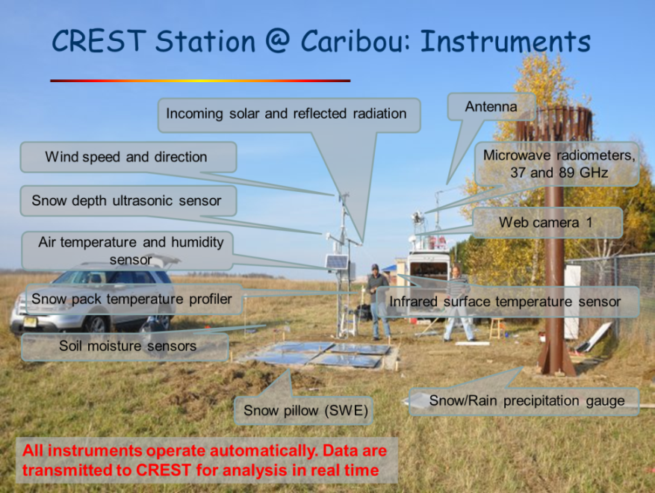
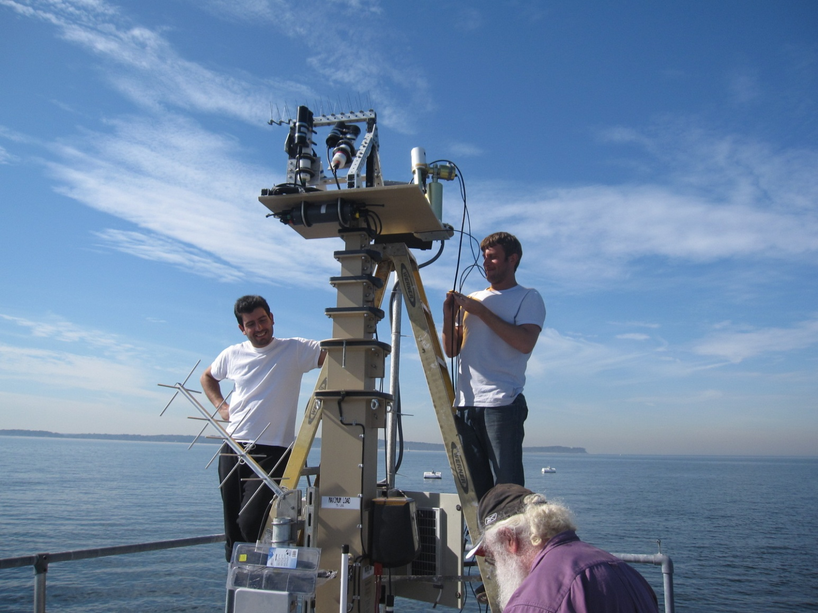
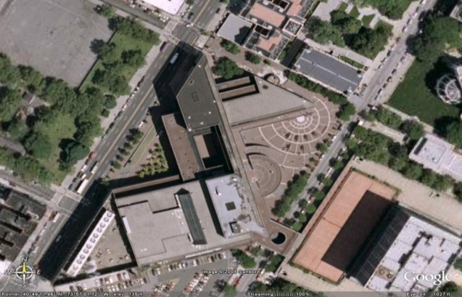
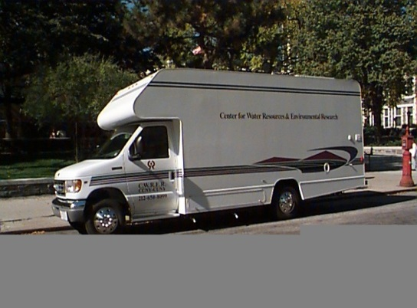
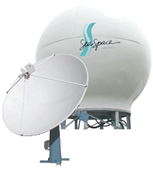

NOAA-CREST Institutional Members
CUNY
  City College
  CUNY Lehman College
  Bronx Community College
        NY City Tech College, CUNY
        Hunter College, CUNY
        Hostos Community College
        LaGuardia Community College
Columbia University
University of Maryland - Baltimore County
Hampton University-Virginia
University of Puerto Rico, Mayaguez
California State University, Los Angeles, CA
UPR, Rio Piedras
Raytheon
Northrop Grumman

Slide 6
CREST
Lead
by
The City
University
Of
New York
University of California, Irvine
University of Wisconsin, MI
(CIMSS- NESDIS/CI)
Strategic
Alliances
Colorado State University, Fort Collins
(CIRA – NESDIS/CI)
University of Maryland, College Park
(CICS- NESDIS/CI)

Slide 7
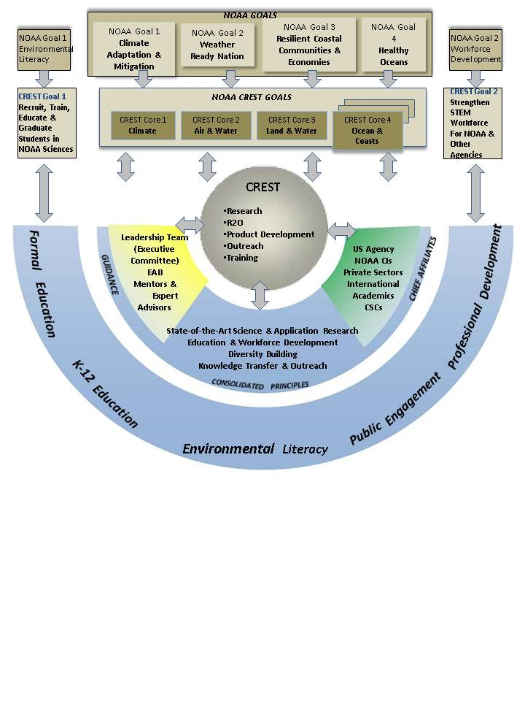

Slide 8
Integrated Data Products
ISCCP – 2012
Radiative Flux Profiles (2014)
Cal/Val
ISCCP Radiance Calibrations confirmed to 3% absolute (VIS) and 2% absolute (IR)
R2O
ISCCP Cloud Product Processing will go operational 2012
Land Inundation (2012)
Snow Cover (2012)
Cyclone Attributes and Dynamics (2013)
Tropical Deep Convection (2013)
Upper Tropospheric Water Vapor (2013)
CRIOS - 2012
ISCCP Cloud Properties confirmed to better than originally estimated uncertainty
Microwave Snow Site – CREST SAFE
Soil Moisture Advanced Radiometric Testbed and In-Site Network
CREST LIDAR NETWORK (CLN) Assessment of Passive and Active Satellite Aerosol Products
ISCCP Radiative Flux Profile Processing will go operational in summer 2014.
Effective cloud emissivity (product of cloud fraction and the cloud emissivity) using CrIS/ATMS and NGAS-CrIMSS radiances
A climatology of PSCs in the Arctic and Antarctic polar winter stratospheres (2013)
MODIS AOD Urban Fusion Product (2014)
Assist OMPS LP retrieval algorithms for ozone, aerosol, and NO2 profiles (2014)
In situ datasets for validation of ocean color satellites including JPSS-VIIRS (2012)
Algal bloom data for West Florida Shelf (2013).
Long Island Sound Coastal Observatory (LISCO) with reflectance and atmospheric data products, matchups of multi and hyperspectral in-situ and Ocean Color satellite data
BRDF model for coastal waters (2014)

Slide 9
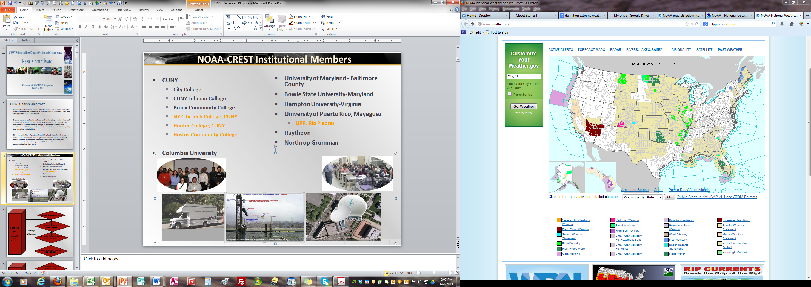
Source: weather.gov – NOAA/NWS

Slide 10
CREST Microwave Observation Unit
Coastal Measurement Platform
CREST Earth Observation Unit
Facilities at CREST
CREST LIDAR Network (CLN)

Slide 11
CREST Unique Research INFRASTRUCTURE
The CREST Lidar Network (CLN) composed of an east-coast line of lidar sites augmented by other surface radiometers and in-situ measurements and satellite observations and combined with the existing environmental observing system;
A high density urban (New York City Metropolitan area) Meteorological Network (NYCMetNet) integrated with high-resolution atmospheric modeling;
A unique multi- and hyper-spectral and polarization observation and satellite validation platform in Long Island Sound Coastal Observations (LISCO) Systems;
State-of-the-art mobile Microwave Observation Units (MOU) for snow properties and soil moisture measurements to calibrate and validate satellite retrievals; and
Advanced air quality measurement network in New York Metropolitan area
Direct Satellite Read-out station for both POLAR and GEO-STATIONARY Satellites

Slide 12
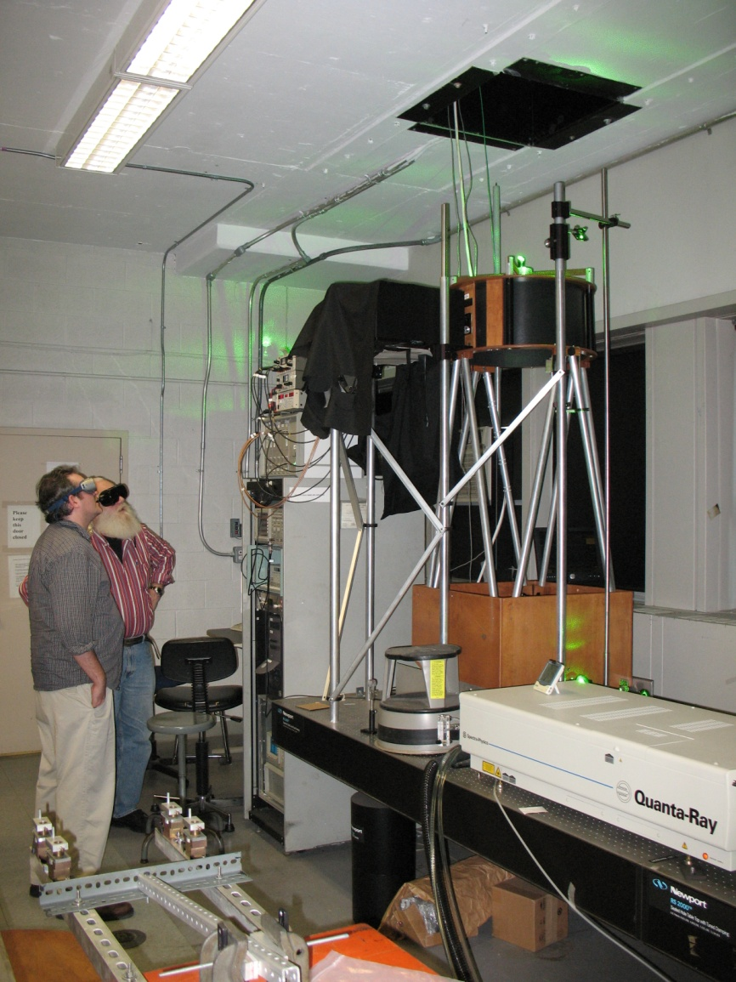
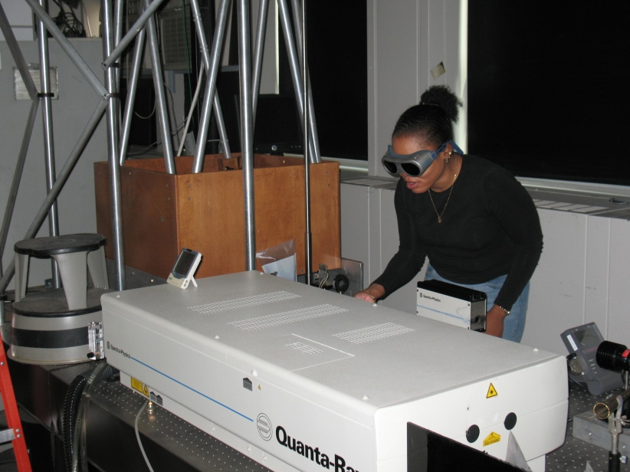
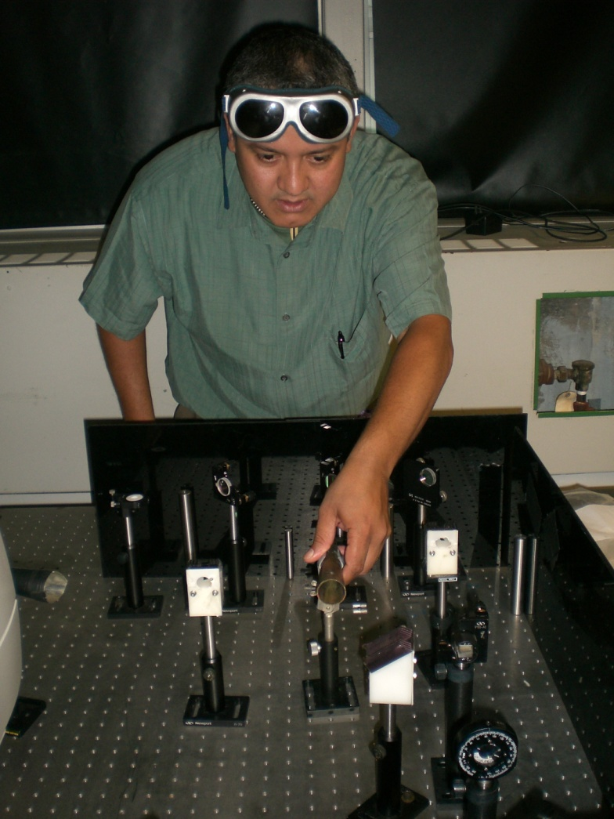
LIDAR @ The City College of New York

Slide 13
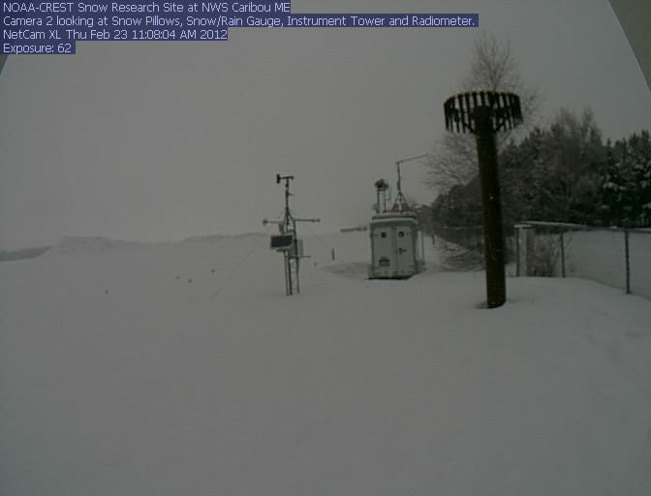
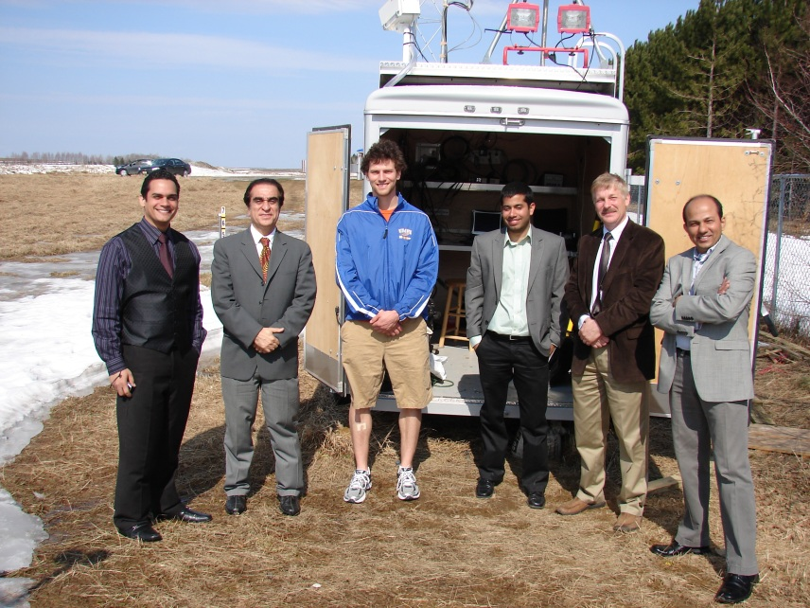
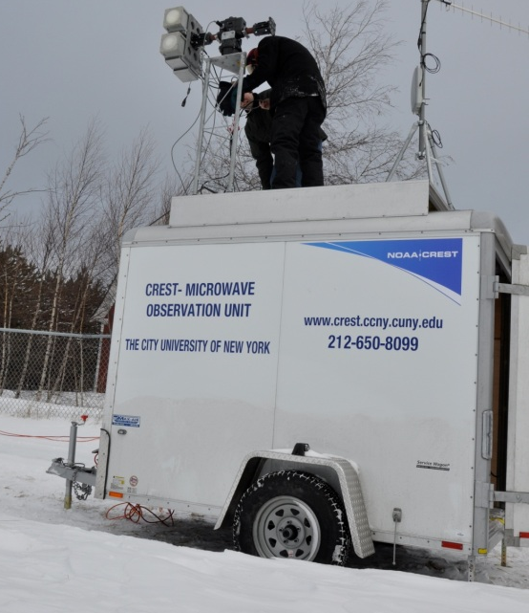
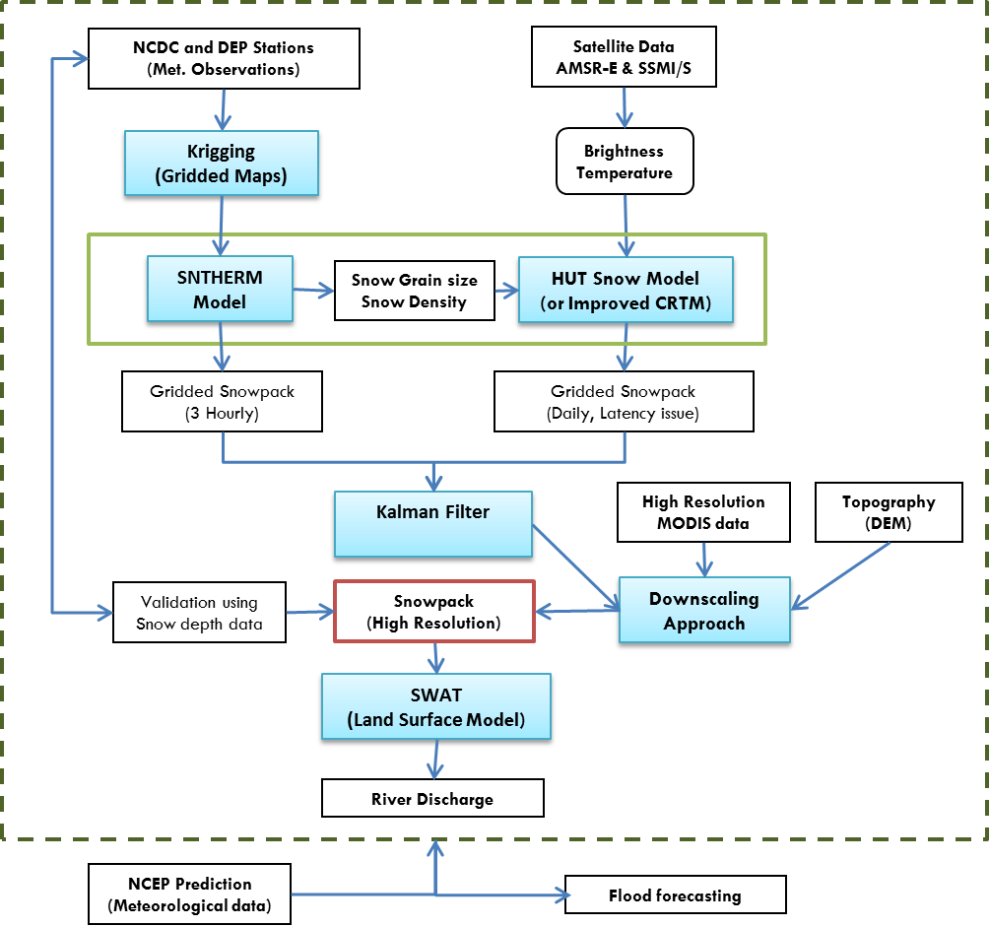
CREST-SAFE - Snow Analysis and Field Experiment
The motivation of this project is to develop real time and forecasted gridded snowpack data by objectively merging in-situ stationed with satellite based VIS/NIR and microwave observation.
The CREST-Snow Analysis and Field Experiment (CREST-SAFE) is setup in the backyard of the National Weather Service office at Caribou, ME using high frequency (37 and 89 GHz), dual polarized microwave radiometers to develop, improve and validate the NOAA’s Snow Retrieval Algorithms.
The field experiment site equipped with Snow Pillows, ultrasonic snow depth sensor, Infrared Thermometer, Radiation Sensors, Humidity, Temperature, snow temperature profiler, snow grain size, density, and network camera for real time remote monitoring of the site.
Real time Web-cam monitoring of site (23 Feb 2012)
http://crest.ccny.cuny.edu/snowcam2

Slide 14
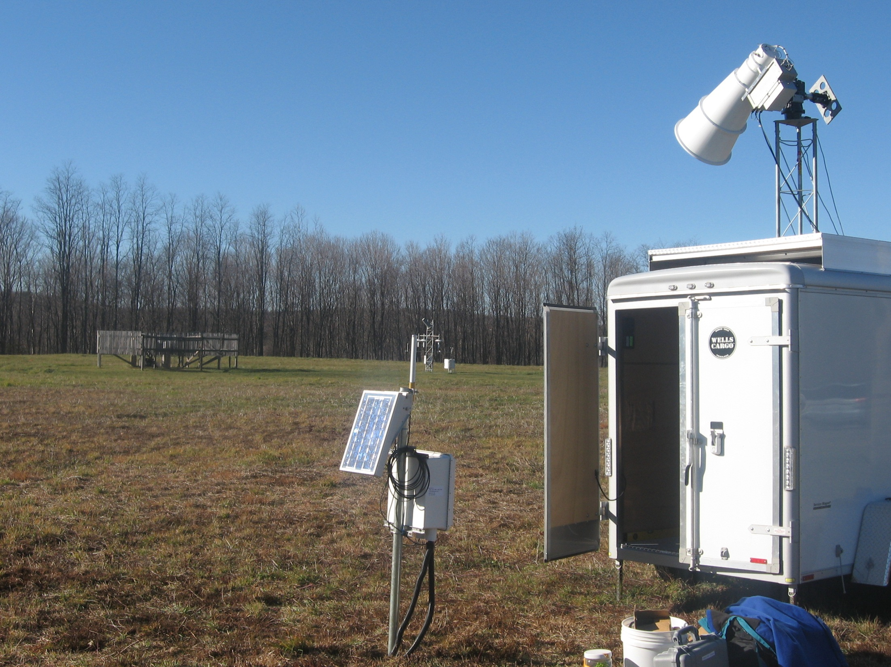
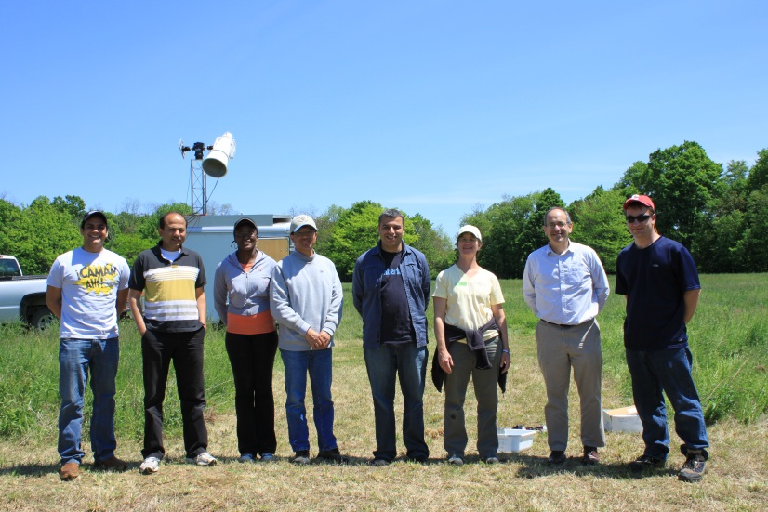
CREST-SMART
Soil Moisture Advanced Radiometric Testbed
The established network was selected by NASA for the Cal/Val of the SMAP mission
A GROUND BASED L BAND RADIOMETER FOR THE MONITRING OF SOIL MOISTURE IN THE REGION OF MILLBROOK NY.
CREST-SMART
Soil Moisture Advanced Radiometric Testbed
Joint Field Experiment in May 2012

Slide 15
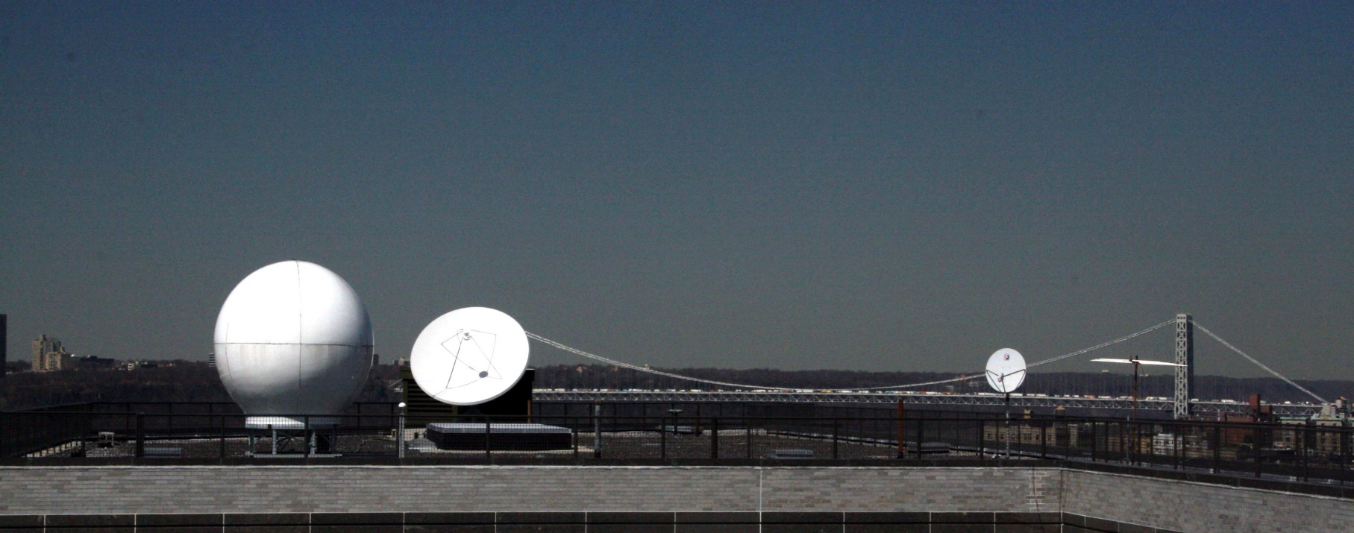
Satellite Earth Observation System
The Satellite Receiving Station is a key component of CREST research . SRS is primarily responsible to acquiring, storing and algorithm processing of all satellite related products.
The Receiving Station currently has 2 antenna and a vast array of data collecting equipment and algorithms for polar and geostationary satellite as well as ground-based field measurement and LIDAR networks.

Slide 16
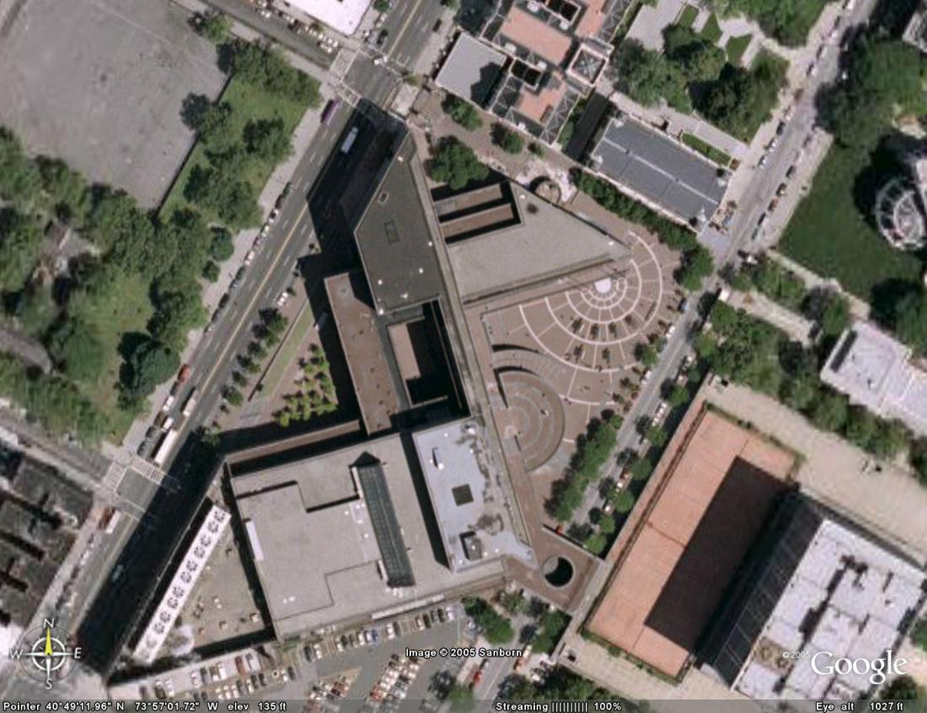
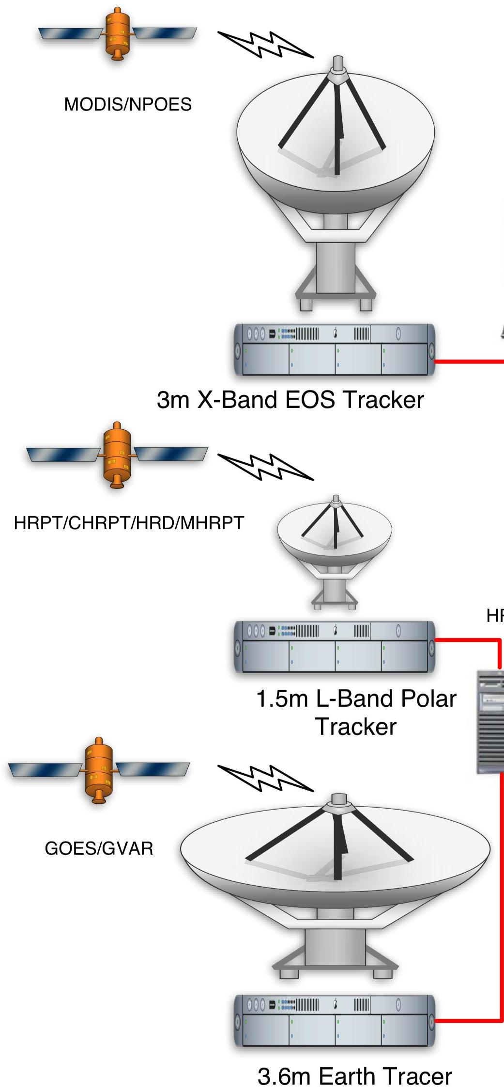
New Satellite Data Acquisition Unit
Amsterdam Ave.
Second stage:
Convent Ave.
NAC building roof

Slide 17
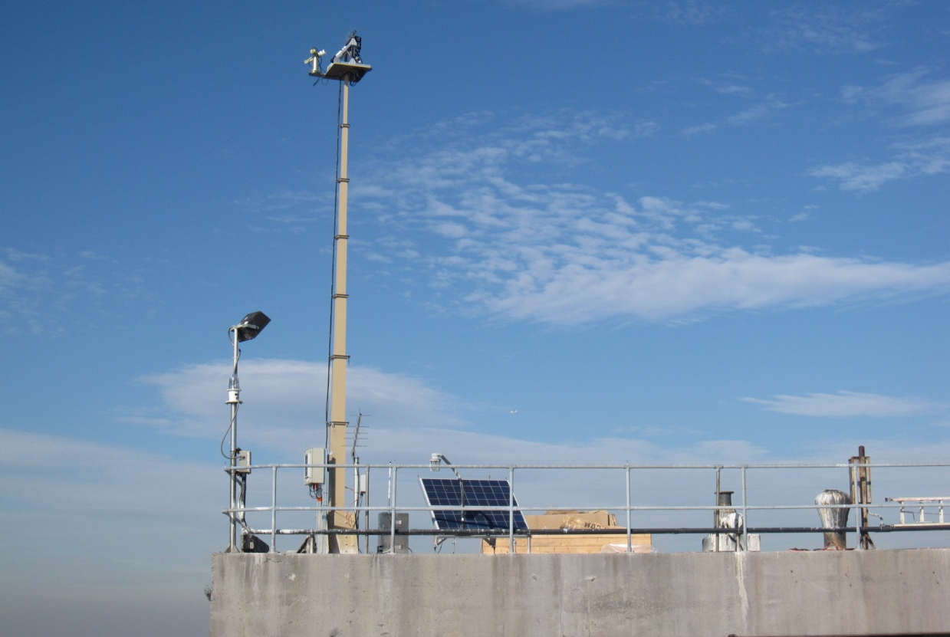
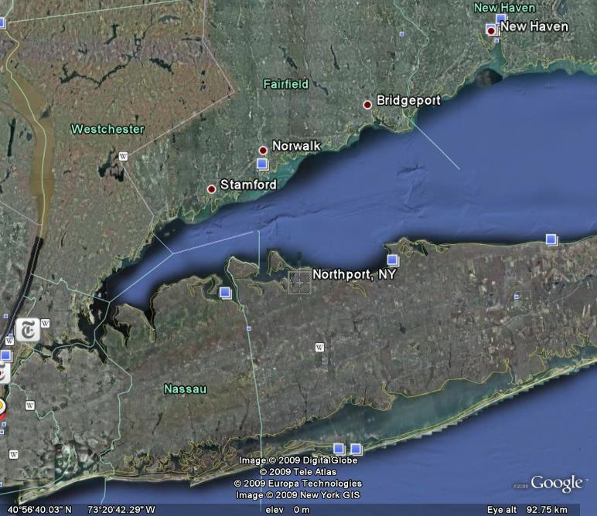
Long Island Sound Coastal Observatory (LISCO
Platform: Unique collocated multispectral SeaPRISM AND hyperspectral HyperSAS radiometer instrumentations
Play important role in satellite ocean color validation and coastal water quality retrievals
LISCO Tower
Instrument Panel
Retractable Instrument
Tower
12 meters
17
Notes:
17
17

Slide 18
Coastal and Ocean Studies: Resilient Ecosystems and Healthy Oceans
Research & Product: Developed Long Island Sound Coastal Observatory (LISCO) for the validation of the Ocean Color satellites. It is a part of NASA AERONET –Ocean Color Network and data are heavily used in post – launch validation of the JPSS-VIIRS sensor. In addition to the standard AERONET instrument LISCO has a hyperspectral instrument which significantly improves observational and validation capabilities.
End users: NOAA-NASA-Navy JPSS-VIIRS validation/calibration team, International Ocean Color community (LISCO data are in the European database as well for the validation of MERIS and other international sensors, etc.).
Enterprise Objective: Accurate and reliable data from sustained and integrated earth observing systems.
Research: New technique for harmful algal blooms detection.
End users: West Florida Shelf coastal communities.
Instrument Panel
Retractable Instrument
Tower
12 meters

Slide 19
CREST science contributes/relates to Extreme Weather events.
Climate and ISCCP related Global Cloud and Surface properties
Help in determination of the atmospheric and surface processes affecting climate sensitivity and water resources.
This research ISCCP 30 is in the phase of research to operations with NOAA/NCDC
Helps address extreme weather events such as
Tornado: clouds, strong wind, rain, hail

Slide 20
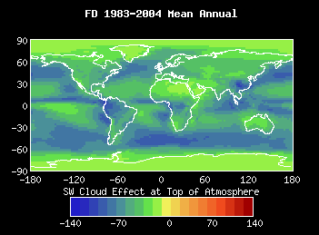
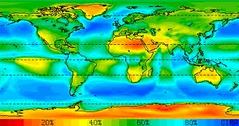
Global Climate Studies: Climate Mitigation and Adaptation
Research and Product: CREST team led by William Rossow, DP of CREST, through national (NOAA-NASA collaborations) and international (WMO, CEOS, GCOS collaborations) developed Climate Data Records and how to move Research Analysis to Operational Analysis
End Users:
National and International Scientific community -- the benefit is that this will allow a determination of the atmospheric and surface processes affecting climate sensitivity and water resources.

Slide 21
CREST science contributes/relates to Extreme Weather events.
CREST’s unique high resolution NWP model
tailored for complex urban environments (uWRF) – validated for the extreme heat wave conditions
Future research will include tropical storms intensity and trajectory in and around NYC.
Key to the success of this effort is the urban observatory operated by CREST (NY MetNet). This work is a close collaboration of NOAA-NWS, and NCAR.
Helps address extreme weather events such as
Urban Heat Islands/Waves , Tropical storm predictions

Slide 22
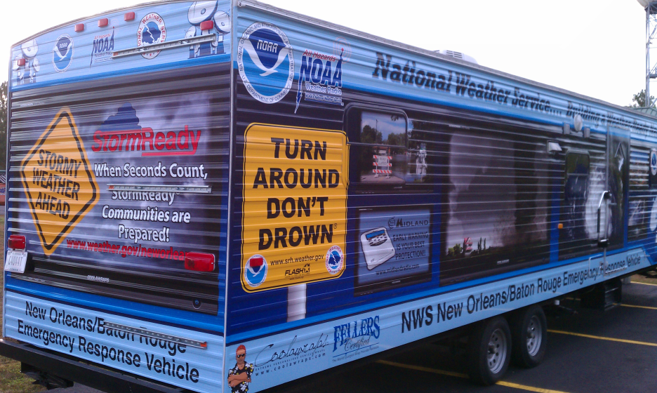

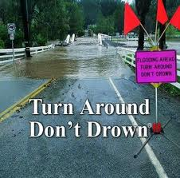
Urban-Coastal Studies: Weather Ready Nation
CREST is leading the development of a unique very high resolution NWP model tailored for complex urban environments (uWRF). This NWP model has been validated for heat wave events in NYC with great success. Future works will include tropical storms intensity and trajectory in and around NYC. Key to the success of this effort is the urban observatory operated by CREST (NY MetNet). This work is a close collaboration of CREST, NOAA-NWS, and NCAR.

Slide 23
CREST science contributes/relates to Extreme Weather events.
CREST’s Snow Analysis and Field Experiment (SAFE)
a unique snow radiometer site in Caribou, Maine
To validate snow retrievals algorithms and develop real time and forecasted gridded snowpack data
Helps address extreme weather events such as
Blizzard: heavy snow, ice, cold temperatures

Slide 24
CREST-SMART - Soil Moisture Advanced Radiometric Testbed
The established network was selected by NASA for the Cal/Val of the SMAP mission
A soil moisture observation network approved by NASA as a core validation site for the SMAP mission is deployed in the region of Millbrook, NY. It includes an L band dual polarization radiometer that is part of the CREST Microwave Observation Unit.
Joint Field Experiment in May 2012

Slide 25
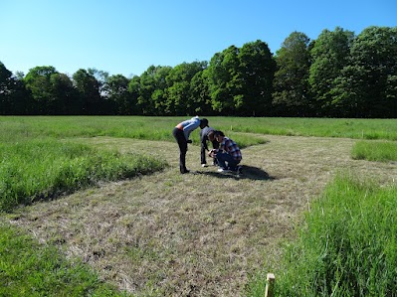
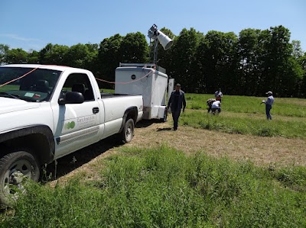
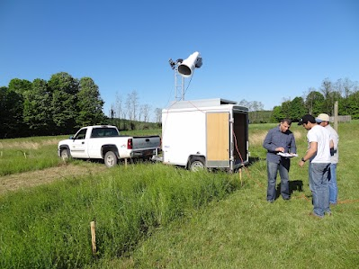

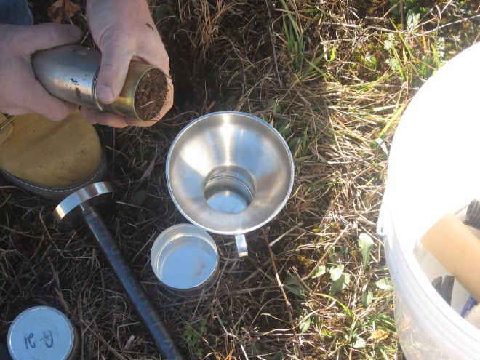
NOAA-USDA-CUNY joint field campaign in 2012
Notes:
25

Slide 26
CREST science contributes/relates to Extreme Weather events.
CREST NYCMetNet
a portal for Regional Urban Micro Climate, Weather and Atmospheric Boundary Layer information
The network provides real time and archived vertically profiled wind, turbulence, mixing layer heights, aerosol profiles, temperature, humidity and liquid water content
Helps address extreme weather events such as
Air Quality and impact on micro climate

Slide 27
CREST science contributes/relates to Extreme Weather events.
CREST CRIOS – CREST River Ice Observation System
A satellite based ice detection and mapping system is a satellite based web tool for monitoring ice conditions in major rivers in NE region of US
CRIOS helps give early warning systems related to floods (reservoirs, rivers/lakes due to ice melting
Helps address extreme weather events such as
Flood: heavy rainfall

Slide 28
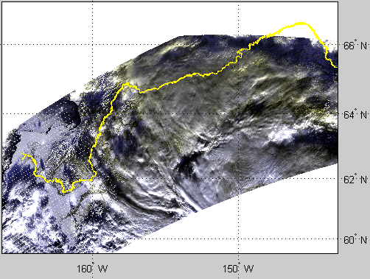
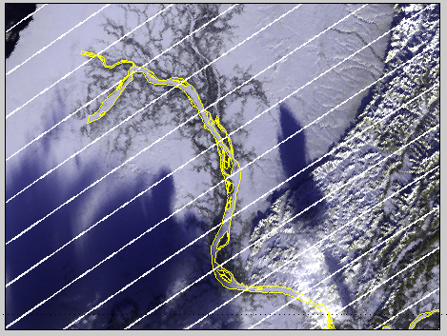
River and Lake Ice mapping using NPP/JPSS VIIRS sensor To support NOAA NWS
Naira Chaouch, Marouane Temimi, Reza Khanbilvardi;
NOAA Collaborators: Mitch Goldberg, Reggina Cabrera,
Yukon River
RGB, 01/03/2013
Naira Chaouch, Marouane Temimi, Peter Romanov, Regina Cabrera, George Mckillop, Reza Khanbilvardi. An Automated Algorithm for the Monitoring of River Ice over the Susquehanna River Basin using MODIS data. Hydrological Processes. (In press, 2012).
Notes:
Funded by NWS; for the development of an operational tool for the mapping of ice in major river using MODIS; work is in progress to include additional river like the Hudson River.
Also; We just got our proposal funded to add VIIRS images and expand the study to ice in lakes as well.

Slide 29
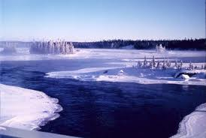
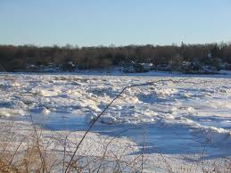
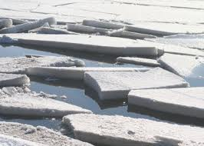
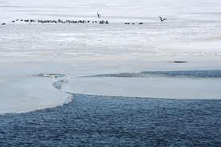
River Ice: Weather Ready Nation
Research: The project introduces an operational new satellite based river ice product to display ice conditions in major rivers in the northern watersheds. Ice maps are updated on a daily basis and the product makes use of images from MODIS acquired in near real time by the CREST satellite receiving station.
Product: Developed ice maps are made available online through a data portal superimposing the Google Earth
End-users: like NOAA NWS River Forecast Centers and Weather Forecast Offices as well as reservoir managers in hydropower plants along the rivers.

Slide 30
CREST science contributes/relates to Extreme Weather events.
CREST Nowcasting
The CREST Thunderstorm Nowcasting project identified and tracks thunderstorms using geostationary satellite data from the CUNY-CREST Satellite Receiving Station.
It uses the Rapidly Developing Thunderstorm (RDT) algorithm developed at Meteo-France and modified to use NOAA’s GOES satellite
Helps address extreme weather events such as
Thunderstorms: nowcasting of tropical storms/heavy rainfall

Slide 31
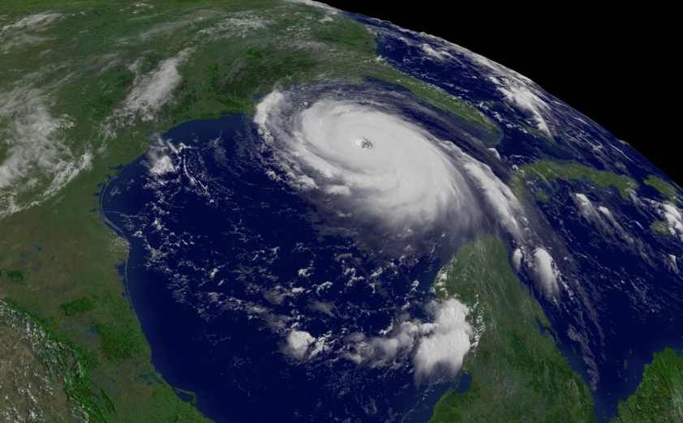

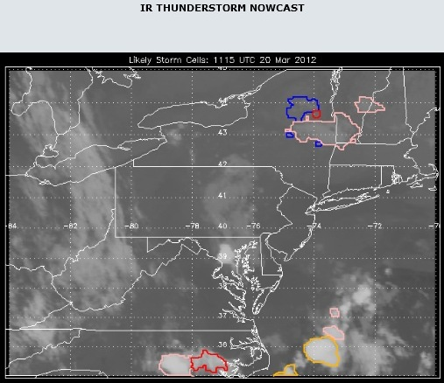
Thunderstorm Nowcasting: Weather Ready Nation
Research Product: The CREST Thunderstorm Nowcasting project identified and tracks thunderstorms using geostationary satellite data from the CUNY-CREST Satellite Receiving Station. We use the Rapidly Developing Thunderstorm (RDT) algorithm developed at Meteo-France and modified to use NOAA’s GOES satellite. It detects towers in the brightness temperature field, tracks them and gathers statistics to determine if the tower might be a convective system. An upgrade that uses water vapor channels and numerical weather data has been installed and is in the process of being tuned against lightning data before being made operational.
End Users: Aviation over ocean or mountains where radar coverage is not available.

Slide 32
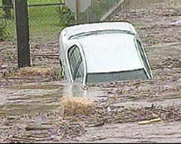
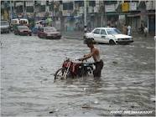
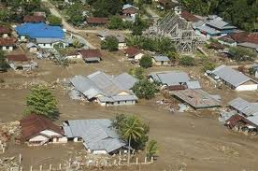
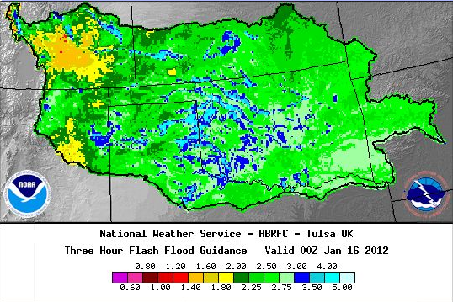
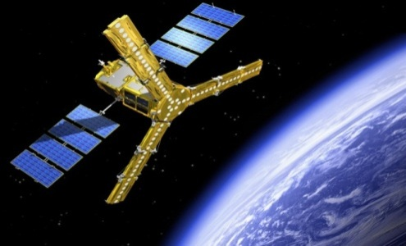
Flash Floods: Weather Ready Nation
Research: In the US, flash flooding is the number one killer among all weather-related hazards. The 30 Year Flood Loss Averages = $7.82 Billion in damages, 94 deaths per year.
This project integrates remote sensing satellite based soil moisture data in current hydrological modeling to improve Gridded Flash Flood Guidance System.
Collaborators:
Office of Hydrological Development (OHD/NWS).
Regional Forecasting Center, National Weather Service (NWS), Tulsa OK.
National Environmental Satellite, Data, and Information Service (NESDIS).
End Users:
Weather Forecasting Offices; Local Emergency Management Offices; Federal Emergency Management Agency (FEMA) .

Slide 33
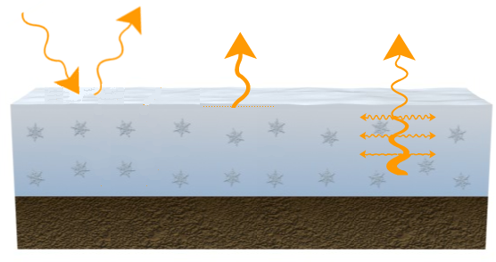
Microwave: The way to look inside the snowpack
Optical
Infrared
Microwave
Upwelling microwave radiation is emitted by the sub-snow surface and altered by the snow pack.
Therefore it carries information on the physical properties of the snow pack.
Spectral range 10-100GHz is most efficient for snow remote sensing
Formation of upwelling radiation in the optical (visible, near infrared), infrared and microwave spectral range
Notes:
33

Slide 34

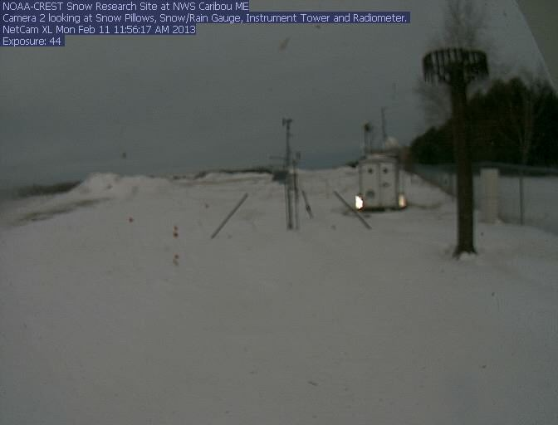

CREST-SAFE - Snow Analysis and Field Experiment
This Field Experiment is setup near the National Weather Service office at Caribou, ME in 2010.
This project is motivated to (a) develop, improve and validate the NOAA’s Snow Retrieval Algorithms (b) develop real time and forecasted gridded snowpack data by objectively merging in-situ stationed with satellite based VIS/NIR and microwave observation.
http://crest.ccny.cuny.edu/snow
Real time Web-cam monitoring of site (11 Feb 2013)
http://crest.ccny.cuny.edu/snowcam2
Snow Pillow (SWE)
Rain/Snow Gauge
Soil Moisture (2.5, 5, 10cm)
Soil Temp (2.5, 5, 10cm)
Network Cameras (2)
Infrared Thermometer
(Skin Temperature)
Radiation Sensors
Wind Speed/Direction, Humidity/air temperature
37 GHz Radiometer
89 GHz Radiometer
23, 19, 10.65 GHz, Radiometers ???
Snow Temperature Profiler
2010
2011
2012
2013
Timeline of Snow Experiment Development

Slide 35
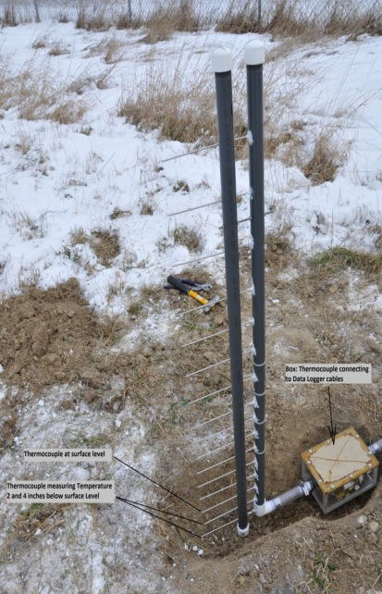


CREST-SAFE - Snow Analysis and Field Experiment
Snowfall event
Potential End-users:
  NOAA/NESDIS for Cal/Val of CRTM and other models.
  DEP/NYC for Snowpack Modeling
People involved:
Tarendra Lakhankar, Peter Romanov, Reza Khanbilvardi, William Rossow, Alfred Powell
Students: Jonathan Munoz, Jose Infante, Christopher Chan, Philip Boody (Student, University of Maine)

Slide 36





Analysis and Validation of Snowpack Grain Size, Density and Temperature using Snow Physical Model
The CREST-Snow Analysis and Field Experiment (CREST-SAFE) is setup in the backyard of the National Weather Service office at Caribou, ME using high frequency (37 and 89 GHz), dual polarized microwave radiometers and other snowpack and meteorological instruments to develop, improve and validate the snow retrieval algorithms.
In this particular task, field experiment is carried out throughout the winter season, to measure the snow grain size, and snow density at CREST-SAFE site along with other microwave and meteorological measurements. Observations of the temperature vertical distribution in the snowpack were measured with a specially developed temperature profiler.
On site field measurements of Snow grain size, snow density and snowpack temperature
Simulated snow depth and snow temperature profiles
Observed snow depth and snow temperature profiles
Lakhankar, T., Muñoz, J., Romanov, P., Powell, A. M., Krakauer, N. Y., Rossow, W. B., and R. M. Khanbilvardi (2013) CREST-Snow Field Experiment: analysis of snowpack properties using multi-frequency microwave remote sensing data, Hydrology Earth System Sciences (HESS), 17, 783-793, doi:10.5194/hess-17-783-2013.

Slide 37




Monitoring of Ice breakup in Alaska, VIIRS RGB5/09/2013
Projected and masked RGB images
Swath RGB images

Slide 38

Towards developing global flood monitoring system using ATMS
Kibrewossen Tesfagiorgis, Marouane Temimi, Reza Khanbilvardi
NOAA-CREST, CCNY
http://water.ccny.cuny.edu/research-product/inundation/

Slide 39

Enhanced use of GOES for estimating land surface wetness with application to wildfire forecasting at the NOAA Storm Prediction Center
CREST: Marouane Temimi NOAA/CREST/CCNY
Jan Stepinski CREST/CCNY student
NOAA: Robert M Rabin NOAA/NSSL rabin@ssec.wisc.edu
Rabin, Temimi, Stepenski et al, 2013, submitted
GOES-13
Heating Rate Anomaly: 25 June-09 July 2011
3939
Notes:
39

Slide 40



i –NOAA CREST
  Caribbean: (under Carib-SEES (NSF/USAID/IAI funding));
    FUNDGLODE – Foundation for Global Development (DR-President’s Foundation)
    National Commission for Science and Technology of Dominican Republic
    Organismo Nacional de Meteorologia (ONAMET) of Dominican Republic
    Instituto Technologico de Santo Domingo
    University of West-Indies, Cave Hill, Jamaica
CUNY Undergraduate students at field work in Dominican Republic

Slide 41



A vulnerable region in the DR/Haiti Border
CREST is collaborating with INTEC to determine the causes of the growth of the Lakes Enriquillo and Sumatre in the Dominican Republic/Haiti Border

