Slide 1

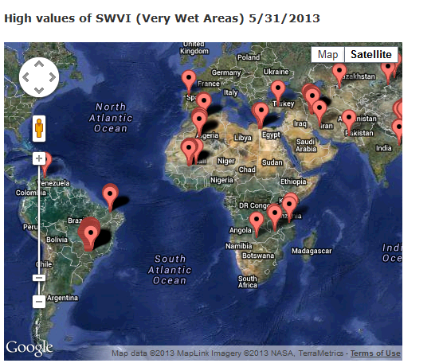
Towards developing global flood monitoring system using ATMS
Kibrewossen Tesfagiorgis, Marouane Temimi, Reza Khanbilvardi
NOAA-CREST, CCNY
http://water.ccny.cuny.edu/research-product/inundation/

Slide 2
Outline
Background
Methodology
  Polarization Ratio Variational Index (PRVI)
  Soil Wetness Variational Index (SWVI)
Towards global inundation monitoring
Conclusion
Future work
Overview of other ongoing projects

Slide 3
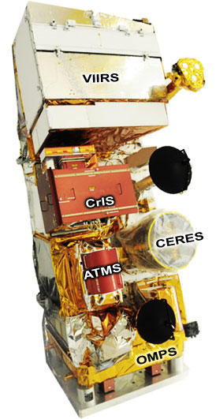
Background
The Advanced Technology Microwave Sounder (ATMS) onboard Soumi-NPP:
  One of the five sensor payloads on NPP
  Launched on October 28, 2011
  NOAA-NASA Joint project
  Cross-track scanning radiometer
  22 channel Microwave Sounder (23 to 183 GHz)
  ~35 km spatial resolution
  Better than existing AMSU in terms of capabilities
Soumi-NPP

Slide 4
Methodology
ATMS/AMSU include window channels (23.8, 31.4, 50.3 and 89.0 GHz) to monitor surface features, such as soil moisture.
A combination of two or more of these channels can be used for a qualitative soil wetness estimation
There are two well established methodologies to monitor inundation/flood using Microwave BT measurements.
  PRVI (Polarization Ratio Variational Index)
  SWVI (Soil Wetness Variational Index)

Slide 5
Polarization Ratio Variational Index (PRVI)
PRVI (Temimi et al., 2008, 2011), used to study the major flooding in Iowa in 2008.
Where, μi and σi are average and standard deviation of the Polarization Ratio, PR=(Tbv-Tbh)/(Tbv+Tbh) respectively for a given month i. Average and standard deviation were estimated on a monthly basis to account for changes in surface conditions (i.e. soil roughness and vegetation density) which might affect the microwave signal.
  Theoretically PRVI ranges from negative infinity to positive infinity.
  Positive PRVI means surface wetness
  Negative PRVI means the area is drier than normal (long term mean)

Slide 6
Example: using PRVI for the 2008 Iowa flooding
High values of PR during Iowa’s 2008 flooding
Assessing Iowa flooding using PRVI (Temimi et al., 2011)

Slide 7
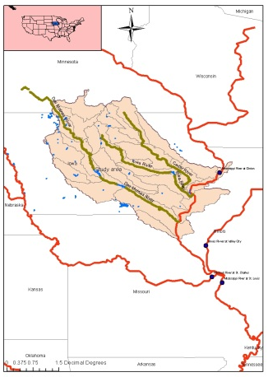
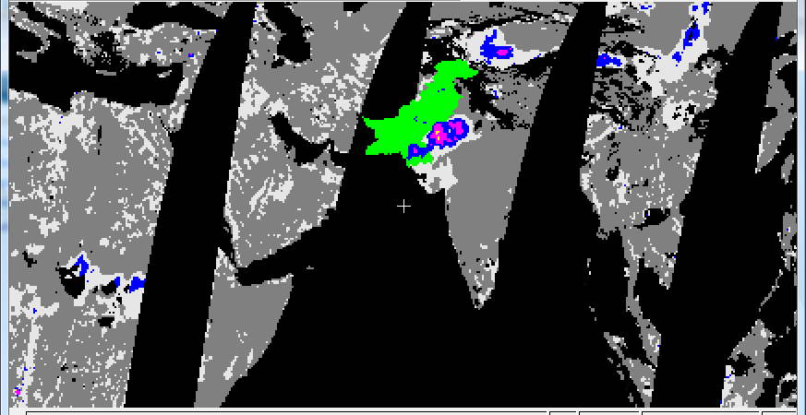
Flood and discharge monitoring during the 2008 Iowa flood using AMSR-E data
Marouane Temimi, Teodosio Lacava, Tarendra Lakhankar, Hosni Ghdira, Reza Khanbilvardi, Trumatoli, V. Flood and discharge monitoring during the 2008 flood In Iowa using AMSR-E data. 2011. Hydrological Processes. (In press)
Polarization Ratio Variation Index (PRVI)
Data assimilation using the Kalman Filter
Log (Q(t)) = log(a) + b log ( FA(t+ d.Δt))
Y = A X + B
A
Yt = Ht. At where Yt = Y
H_{t} =
(State equation)
A_{t} =
X 1
Where, μi and σi are average and standard deviation of the PR (PR=Tbv-Tbh/Tbv+Tbh) respectively for a given month i. Average and standard deviation were estimated on a monthly basis to account for changes in surface conditions
B
At+1 = Φt At +Wt
Yt = Ht At+ Vt
(Observation equation)
PRVI values obtained on June 9th, 2008 compared with observed water levels above flood stage as provide by the USGS (http://water.usgs.gov/osw/)
PRVI used for the monitoring of the major flood in Pakistan in 2010
Notes:
The objective of this work is to demonstrate the potential in using passive microwave data for monitoring flood and discharge conditions and inferring watershed hydraulic and hydrologic parameters. The case study is the recent flood in Iowa in summer 2008. AMSR-E 37 GHz data have been used to calculate a Polarization Ratio Variation Index (PRVI). This new index uses the classic Polarization Index with the mean and the standard deviation to detect anomalies in soil moisture and/or flooded area extent. A rating curve has been developed to assess the relationship between PRVI values and discharge observations downstream. A time lag term has been introduced and adjusted to account for the changing delay between PRVI and streamflow. Moreover, the Kalman filter has been used to update the rating curve parameters in near real time. The temporal variability of the b exponent, so-called river hydraulic width, shows that it converges toward a constant value. A consistent 21 day time lag has led to 65% agreement between estimated and observed discharge and has shown that this parameter is a good proxy for watershed time of concentration suggesting that passive microwave image can be used to measure key watershed hydrologic parameters.

Slide 8
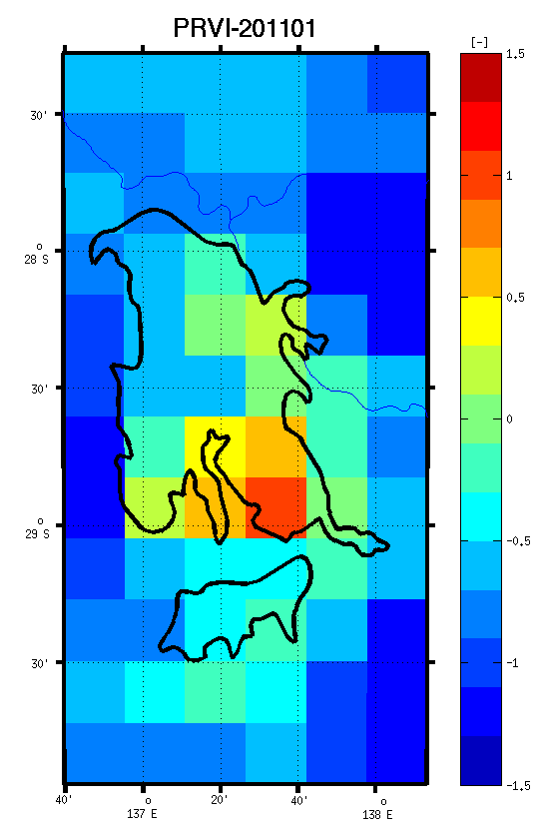
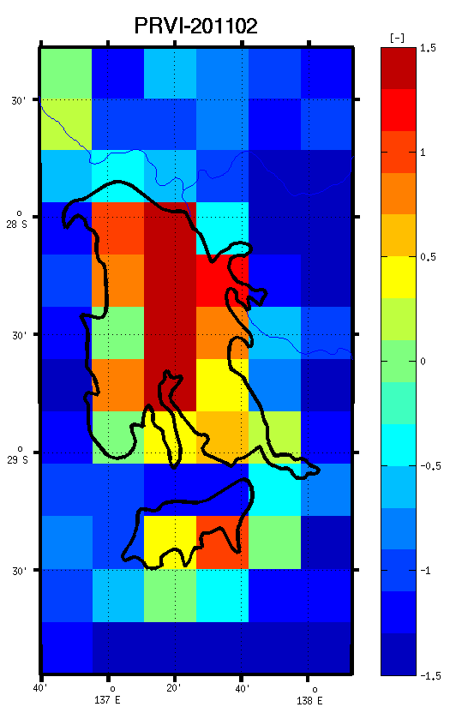
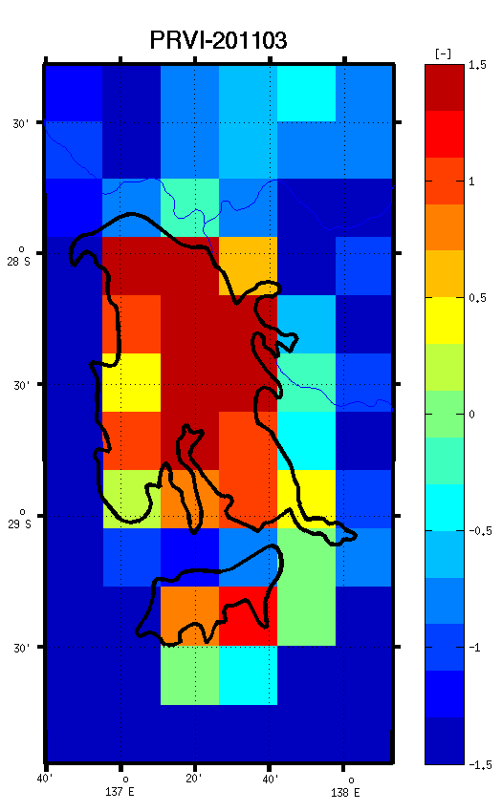
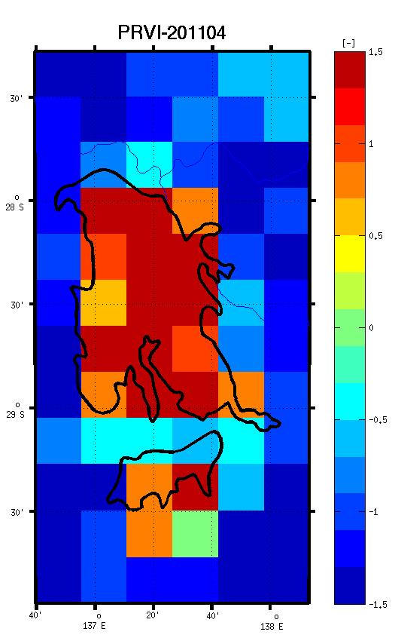
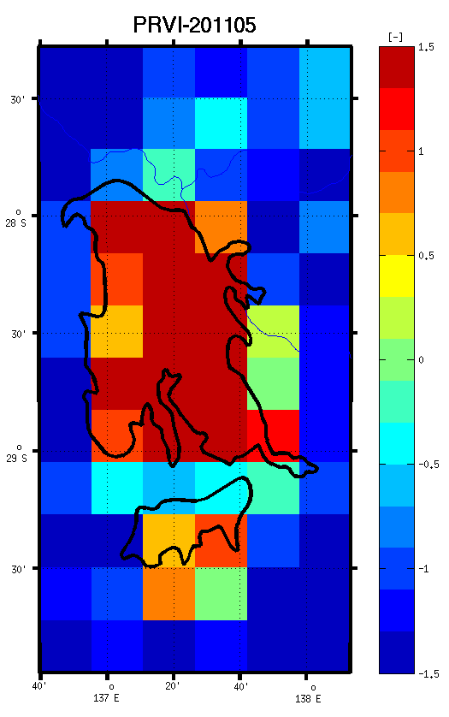
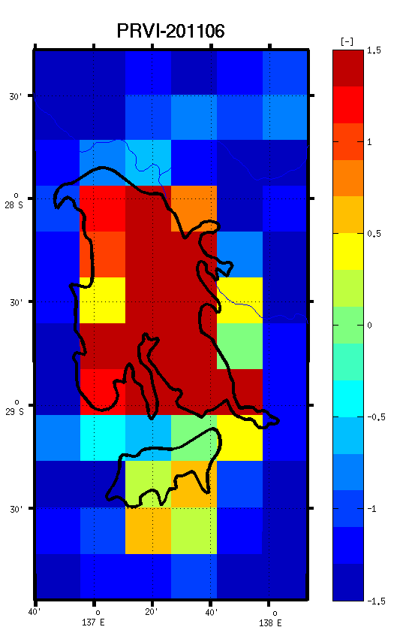
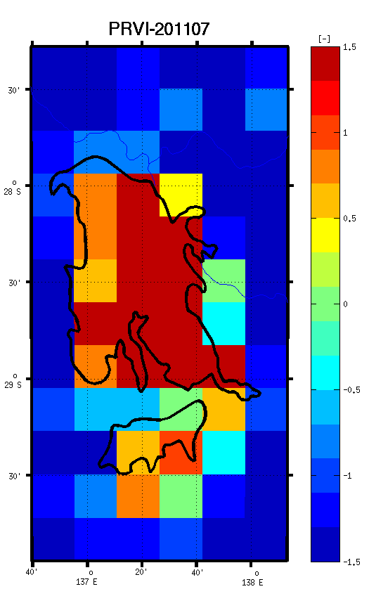
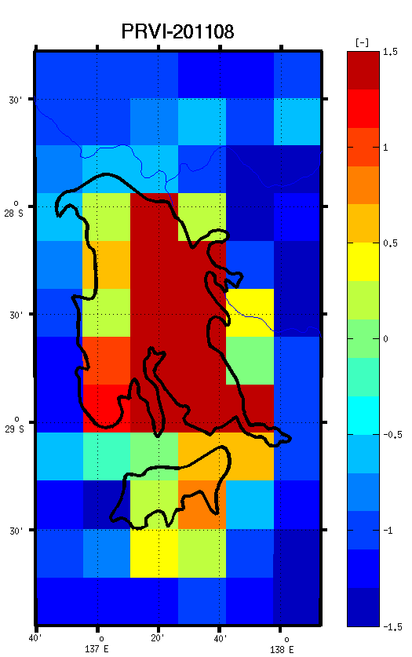
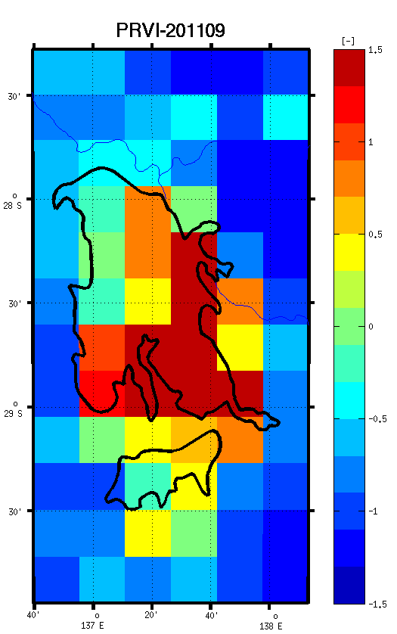
Observing the evolution of lake Eyre, Australia using PRVI
~DRY
FULL
Evolution of Lake Eyre, Australia using PRVIs
Lake Eyre (North) was full in May 2011.
The lake was almost completely dry in Jan. 2011.

Slide 9
Soil Wetness Variational Index (SWVI)
SWVI (Lacava et al., 2006), used to study the flooding in some parts of Europe (eg. Italy, Hungary, Spain).
Based on AMSU-A
Where, SWIμi and SWIσi are average and standard deviation of the Soil Wetness Index, *SWI=(Tb15-Tb1) respectively for a given month i. Average and standard deviation were estimated on a monthly basis to account for changes in surface conditions (i.e. soil roughness and vegetation density) which might affect the microwave signal.
  SWVI > 2 & SWVI < 3 Medium wet
  SWVI > 3 & SWVI < 4 Anomalous wet conditions
  SWVI > 4 Very wet surface
Qualitatively
*SWI was original proposed by Grody 2002

Slide 10
Which one is feasible for our application?
PRVI | SWVI
Based on Polarization Ratio, which is dependent on Vertically and Horizontally polarized measurements of the same channel. (37 GHz from AMSR-E was used). | Based on Soil Wetness Index, which is the difference between two brightness temperature measurements. (TB23GHz-TB89GHz from AMSU-A)
Since ATMS channels are either Quasi-horizontally or Quasi-vertically polarized, we can only adopt the SWVI approach for our global inundation/flood monitoring system.
Problem:
We cannot develop long term monthly mean and standard deviation SWI values for ATMS (Launched in October 28, 2011).
Solution (temporarily):
Use previous month mean and standard deviation SWI values to calculate present time SWVIs.
Use AMSU-A channels to build the long term mean and Standard deviations.

Slide 11
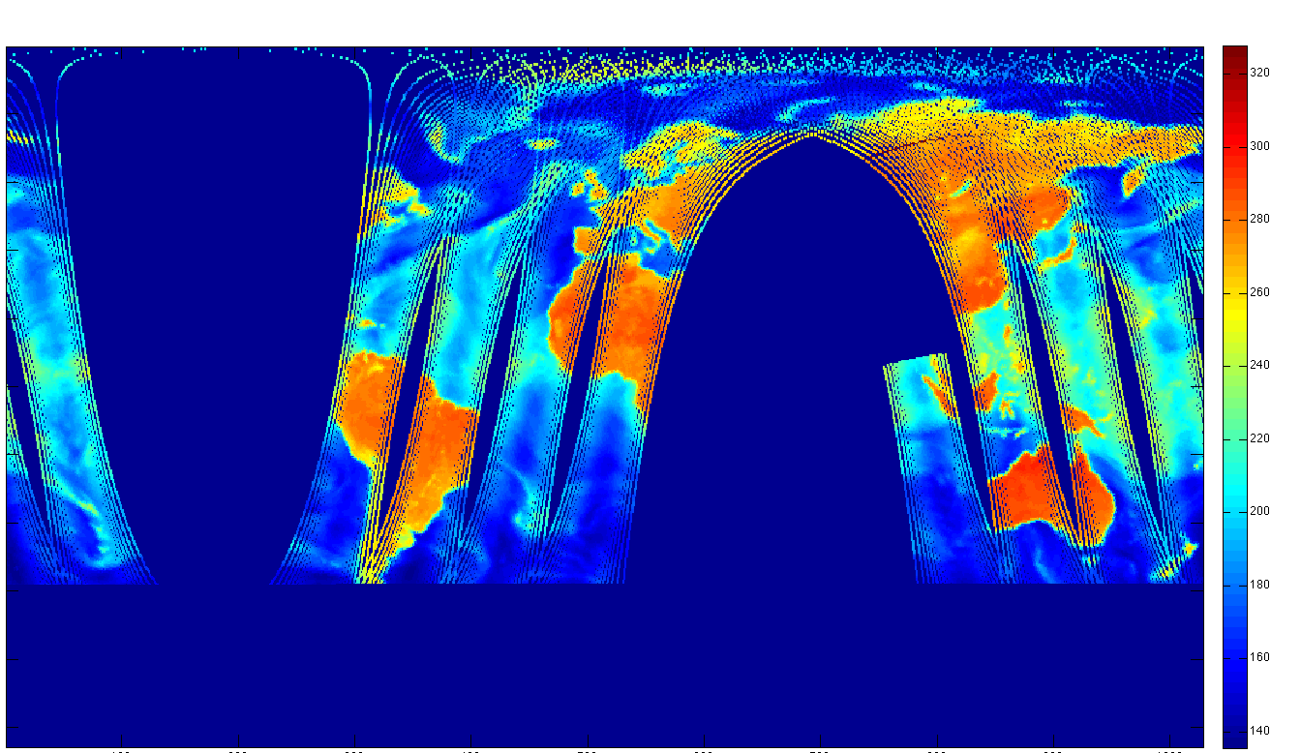
Towards global inundation monitoring system using ATMS
Get ATMS swath data from CLASS website (Channel 1 and 16).
Stitch them together to produce global maps of these observations.
Mask out the sea
Calculate the SWI
Calculate the PRVI
Overlay the product
on Google API
Compare results with
news agencies
and other sources
23 GHz MW-BT from ATMS
An example of stitching swath data to a regular 35 km resolution global map

Slide 12
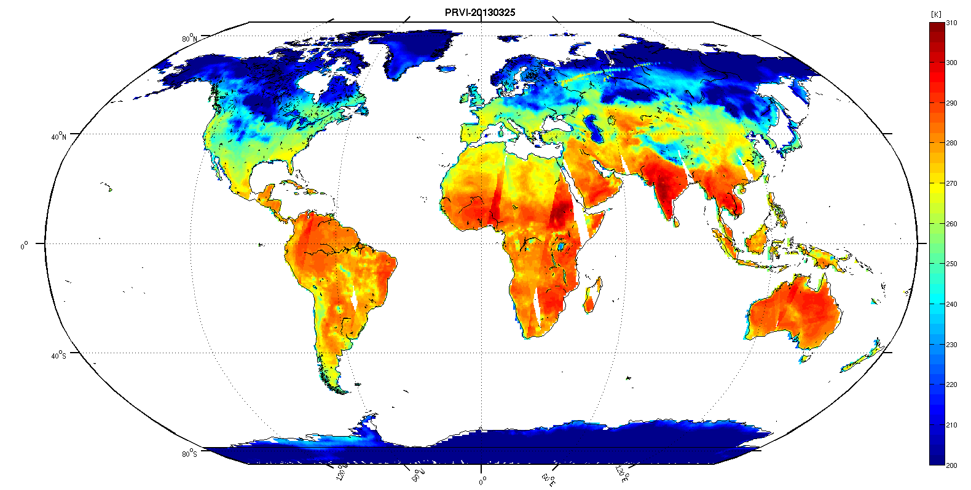
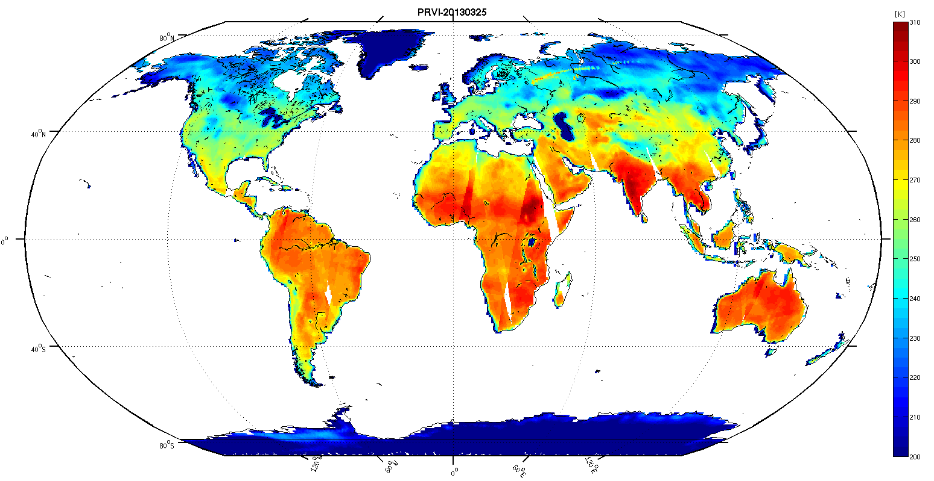
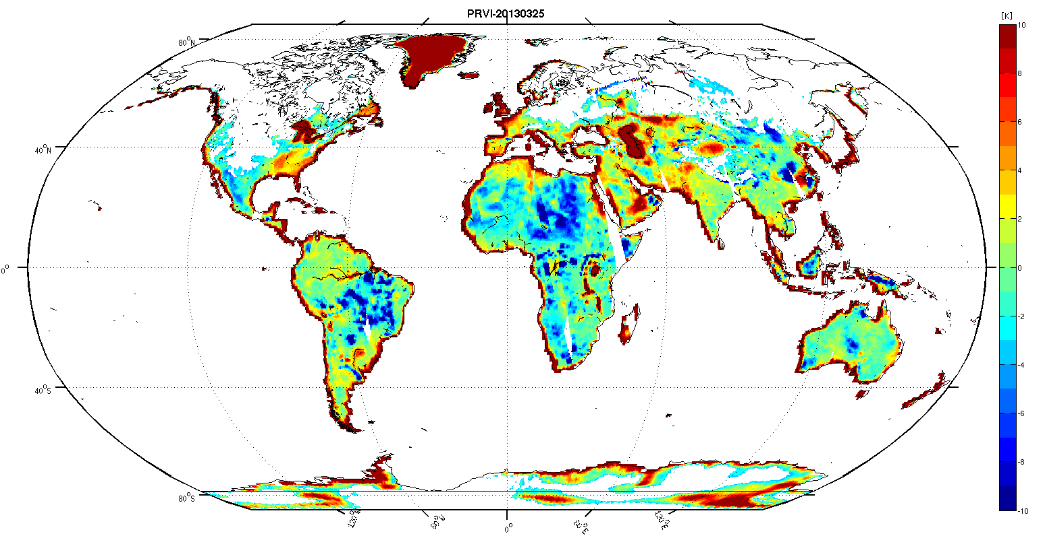
Global SWI calculation from ATMS
89 GHZ MWBT
23 GHZ MWBT,
___
SWI
=
The above maps are for 20130225

Slide 13
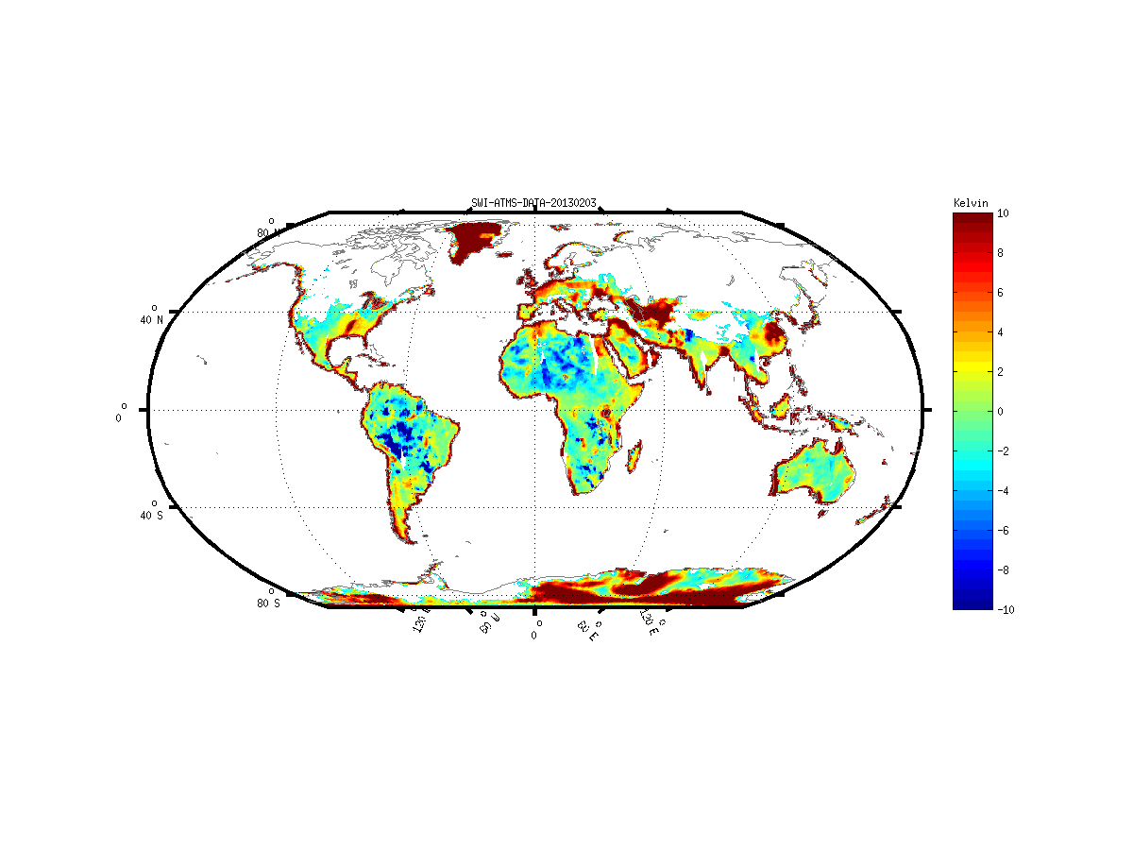
Global Soil Wetness Index (SWI) from ATMS channels
Animation of variation of SWI for February 2013
Snowy/icy surfaces are relatively noisy.
Snowy/icy surfaces are masked out using Kongoli’s criteria (Kongoli et al., 2006)

Slide 14
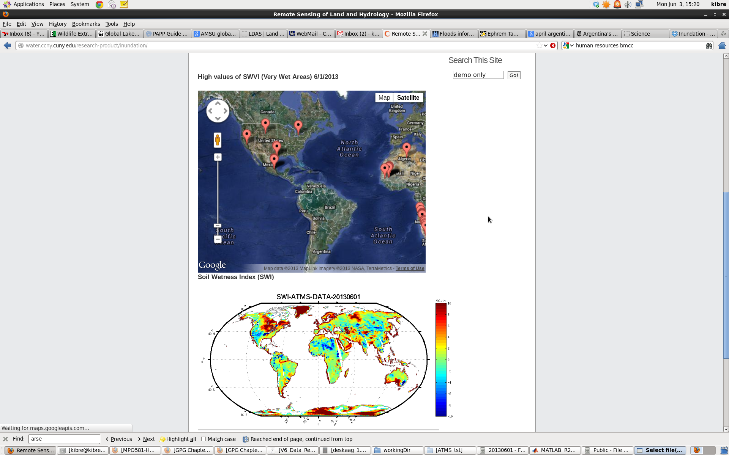
CREST Global Inundation Monitoring Website
http://water.ccny.cuny.edu/research-product/inundation/
It contains markers on Google API at locations where we have high values of SWVI.
The website contains animations of daily SWI maps
The website is routinely updated everyday at 9:00 PM

Slide 15
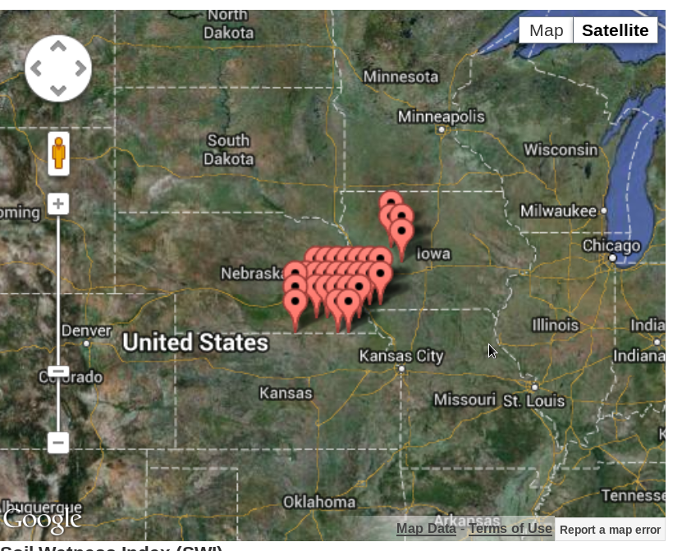
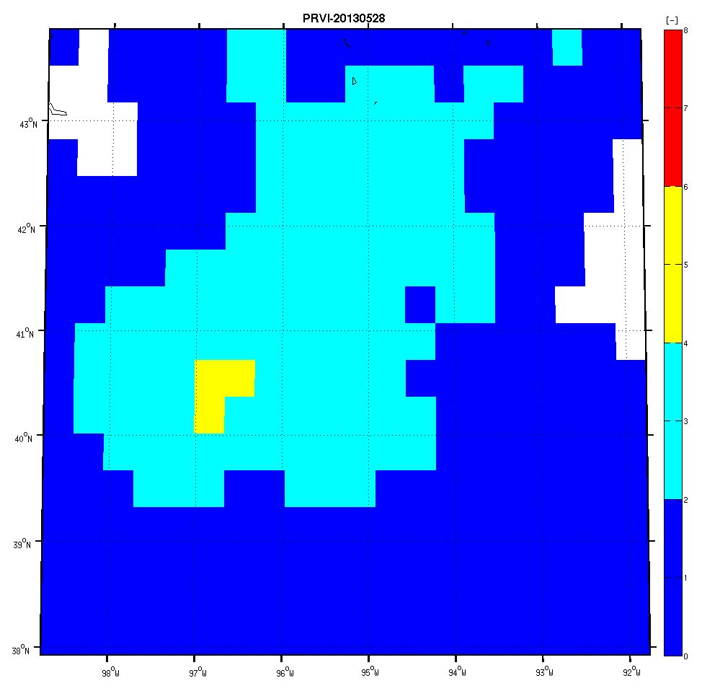
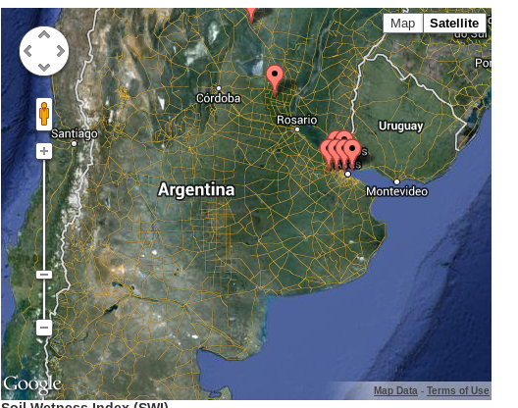
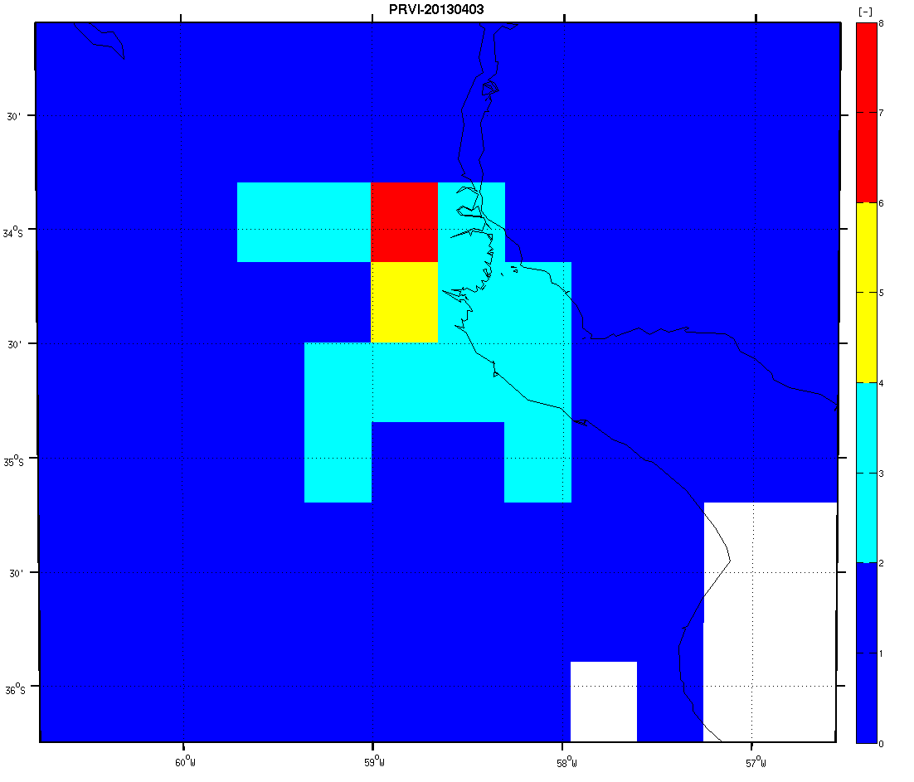
Examples of recent events
Iowa, May 28, 2013
Buenos Aires, April 03, 2013

Slide 16
Conclusion (PRVI)
The PRVIs methodology is adaptable to AMSR-2.
For a longer inundation record, we are planning to incorporate AMSU into our analysis.
In the future we will combine ATMS with VIIRS to produce high resolution inundation/water extent maps.

Slide 17


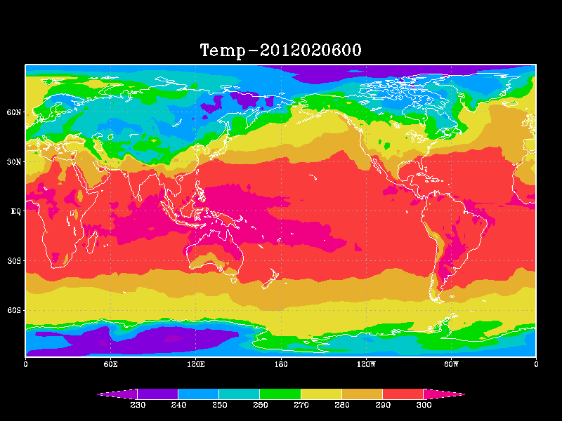
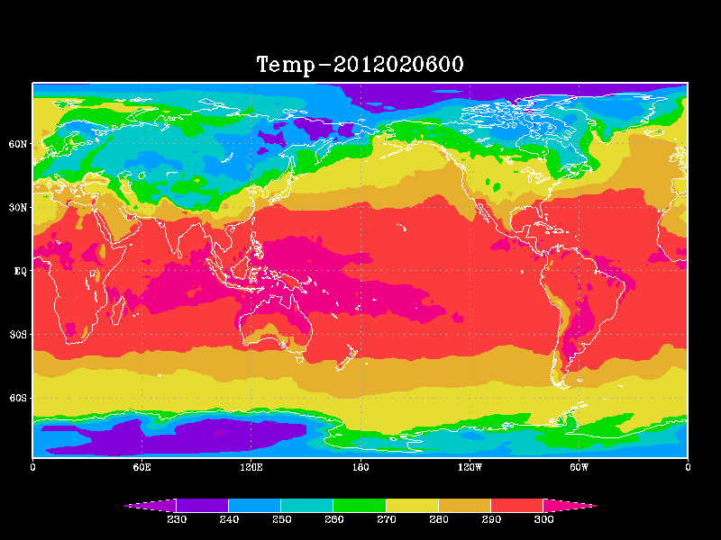
Assessment of assimilating ATMS land surface
sensitive observations in the NOAA Global Forecast System
Drs. Marouane Temimi and Kibrewossen Tesfagiorgis, NOAA-CREST, CCNY; NOAA Collaborator: Sid Boukabara
Currently NOAA operational forecast system does not account for radiances observed in window channels which are highly sensitive to surface parameters.
Goal: Assimilating dynamic land surface emissivity values has positive impact on weather prediction
72 hours lead forecast
Warmer in the Antarctica and cooler in the Arctic

Slide 18
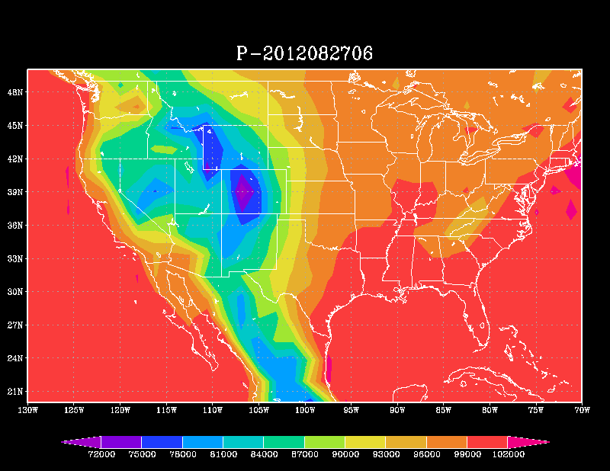

Assessment of assimilating ATMS land surface
sensitive observations in the NOAA Global Forecast System
Drs. Kibrewossen Tesfagiorgis (PostDoc), Marouane Temimi, NOAA-CREST, CCNY; NOAA Collaborator: Sid Boukabara
Currently NOAA operational forecast system does not account for radiances observed in window channels which are highly sensitive to surface parameters.
Tracking Hurricane Isaac Using the NPP/ATMS Observations
ATMS OFF
ATMS ON

Slide 19
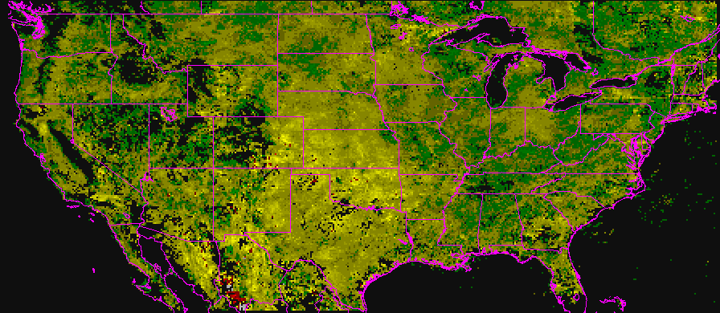
Enhanced use of GOES for estimating land surface wetness with application to wildfire forecasting at the NOAA Storm Prediction Center
CREST: Marouane Temimi NOAA/CREST/CCNY
Jan Stepinski CREST/CCNY student
NOAA: Robert M Rabin NOAA/NSSL rabin@ssec.wisc.edu
Rabin, Temimi, Stepenski et al, 2013, submitted
GOES-13
Heating Rate Anomaly: 25 June-09 July 2011
1919
Notes:
19

Slide 20
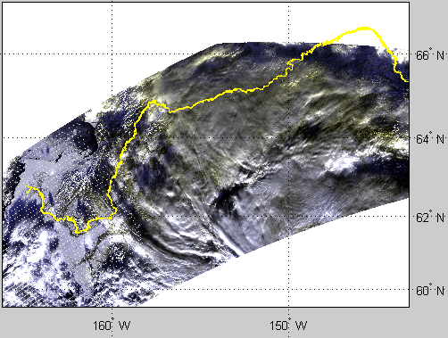
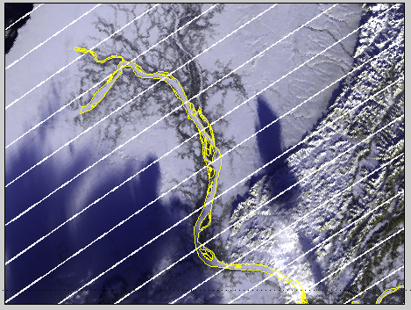
River and Lake Ice mapping using NPP/JPSS VIIRS sensor To support NOAA NWS
Drs Naira Chaouch, Marouane Temimi, Reza Khanbilvardi ; NOAA Collaborators: Mitch Goldberg, Reggina Cabrera,
Yukon River
RGB, 01/03/2013
Naira Chaouch, Marouane Temimi, Peter Romanov, Regina Cabrera, George Mckillop, Reza Khanbilvardi. An Automated Algorithm for the Monitoring of River Ice over the Susquehanna River Basin using MODIS data. Hydrological Processes. (In press, 2012).
Notes:
Funded by NWS; for the development of an operational tool for the mapping of ice in major river using MODIS; work is in progress to include additional river like the Hudson River.
Also; We just got our proposal funded to add VIIRS images and expand the study to ice in lakes as well.

Slide 21
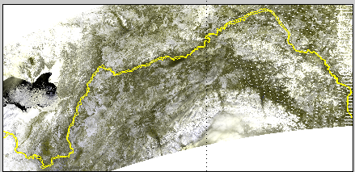
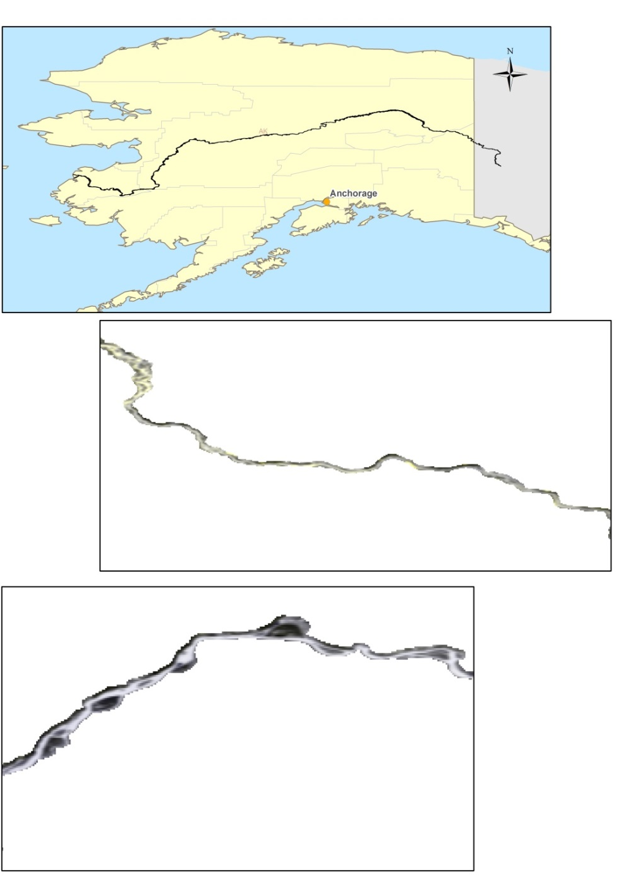
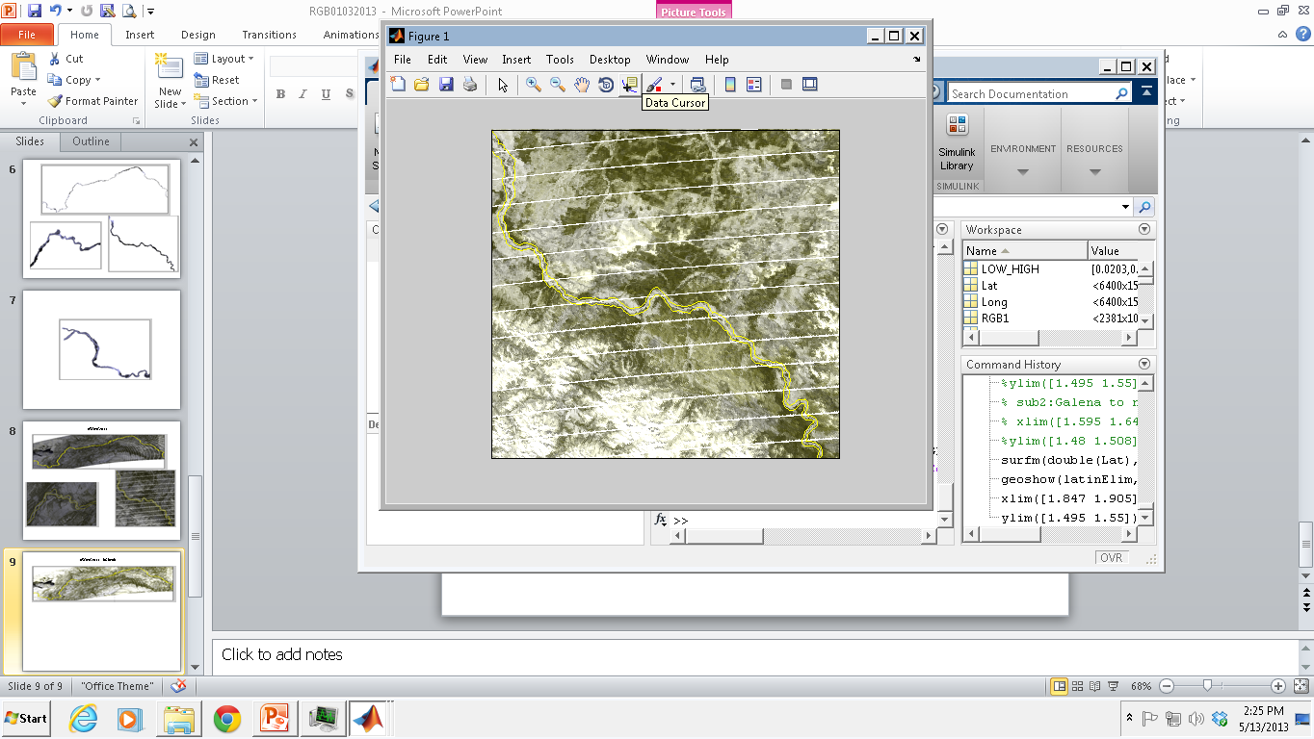
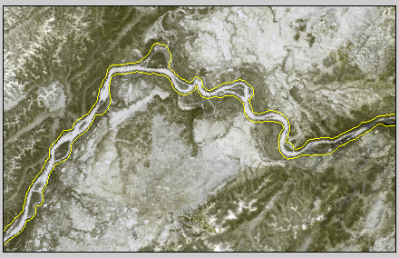
Monitoring of Ice breakup in Alaska, VIIRS RGB5/09/2013
Swath RGB images
Projected and masked RGB images

Slide 22
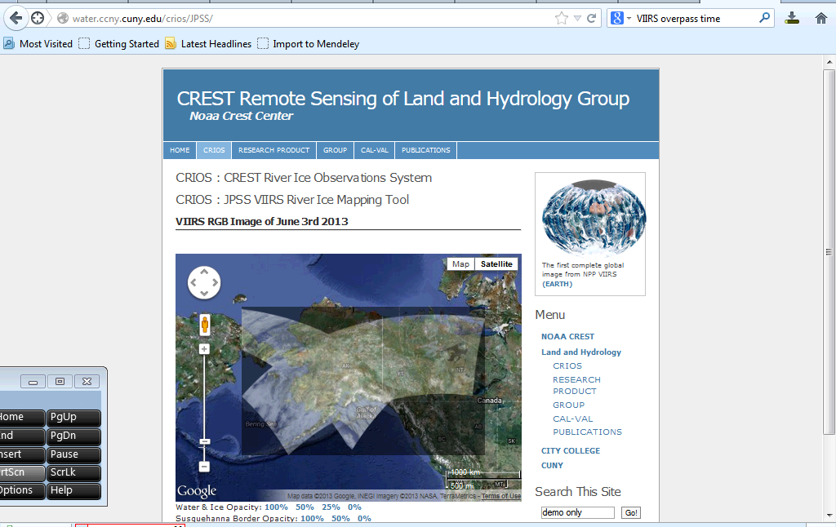
Monitoring of Ice breakup in Alaska, VIIRS RGB
http://water.ccny.cuny.edu/CRIOS/JPSS
CSPP tools (university of Wisconsin) are used to download and reproject VIIRS images regularly

Slide 23
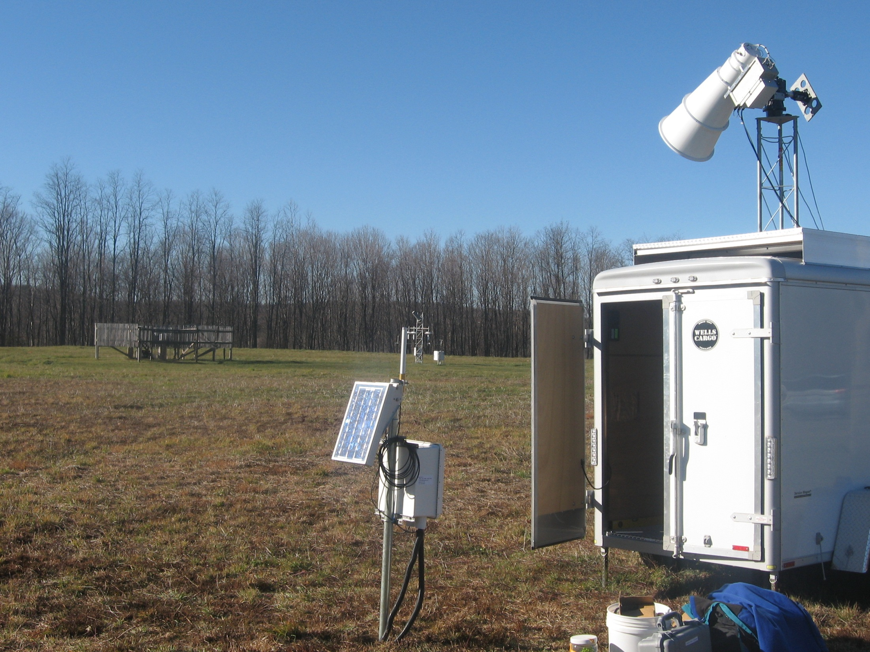
CREST-SMART
Soil Moisture Advanced Radiometric Testbed
Notes:
23

Slide 24
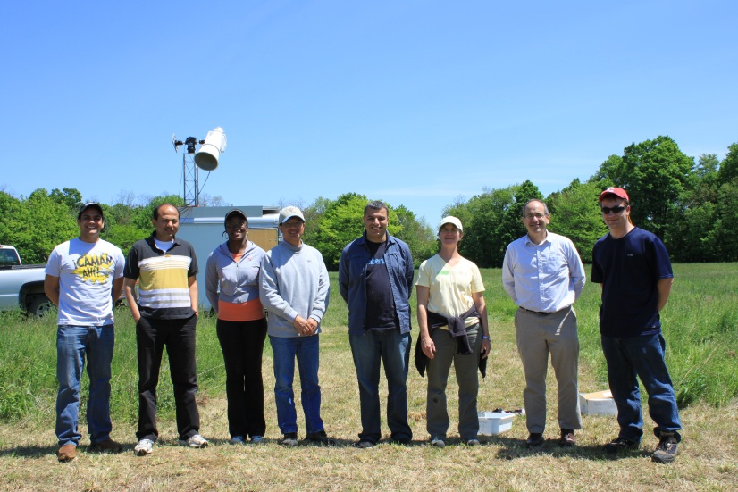
CREST-SMART
Soil Moisture Advanced Radiometric Testbed
Team: Marouane Temimi, Tarendra Lakhankar, Xiwu Zhan, Mike Cosh, Nir Krakauer Vicky Kelly, Laetitia Kumassi (graduate), Amelise Bonhomme (undergrad)
The established network was selected by NASA for the Cal/Val of the SMAP mission
Marouane Temimi, Tarendra Lakhankar, Xiwu Zhan, Mike Cosh, Nir Krakauer Vicky Kelly, Laetitia Kumassi (graduate), Amelise Bonhomme (undergrad). A GROUND BASED L BAND RADIOMETER FOR THE MONITRING OF SOIL MOISTURE IN THE REGION OF MILLBROOK NY. Vadose Zone Journal. Submitted.
CREST-SMART
Soil Moisture Advanced Radiometric Testbed
Joint Field Experiment in May 2012

Slide 25
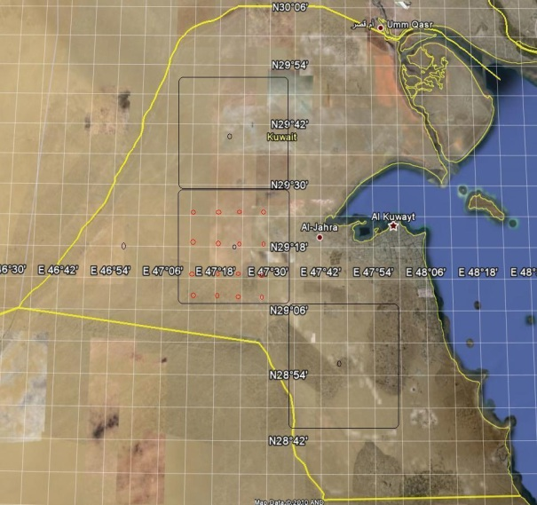

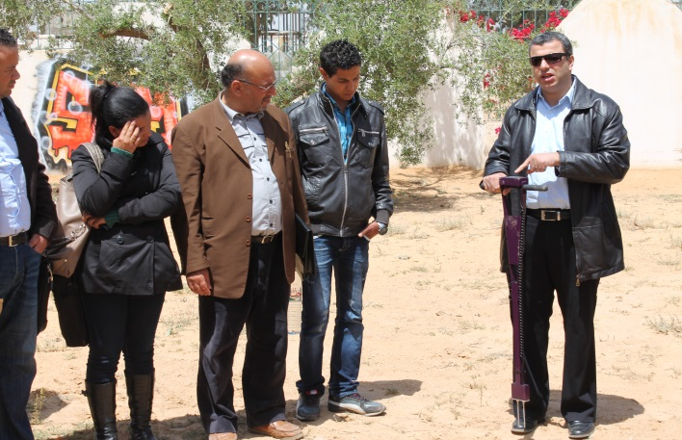
NASA SMAP Early adopters
NOAA NCEP
NY DEP Water Supply Division
Soil moisture monitoring in Kuwait
Soil moisture monitoring in Tunisia

Slide 26

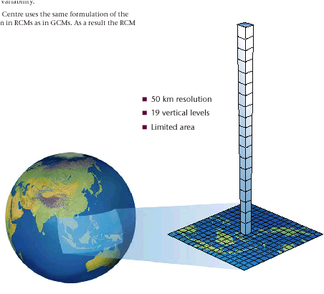

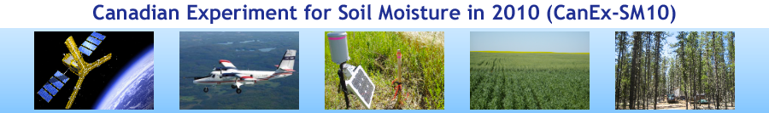

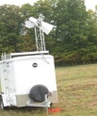
Examples of data products
Application of high resolution satellite imagery to improve coastal and estuarine models
Improvement and validation of land surface emission models using NOAA-CREST Microwave Radiometers
Application of satellite based soil moisture data for weather modeling and prediction
Improvement and validation of soil moisture algorithm using NOAA-CREST L-band microwave radiometer
Use of Geostationary satellites for drought monitoring.
Global land surface emissivity product
wetlands and inundation maps
Downscaling
http://water.ccny.cuny.edu/research-product/
Upscaling

