Slide 1
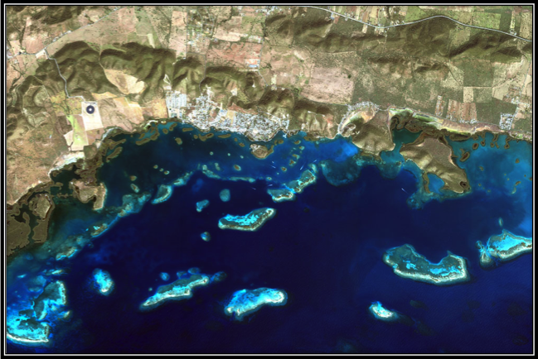
Hyperspectral Remote Sensing of Tropical Coastal Environments: the use of HICO data to derive water quality parameters in SW Puerto Rico
Roy A. Armstrong, Ph.D.
NOAA-CREST, University of Puerto Rico, Mayagüez Campus
8th Annual NOAA‐CREST Symposium

Slide 2


Introduction and Outline
Justification
Direct vs. Indirect Monitoring of Coral Reefs Using Remote Sensing
Sampling Sites and Measurements
  AOPs
  IOPs
  Water Quality Parameters
HICO Summary
Atmospheric Correction
Comparison with Field Rrs
Ongoing and Future Work

Slide 3
Justification
Coral reefs are highly productive coastal ecosystems that are often described as the marine equivalent of terrestrial rainforests in terms of biodiversity.
Coral reefs are among the most threatened coastal ecosystems worldwide resulting in unprecedented degradation over the past few decades.
Recent accelerated coral reef decline is mostly related to anthropogenic impacts such as increased sedimentation and nutrient overloading.
There is an urgent need to monitor changes in water quality parameters that are detrimental to coral reefs.

Slide 4
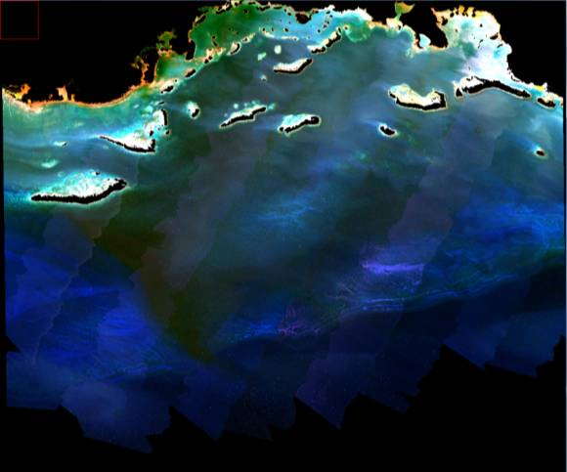
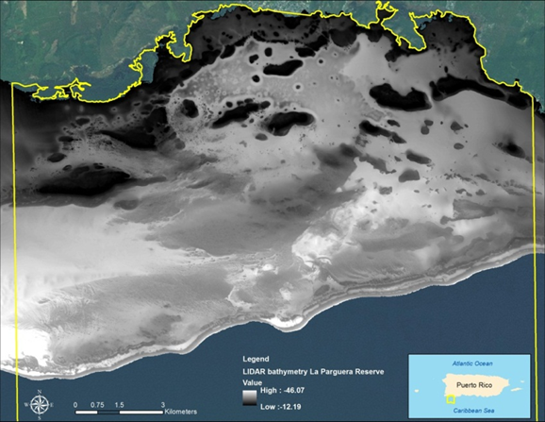
Direct vs. Indirect Monitoring of Coral
Reefs Using Remote Sensing
Direct – includes benthic mapping and characterization of coral reefs and other biotopes using a “sensor down” approach.
For example, AVIRIS airborne hyperspectral data is combined with LiDAR bathymetry data to produce a benthic classification map of La Parguera. Requires atmospheric and water column corrections. See Poster #14.

Slide 5
Direct vs. Indirect Monitoring of Coral
Reefs Using Remote Sensing
Indirect – addresses the oceanic environment around the reef.
  Sea surface temperatures (SSTs) and bleaching events.
  Low salinities and high turbidity from episodic rainfall events.
  Water optical properties (AOP and IOP) and coral reef parameters.
MERIS 300 m derived Chl-a

Slide 6
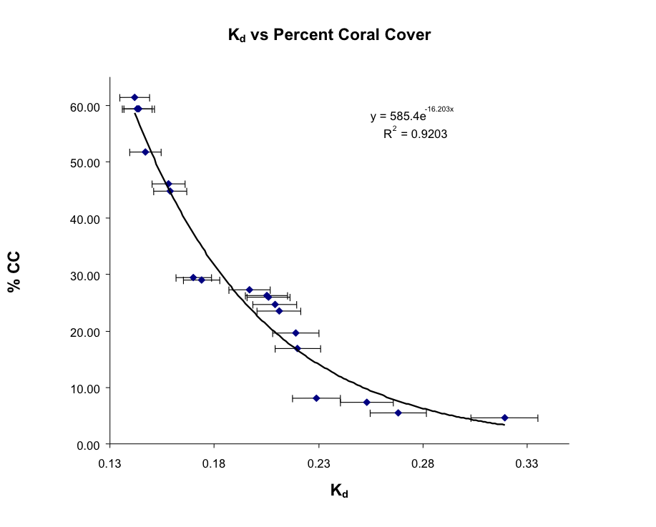
Water Optical Properties (AOP and IOP) and Coral Reef Parameters

Slide 7
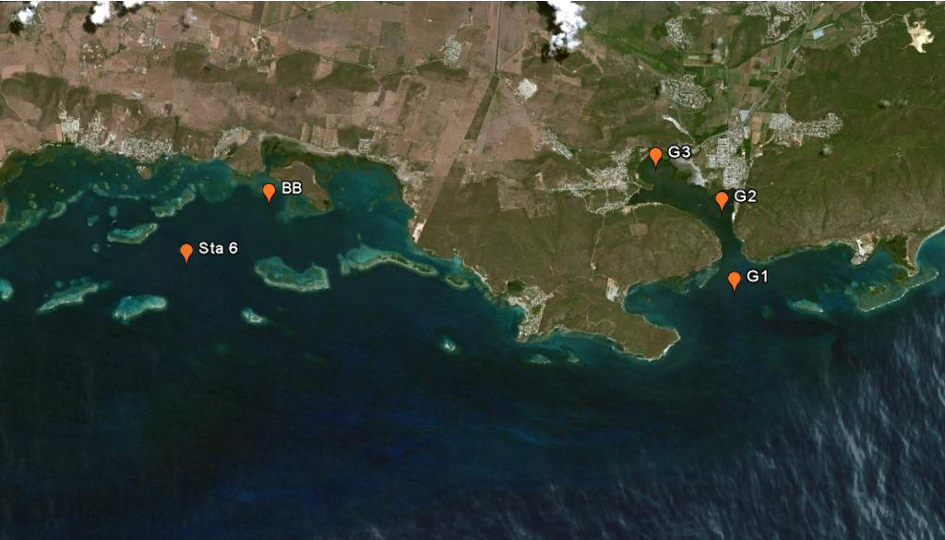
Sampling Sites

Slide 8
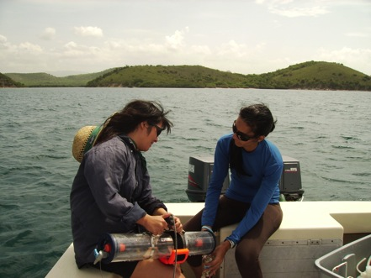
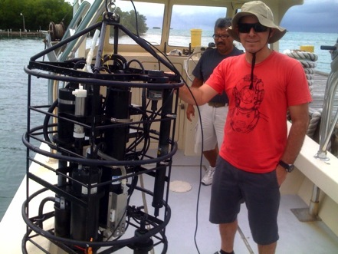
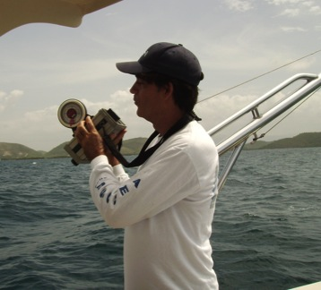
Field Sampling:
Instrumentation
Biogeochemical Properties
IOPs: a, c, b_{b}
AOP: Lu, Ed, Rrs
Surface water samples are used for measuring CDOM, Total Suspended Matter, and Chlorophyll.
Profiling sensor package that includes a CTD, a WetStar fluorometer, an ac-9 for absorption and attenuation, and a HydroScat-6 for backscattering.
GER-1500 spectroradiometer measures Lu, Ls, and Ed. This was used to calculate Rrs.

Slide 9
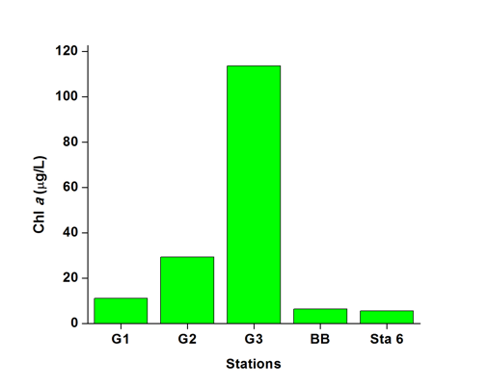
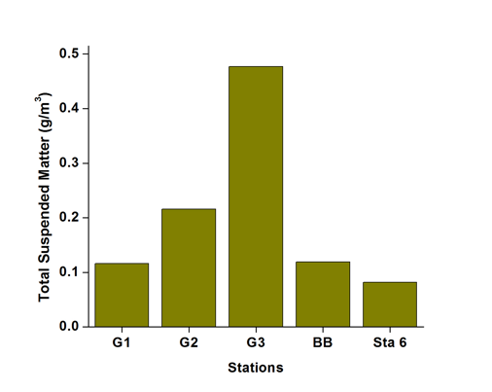
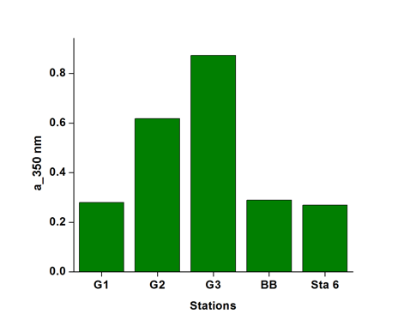
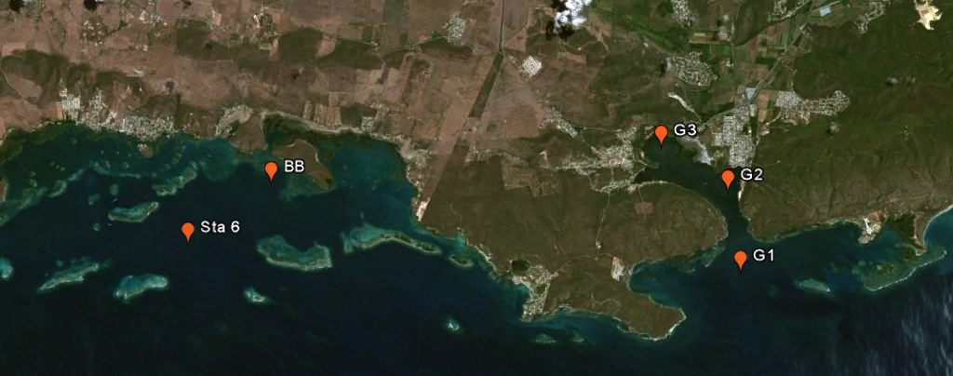
Water Quality Parameters
Median values for Chl-a, TSM, and CDOM absorption at 350 nm at the six stations.

Slide 10

HICO Summary
HICO operating since September 25, 2009
Over 6000 scenes collected
Slot on ISS until July 2014
Data from OSU website – http://hico.coas.oregonstate.edu

Slide 11
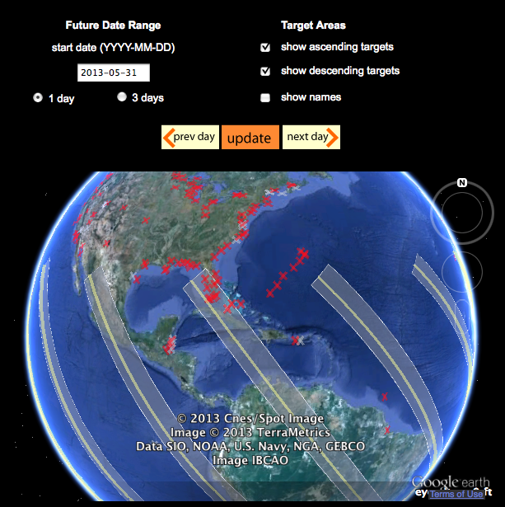
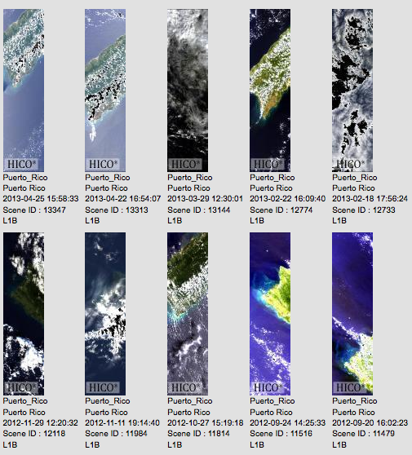
HICO Data

Slide 12
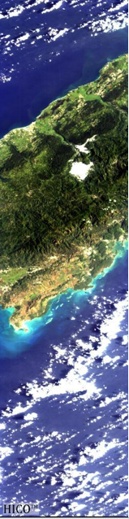
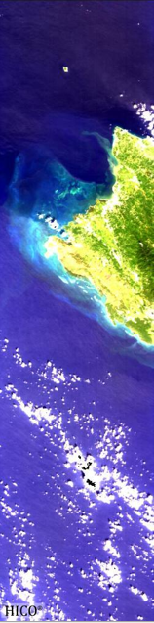
HICO Data for
Puerto Rico
Targets cover an area 50 km wide by 200 km long
One scene per orbit
Orbits
  NW to SE (descending)
  SW to NE (ascending)
87 bands (400 – 900 nm)
5.7 nm spectral resolution
SNR: 200:1
Total of 38 images to date
  15 are cloud free
  2 images with simultaneous field measurements

Slide 13
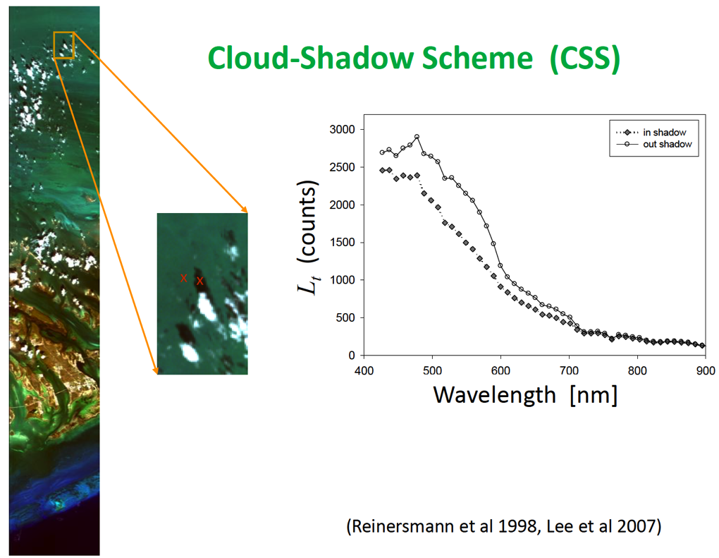
Atmospheric Correction
Slide courtesy of Z. Lee

Slide 14
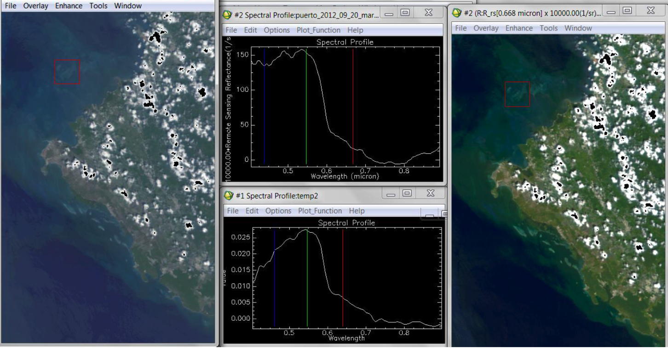
TAFKAA Vs. CSS
Puerto Rico
Slide courtesy of Z. Lee

Slide 15
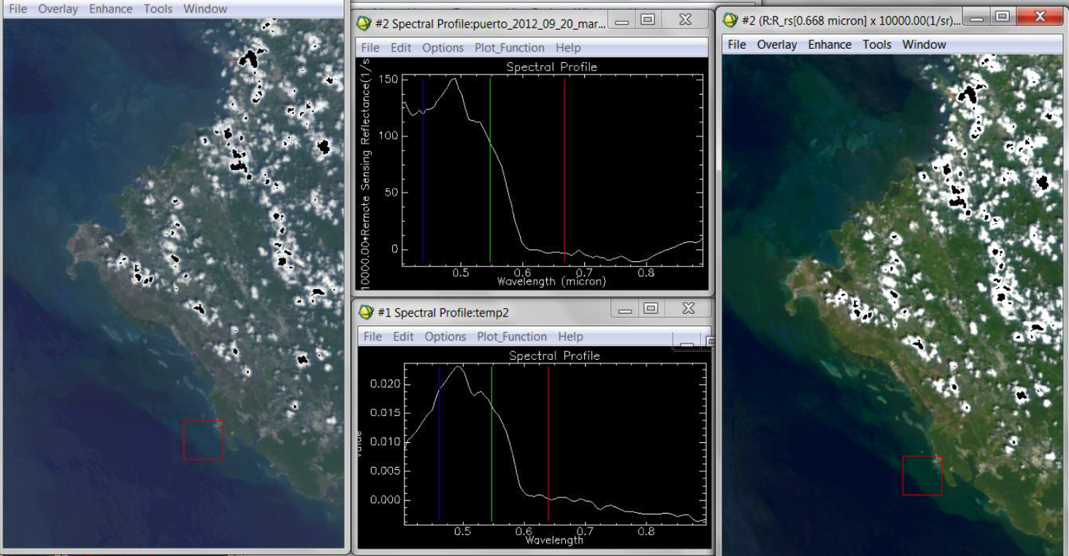
TAFKAA Vs. CSS
Puerto Rico
Slide courtesy of Z. Lee

Slide 16
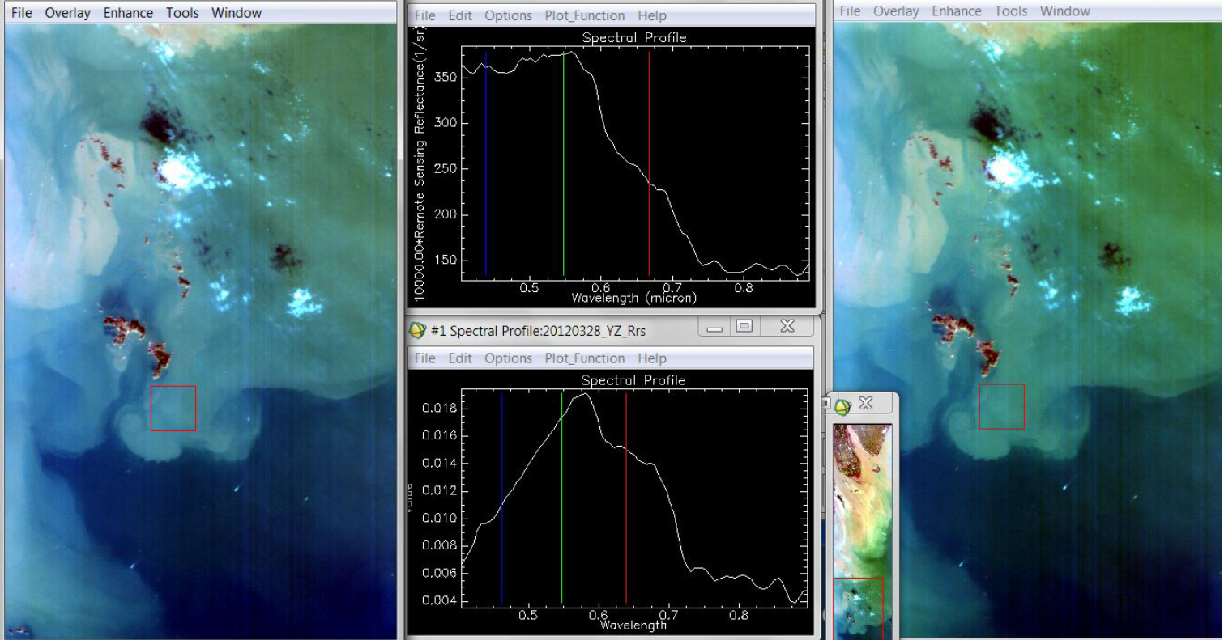
TAFKAA Vs. CSS
Yangtze River
Slide courtesy of Z. Lee

Slide 17
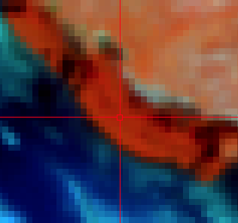
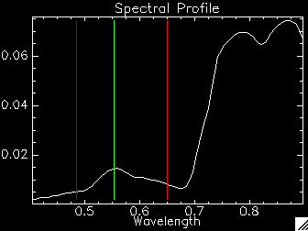
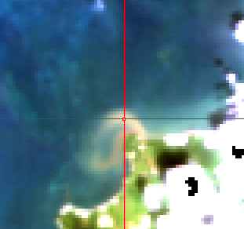
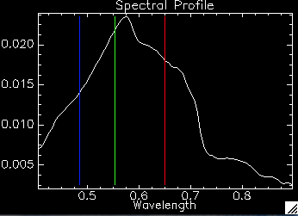
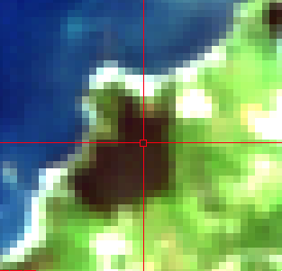
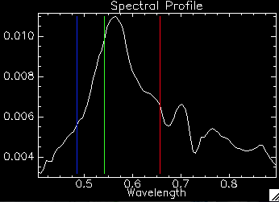
HICO September 20, 2012

Slide 18
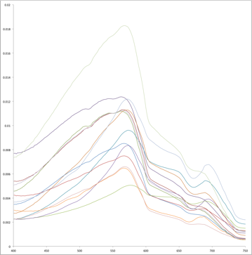
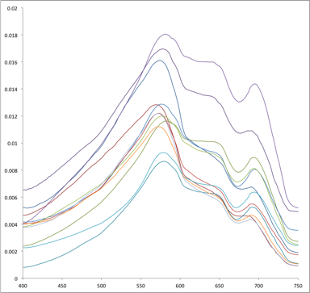
Variability of Field Rrs

Slide 19
Comparison with Field Rrs
Field Rrs – G1
HICO Rrs – G1

Slide 20
Comparison with Field Rrs

Slide 21
Ongoing and future work
Quality control of field data
Spatial patterns and trends in AOPs, IOPs,
Chl-a, TSS, and CDOM
Algorithm development using derivative analysis
  Using field Rrs
  Using HICO data
Relate spatial patterns in water quality, as determined
by bio-optical properties to the condition of coral reefs

Slide 22
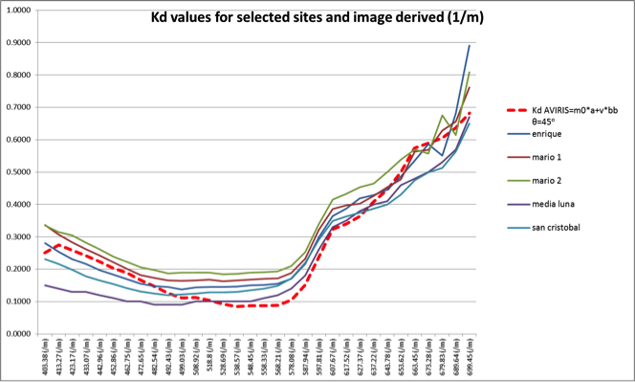
Image-derived Kd values
(Using AVIRIS Data)
Poster 14: Benthic Habitat Mapping for La PargueraMarine Reserve, Southwestern Puerto Rico, Using Passive and Active Remote Sensing Data.
William Hernandez, Doctoral Candidate, NOAA-CREST, UPRM-Mayaguez Campus

Slide 23
Acknowledgments
Belitza Brocco and William Hernandez
Fernando Gilbes
Zhong Pin Lee
Curtiss Davis and the HICO Science Team
CariCOOS - IOOS – NOAA
NOAA CREST CSC

