Slide 1
An Agricultural Application of GOES-PRWEB
Dr. Eric Harmsen
Professor, Dept. of Agricultural and Biosystems Eng., Univ. of Puerto Rico-Mayaguez
Victor J. Reventos
Undergraduate Research Assistant, Dept. of Electric and Computer Eng., Univ. of Puerto Rico-Mayaguez
8th Annual NOAA CREST Symposium
The City College of City University of New York, NY
June 5-6, 2013

Slide 2
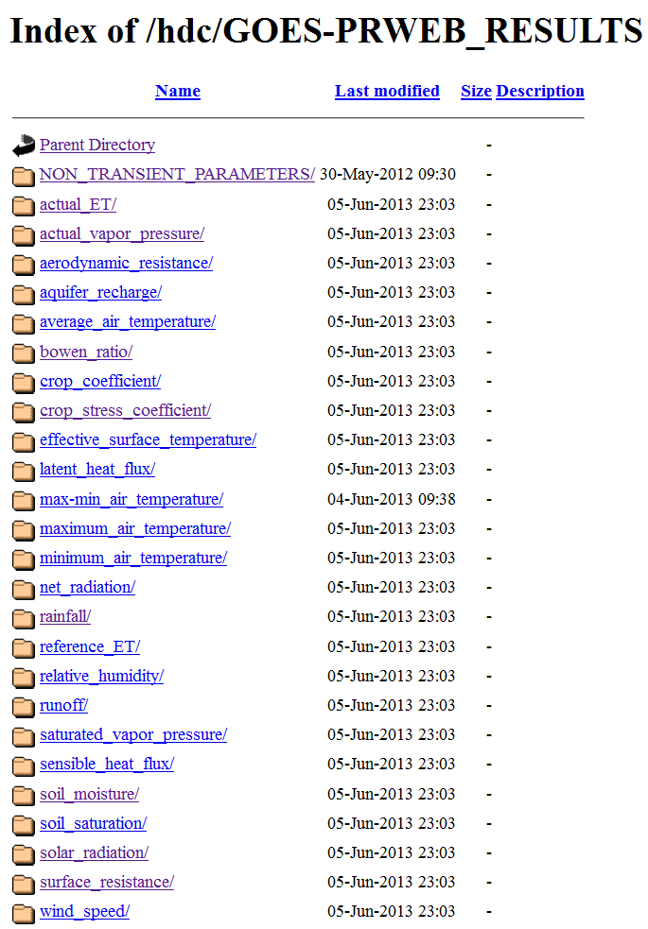
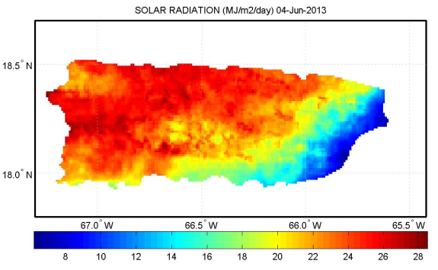
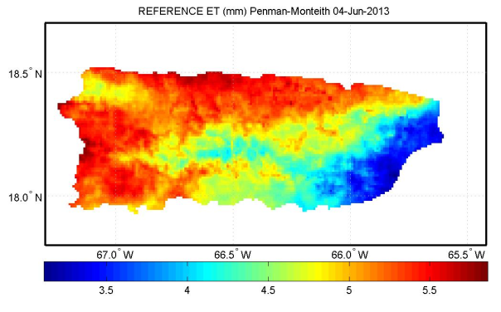
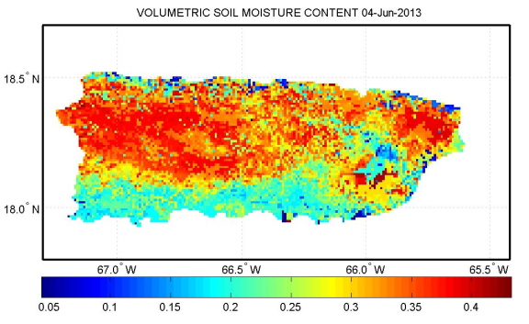
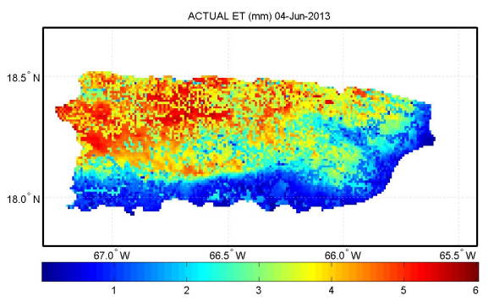
GOES-PRWEB
25 daily hydro-climate variables published to internet
Solar Radiation Reference Evapotranspiration
Soil Moisture Actual Evapotranspiration
June 4th, 2013

Slide 3
Objective
To show an agriculture application of GOES-PRWEB algorithm. Specifically:
A simple web-based method for scheduling irrigation

Slide 4
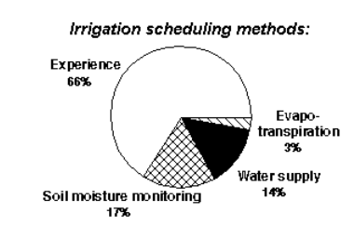
What is the problem?
There is anecdotal evidence that most farmers do not use scientific methods for scheduling irrigation
DEFINITION: Irrigation scheduling is the process used by irrigation system managers (farmers) to determine the correct frequency and duration of watering. (wikipedia.org)
Data from Idaho

Slide 5
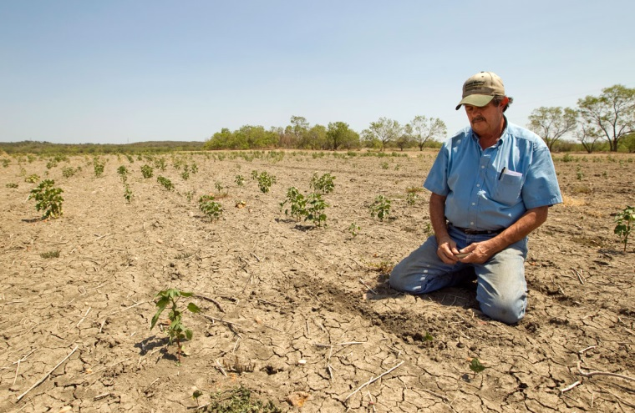
Why do we care?
Over application of water
Leads to the waste of
water
energy
chemicals
money
may lead to the contamination of ground and surface waters.
leaching of fertilizers past the root zone
water logging
lower crop yields.
Under-application of water
Lead to
crop water stress
reduced crop yields
loss of revenue to the grower
“I wish I would have applied more irrigation.”

Slide 6
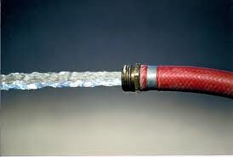
How much water and money are we talking about?

Slide 7
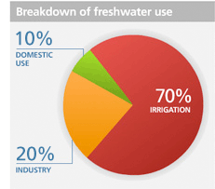
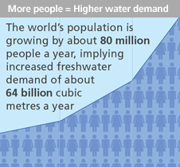
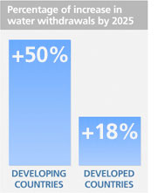
Global Agricultural Water Use
70% of all water withdrawn is used for agriculture and the majority of this water is used for irrigation.
Source of information: FAO

Slide 8
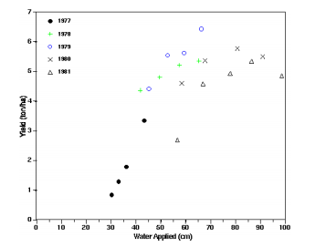
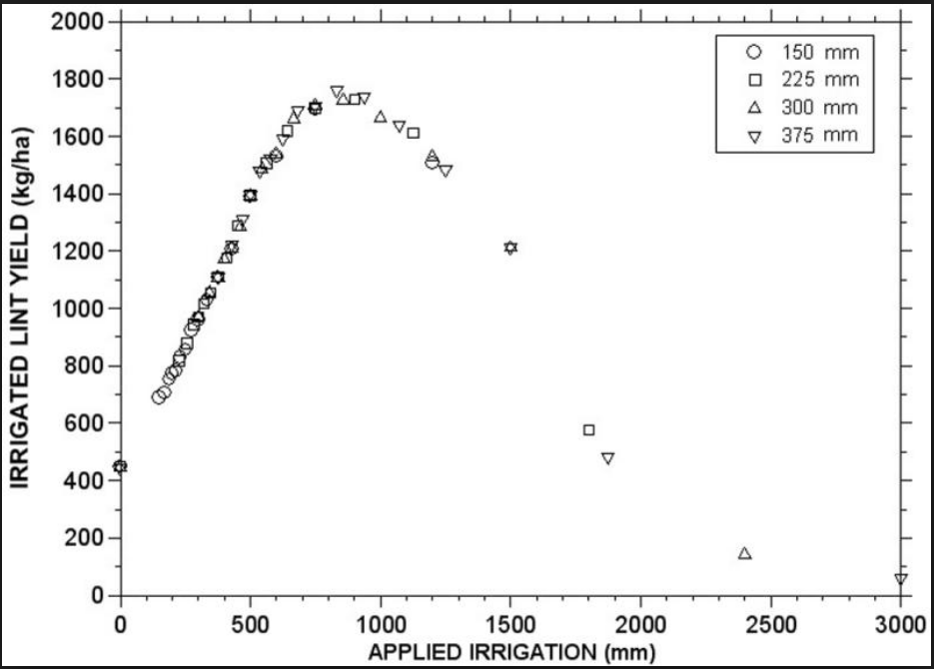
Crop Yield vs. Water Applied/used
Rice
Wheat
Corn
Cotton
Pepper

Slide 9
The Cost of Over-Applying Irrigation Water
Assume the following:
Small 10-acre farm grows squash (calabaza)
Four (4) month season
Estimated consumptive use (CU) for season = 500 mm
Actual potential CU for season = 400 mm
Overall cost of water = $30/acre-ft (considering only: cost of water and electricity)
Assume the normalized yield vs. CU curve in the next slide is applicable.
Value of a typical squash crop (net income)* = $1,243/acre.
*Conjunto Tecnológico para la producción de Calabaza, UPR Experment Station, Publication 155, revised 2012

Slide 11
Example continued
Results:
Excess water applied = 100 mm = 1.07 million gallons = 3 acre-ft (lost to groundwater)
Normalized CU = 1.25, therefore normalized yield = 0.9 (or 0.1 loss)
Potential $ LOST = cost of water + lost yield = 3 ac-ft x $30/ac-ft + [0.1*$1,243/ac] x 10 ac = $1,333
$13,330 for 100 acres, 10.7 million gallons of water
133,300 for 1000 acres, 107 million gallons of water
FYI: Typical cost of irrigaiton water in U.S. is $200 per ac-ft
If ag. chemicals are leached to groundwater , groundwater is potentially
contaminated (cost was not included in calculation).

Slide 12
Cost of Under-Applying Irrigation Water
Assume the following:
Same squash farm (10-acres)
Four (4) month season
Estimated CU for season = 300 mm
Actual potential CU for season = 400 mm
Assume the normalized yield vs. CU curve is applicable.
Value of a typical squash crop* = $1,243/acre.
*Conjunto Tecnológico para la producción de Calabaza, UPR Experment Station, Publication 155, revised 2012

Slide 13
Example continued
Results
Water deficit = 100 mm
With a normalized CU of 0.75, the normalized yield = 0.85 (or 0.15 loss)
Potential $ LOST = lost yield = [0.15*$1,243/ac] x 10 ac = $1,864
$18,640 for 100 acre
180,640 for 1,000 acre
$1,864 could pay your daughter’s university tuition or pay her rent for 6 months
(tuition is cheap in PR)

Slide 14
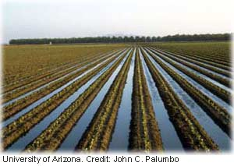
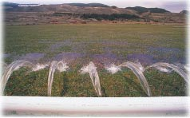
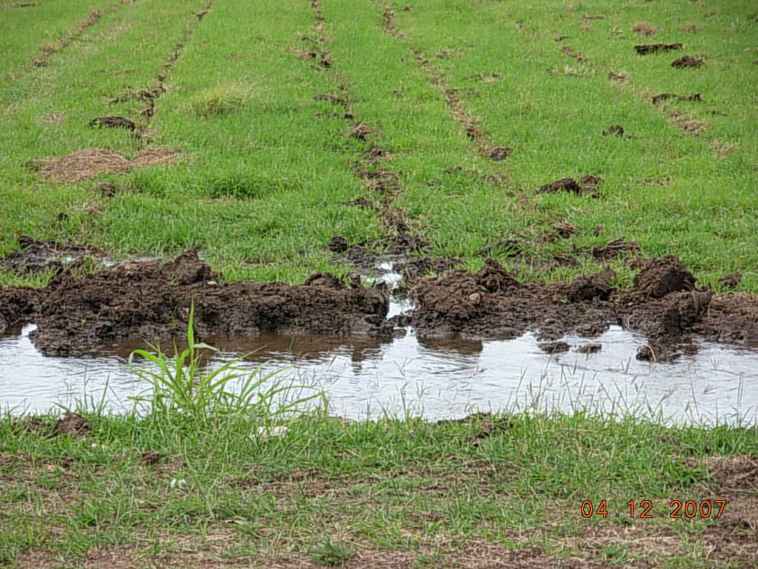
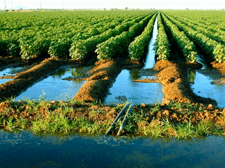
Surface Irrigation
Typical Irrigation Systems

Slide 15
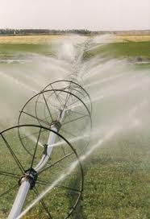
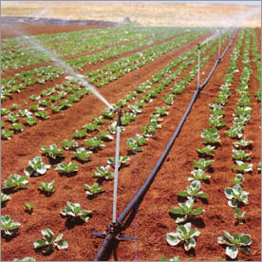
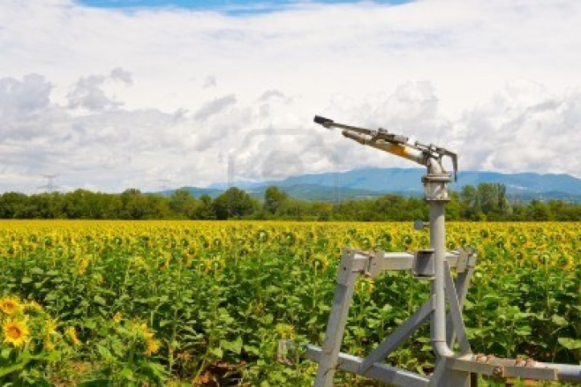
Sprinkler Irrigation

Slide 16
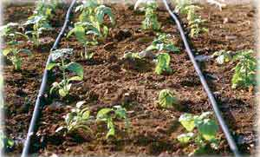
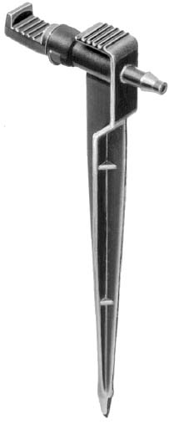
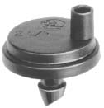
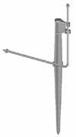
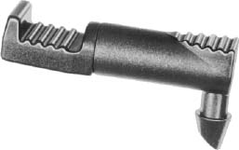
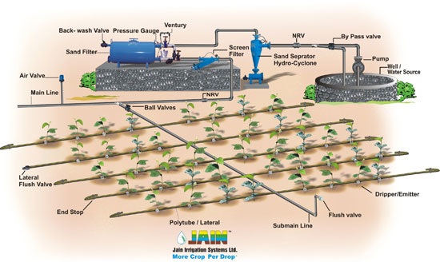
Drip Irrigation

Slide 17
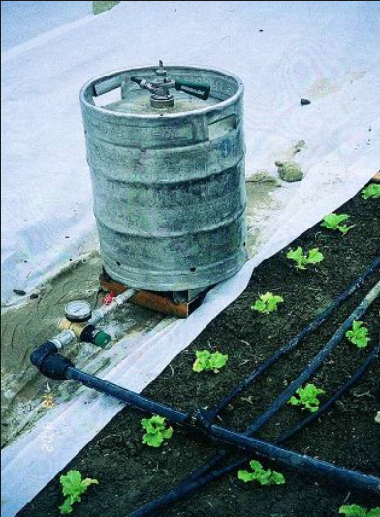
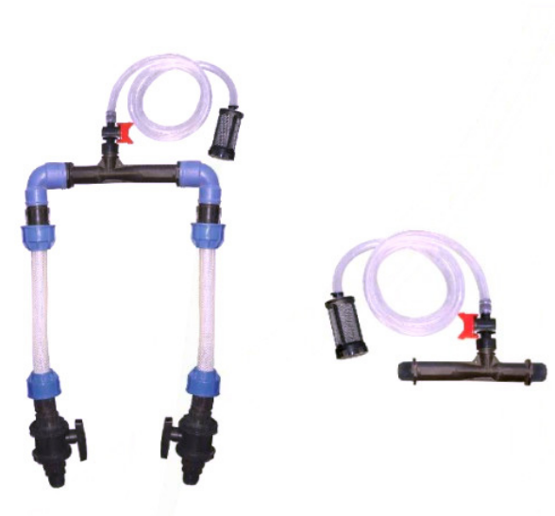
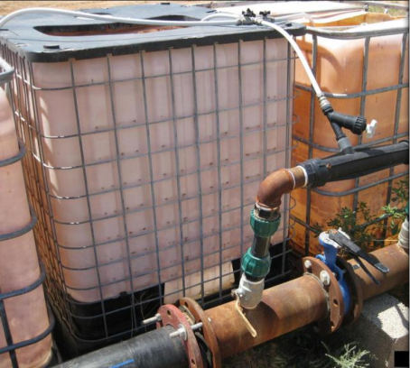
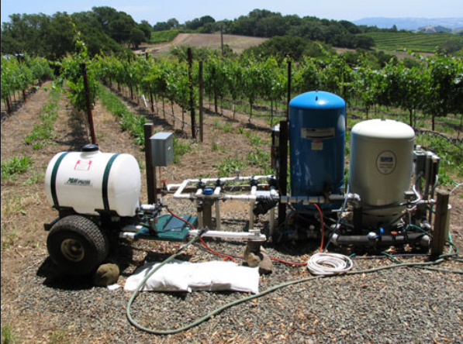
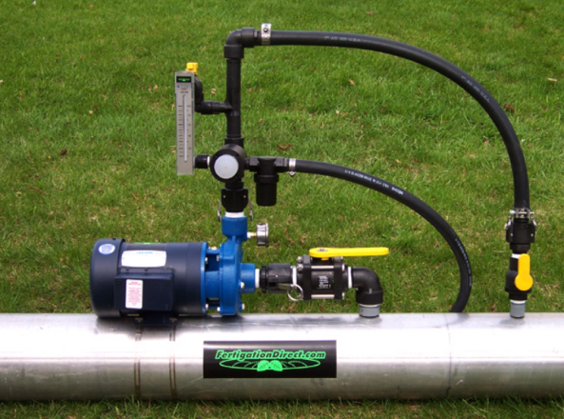
Fertigation

Slide 18
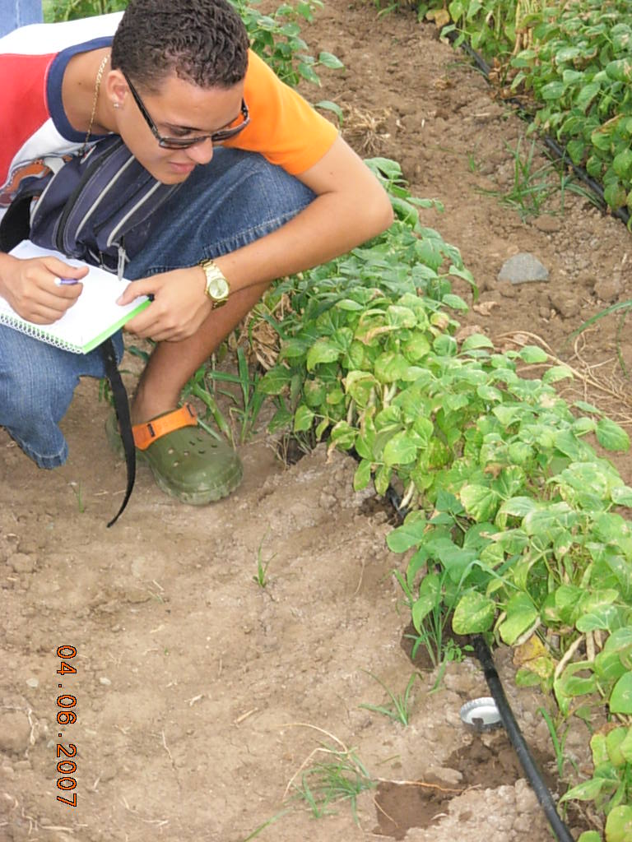
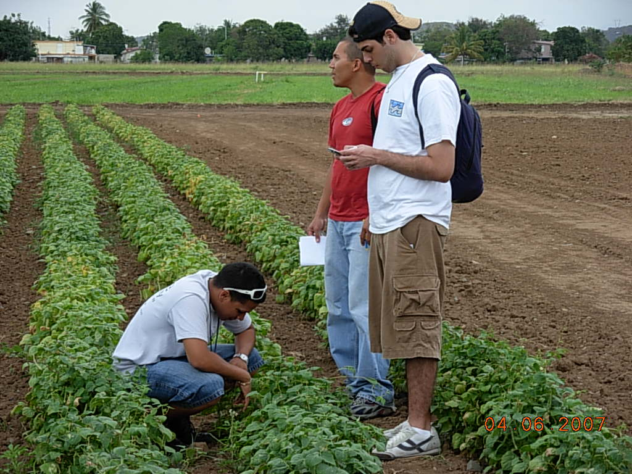
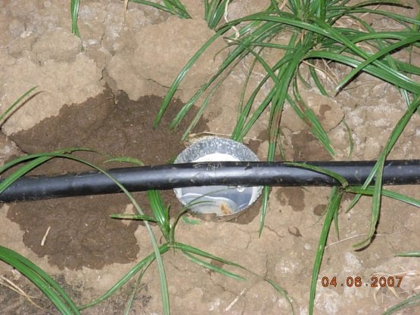
Drip Distribution Uniformity
Distribution Uniformity is critically important in Drip Irrigation
Why?
Sometimes a plant only has one emitter. If the emitter is plugged, then the plant may die.
If water is applied non-uniformly, then fertilizer will also be applied non-uniformly.

Slide 19
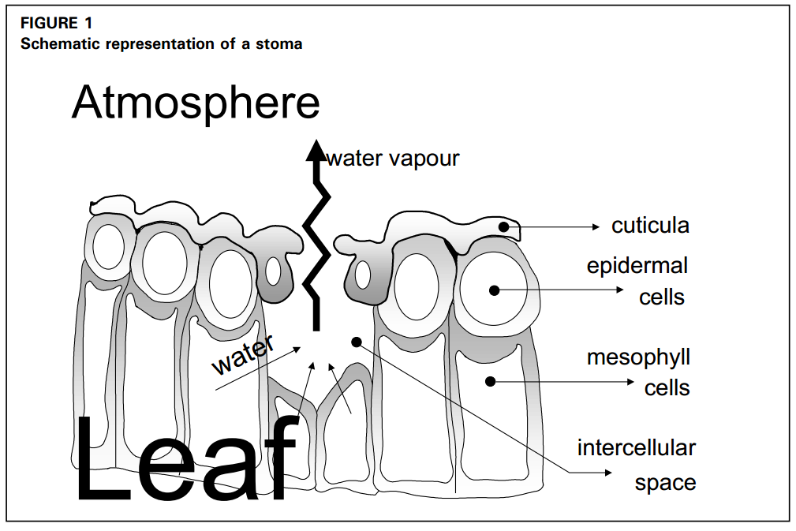
How much water should we apply?
Evapotranspiration = evaporation from soil and wet surfaces + transpiration from leaves
Evapotranspiration = plant water requirement

Slide 20
Determine Crop Water Requirement
ET = K_{c} ET_{o}
where
ET = evapotranspiration = crop water requirement = consumptive use (CU)
K_{c} = Crop Coefficient (unique for every crop)
ET_{o} = Reference Evapotranspiration (function of climate)

Slide 21
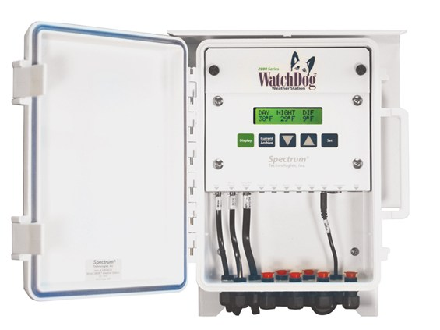
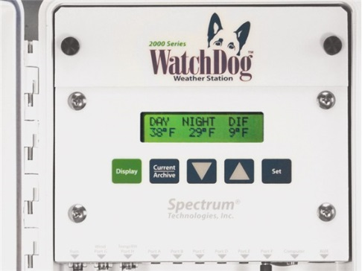
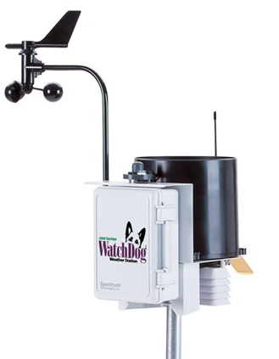
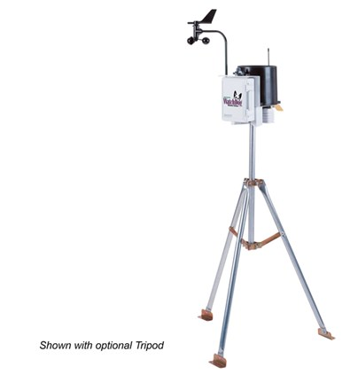
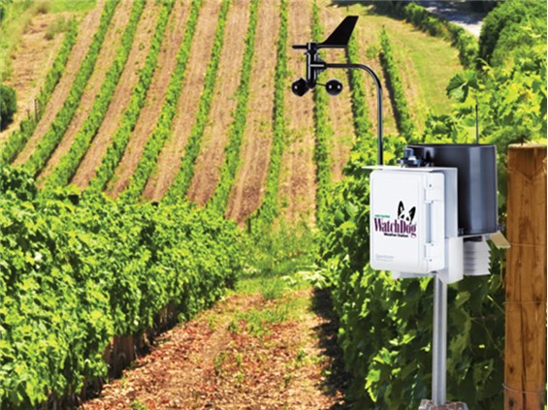
Many weather stations ($1,700 approx.) will calculate the daily reference evapotranspiration

Slide 22
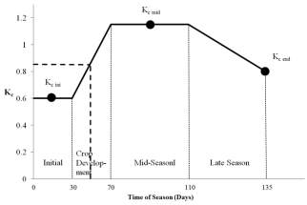
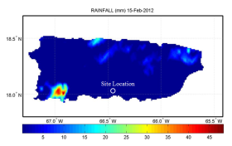
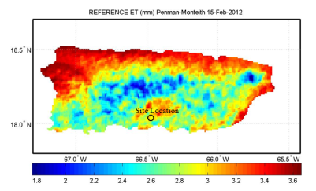
What if a farmer doesn’t have a weather station? Here’s a simple web-based method for scheduling irrigation
Determine average K_{c} for the time period
Determine rainfall
from onsite gauge or NEXRAD
Start
Define problem (location, farm size, crop, etc.)
Determine ET_{o}
Estimate Crop Water Requirement
ET_{c} = K_{c} ET_{o}
Determine the number of hours to run the pump
T = 17.817 x [D x A]/[Q x eff]
Harmsen E.W., 2012. TECHNICAL NOTE: A Simple Web-Based Method for Scheduling Irrigation in Puerto Rico J. Agric. Univ. P.R. 96 (3-4) 2012.

Slide 23
Detailed Example
Determine the irrigation requirement for the 5 day period, February 15-19, 2012, for a tomato crop in Juana Diaz, Puerto Rico. Table 1 summarizes the information used in the example problem. Table 2 provides the important web addresses necessary for obtaining data for use in the example problem. Table 3 shows the crop growth stage and crop coefficient (K_{c}) data for the example problem.

Slide 24
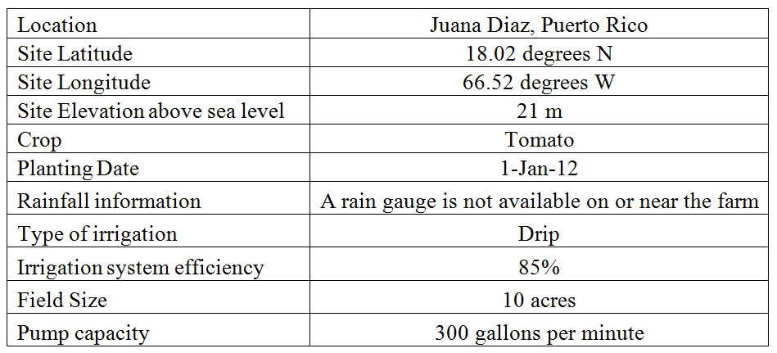
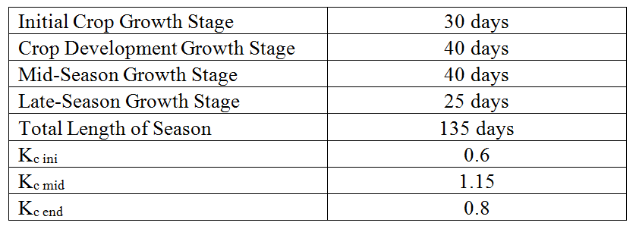
Table 1. Information used in example problem.
Table 2. Internet URLs for example problem.
Table 3. Crop growth stage and crop coefficient data for example problem.

Slide 25
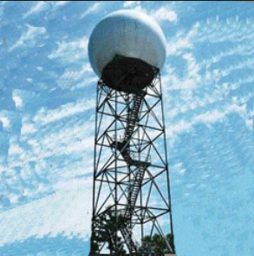
Rainfall
A rain gauge is not available on or near the farm; therefore, it is necessary to obtain rainfall information from NOAA’s MPE (NEXRAD and rain gauges in PR) radar. Inspection of the rainfall maps at the URL provided in Table 2 indicates that there was no rainfall during the five day period. Therefore, all of the crop water requirement will have to be satisfied with irrigation.

Slide 26
Crop Coefficient
The averge K_{c} value of 0.85 for the five day period was obtained.
Crop coefficient curve for the example problem. The heavy dashed line applies to the example problem with day of season 46-50 (i.e., Feb 15-19) corresponding to an approximate crop coefficient of 0.85 (vertical axis).

Slide 27
Reference Evapotranspiration (ET_{o}) from GOES-PRWEB algorithm
The next step is to determine the reference evapotranspiration (ET_{o}) for the five day period. The next slide shows the estimated reference evapotranspiration for Puerto Rico on February 15, 2012 obtained from the web address provided in Table 2.
The estimated ET_{o} for the site location on 15 Feb., 2012 is 2.95 mm.
Using a similar procedure, the ET_{o} values for Feb. 16, 17, 18 and 19 are 2.8 mm, 3.1 mm, 3.5 mm and 3.7 mm, respectively. Summing up the ET_{o} values comes to a total reference evapotranspiration (for the five days) of 16.1 mm.

Slide 28
Reference Evapotranspiration from GOES-PRWEB

Slide 29
Crop Water Requirement
The crop water requirement (ET) for the time period can now be estimated as follows:
ET_{c} = K_{c} ET_{o} = (0.85)(16.1 mm) = 13. 7 mm

Slide 30
Number of hours to run the pump to satisfy the crop water requirement
The final step is to determine the number of hours that the pump should be run to apply the 13.7 mm of water.
A form of the well-known irrigation equation (Fangmeier et al., 2005) can be used:
T = 17.817 x [D x A]/[Q x eff]
where T is time in hours, D is depth of irrigation water in mm, A is effective field area in acres, Q is flow rate in gallons per minute and eff is irrigation system efficiency.
Using D = 16.1 mm, A = 10 acres, Q = 300 gallons per minute and eff = 0.85, yields: T = 17.817 x [16.1 x 10] / [300 x 0.85]
= 11.25 hours.

Slide 31
In Conclusion
Many farmers do not systematically schedule irrigation
Application of the wrong quantity of water can lead to losses in water, fuel, chemicals, yield and money.
A simple web-based method was introduced for scheduling irrigation on farms without weather stations.
The approach presented here is relatively simple and the near-real time data is available to any farmer in Puerto Rico with internet access.

Slide 32
Future Work
Calibration of hydrologic components of GOES-PRWEB. Currently we are working on surface runoff, aquifer recharge and total stream flow.
Develop web tools to make the algorithm results easier for the public to use.
Adapt GOES-PRWEB to the island of Hispañola
Develop additional applications
Potential crop yield
Climate change evaluation

