Slide 1

Tropical Moisture Exports and Extreme Rainfall
Mengqian Lu and Upmanu Lall
Earth and Environmental Engineering, Columbia University, NY, NY, United States.
Columbia Water Center: Global Flood Initiative

Slide 2
Flood Risk and Changing Climate
Typical Hypothesis: Since the water holding capacity of the atmosphere increases with warming, extreme rain events will become more frequent
But where … and in which seasons?
Are most extreme floods over large basins due to local convection or large scale moisture transport?
What aspects of circulation are important for floods?
Specifically, what role is played by organized tropical moisture exports (TME)?

Slide 3
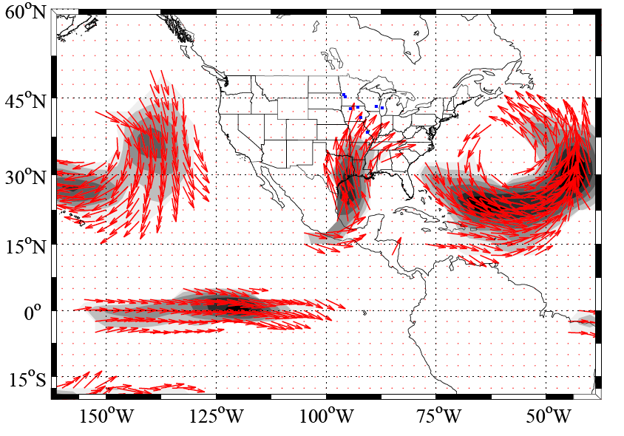
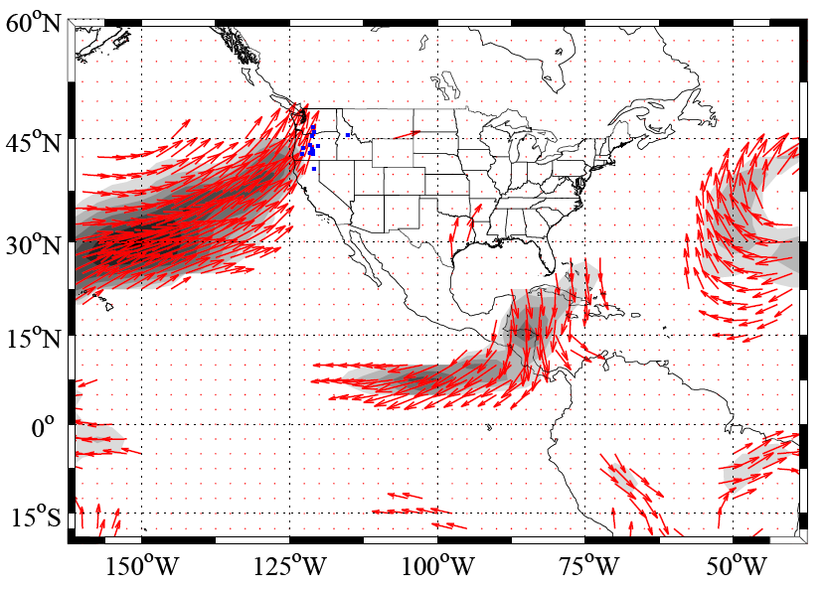
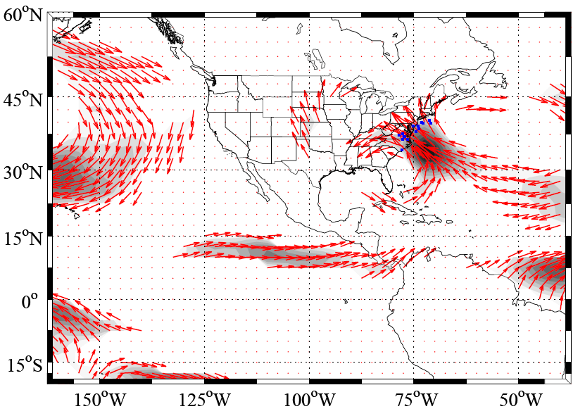
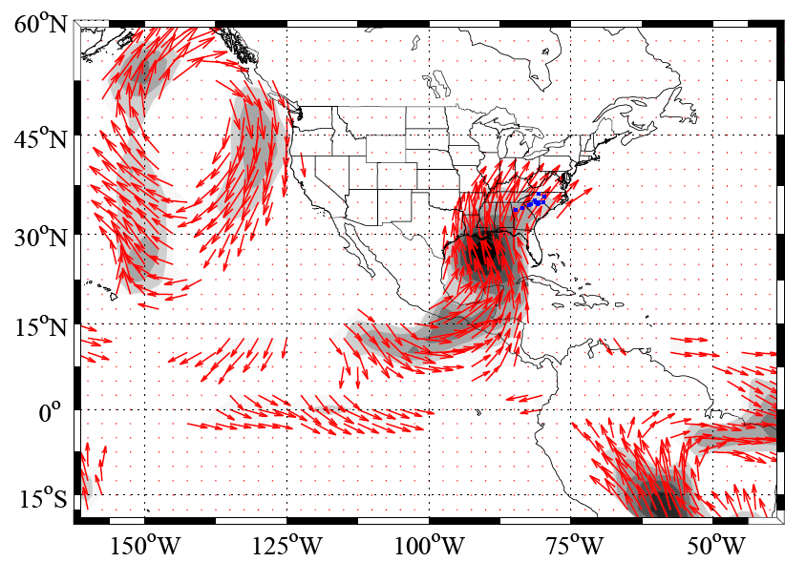
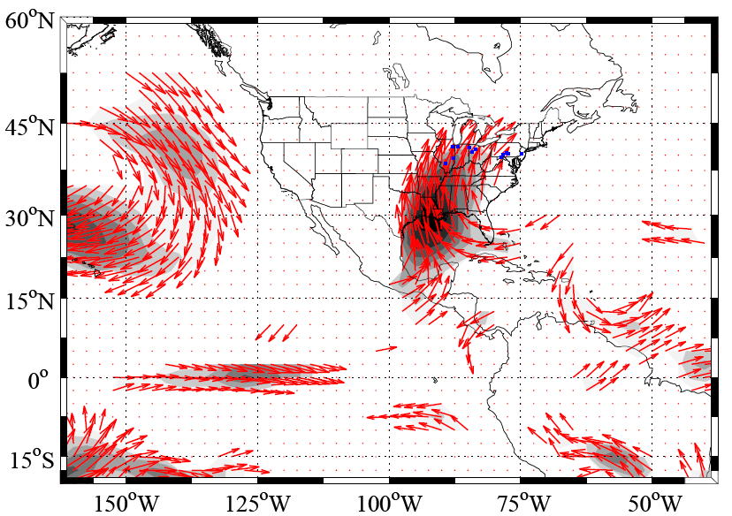
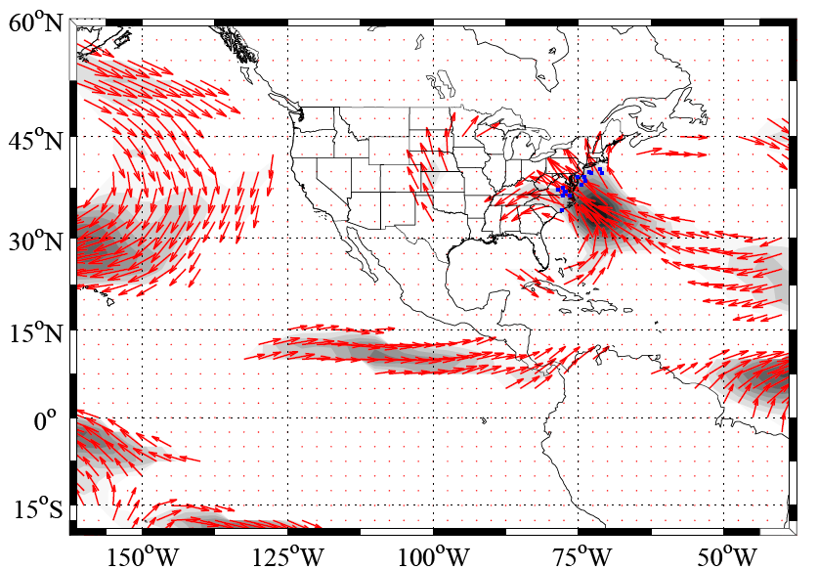
Av. Atmospheric Moisture Transport associated with the top 10 floods at different locations
Source: Hyun-Han Kwon
Columbia Water Center Global Flood Initiative

Slide 4
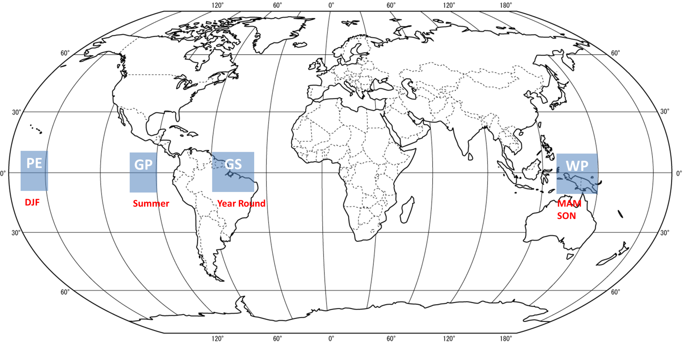
Major TME Source regions and their seasonality for N Hemisphere
1979-2011
Knippertz & Wernli 2010, 2013

Slide 5
A Flood in France & Germany in January 1995
Lu et al 2013

Slide 6
Lu et al 2013
The TME Train Day by Day

Slide 7
Daily TME’s entering the French region and associated Specific Humidity release for the French region
Lu et al 2013

Slide 8
17 Jan 1995 to 28 Jan 1995 mid-latitude daily SLP anomaly field evolution
Lu et al 2013

Slide 9
Leading PC modes of mid-latitude daily
January
Sea Level Pressure fields that are correlated with January rain in the French region
Diagnosed from MERRA January data excluding 1995

Slide 10
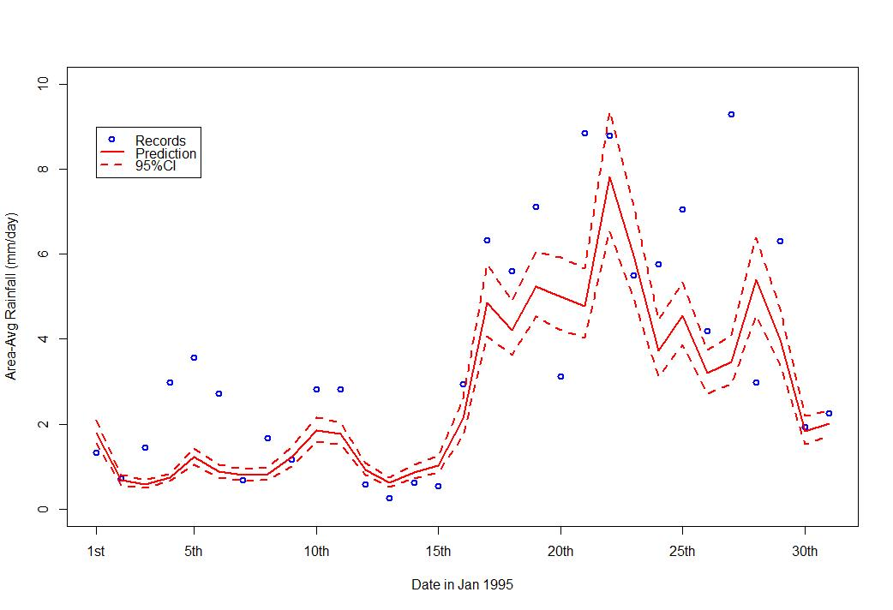
GLM based prediction of area averaged daily rainfall using SLP PC’s
Model built without using January 1995 data
53% variance explained in out of sample prediction
Lu et al 2013

Slide 11
Back to the USA…………
Where do the storm tracks for the N. E. USA come from?
1989-2010 data

Slide 12
Major TME Source regions and their seasonality for N Hemisphere
1979-2011
Knippertz & Wernli 2010, 2013

Slide 15
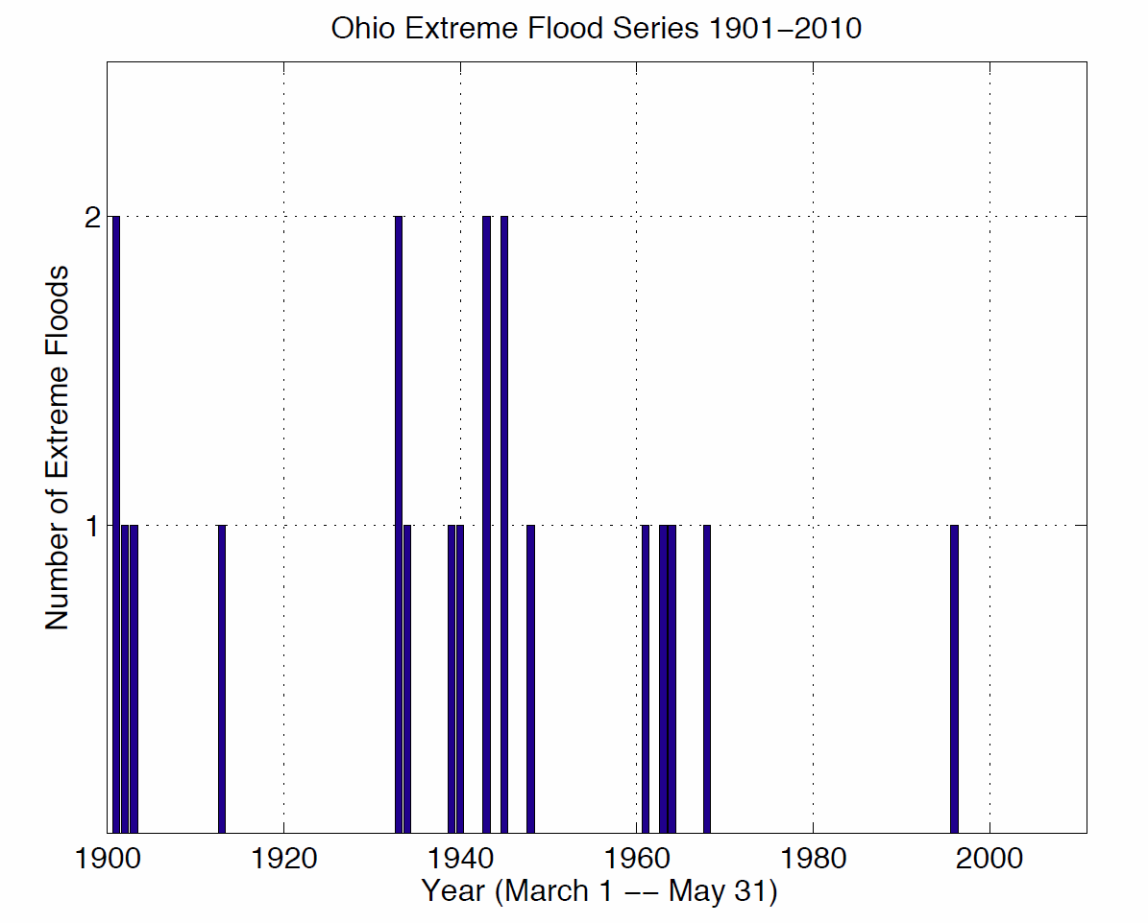
Floods exceeding the 10 year flood across Ohio River sub-basins
Robertson et al, 2013

Slide 16
Nakamura et al, 2013
Full field
Anomaly
(a) Vertically integrated 600 mb - surface moisture flux in kg m s⁻¹ (strongest 20 percent of values shown as arrows) and moisture convergence in gm⁻²s⁻¹ (contours) for drainage basins (size > 10³ km²) within the Ohio Valley averaged over the nine days leading to the 10-year flood.
Large-scale anti-cyclonic moisture flow & convergence (Bermuda High)

Slide 17
Nakamura et al, 2013
700 mb geopotential height anomalies (in m) in contours and vertical pressure velocity (in mb day⁻¹) colors (blue/purple is upward motion).
Left: 20 event average
Right: April 2011
The dipole pattern of a significant positive geopotential high anomaly to the east of the flooded basins together with a weaker but negative anomaly to the west, are established on day -9 and persist throughout the days leading to the flood event.

Slide 18
Summary
Our exploratory analyses suggest that persistent, consistent anomalous circulation and moisture transport patterns may determine large floods in a specific region ← implications for climate scenario “downscaling” and prediction.
Tropical Ocean moisture sources and associated circulation patterns that focus meridional transport into the US Midwest, along the East coast, and into N. Europe can be identified even across event composites. ← flood determinism ?
For such events, persistent wave like patterns and synoptic circulation types potentially related to ENSO and MJO activity may be identified ← Tropical SST/OLR Anomalies?
Short to medium range probabilistic forecasts of the extreme events, as well as seasonal stochastic simulation may be feasible, and are being explored.
Columbia Water Center Global Flood Initiative

