Slide 1
A short term rainfall prediction algorithm
Nazario D. Ramirez and Joan Manuel Castro
University of Puerto Rico
NOAA Collaborator: Robert J. Kuligowski
Other collaborators: Jorge Gonzalez from CUNY
Ernesto Rodriguez from NWS
The 8th NOAA-CREST Symposium, New York
June 5-6, 2013

Slide 2
Description of the problem
During the last decades there is a large motivation on determining the spatial variability of rainfall potentials with purpose of coupling a hydrological numerical model to predict flash flood.
There are physical and statistical models to predict the spatial rainfall distribution:
  Mesoscale numerical models:
    Base on dynamics and thermodynamic, balance of energy and momentum , etc.
  Statistical methods:
    Time series models, point processes, neural networks, Kalman Filter , and probability models.

Slide 3
Objectives
To develop a new algorithm for predicting one to two hours in advance the spatial distribution of rainfall rate.
To use time series models and radar (or satellite) data to predict rainfall rate.
Compare the performance of the proposed method with the performance of the WRF model.

Slide 4
General description
The introduced algorithm includes four major components:
    Detecting rainy cloud cells
    Estimating the cloud motion vector
    Predicting rainy pixels (expected rainfall area)
    Predicting rainfall rate (at the pixel level)

Slide 5
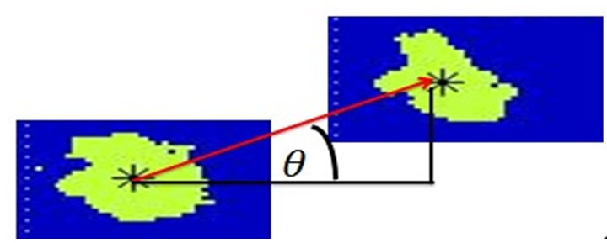




The cloud motion vector
$$m=\sqrt{{\left(Δx\right)}^{2}+{\left(Δy\right)}^{2}}$$
$$θ=\arctan\left(\frac{Δy}{Δx}\right)$$
$$t$$
$$t−1$$
The motion vector for a rainfall event that occurred on October 27, 2007 (at 19:15 and 19:30 UTC)

Slide 6
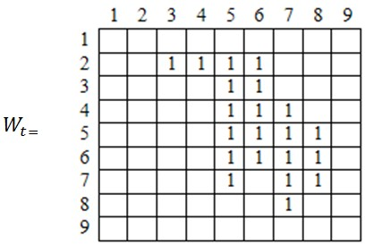
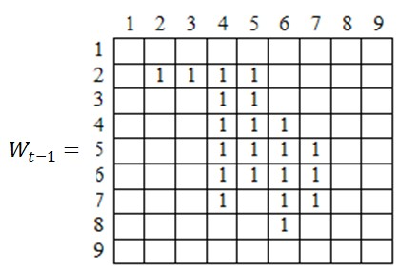
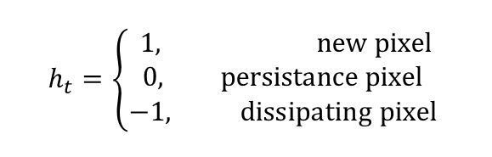
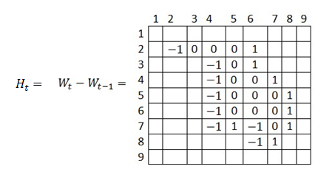
Stages of rainy pixels

Slide 7



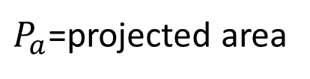

Projecting rainy areas
Clouds are assumed to be rigid objects that move at constant velocity.
The cloud motion vector is used to project the rainy pixels.
Potential rainy pixels
$P_{a}$=projected area
$$t+1$$
$$t$$

Slide 8
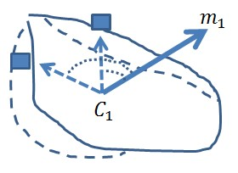
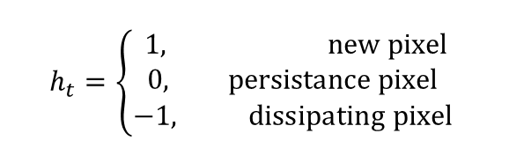
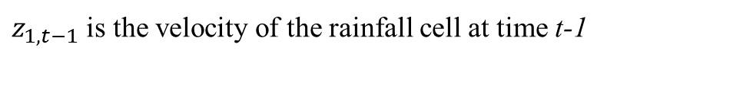

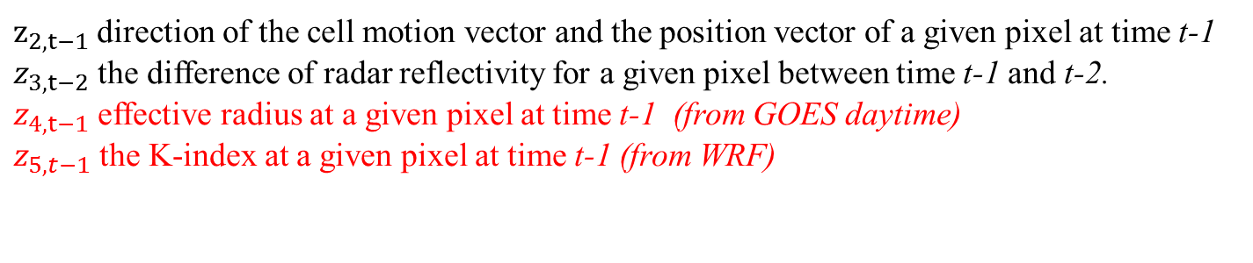
Identification of the rainy pixel stages
Training area
Prediction area
$$P_{e}=P_{t}∪P_{t−1}$$
$$P_{t+1}=P_{t}∪P_{a}$$
$$h_{t}=\left\{\begin{aligned}1, new pixel \\ 0, persistance pixel \\ −1, dissipating pixel \end{aligned}\right.$$
$$h_{t}=b_{0}+b_{1}z_{1,t−1}+b_{2}z_{2,t−1}+b_{3}z_{3,t−2}+ε_{t}$$
$z_{1,t−1}$ is the velocity of the rainfall cell at time t-1
$z_{2,t−1}$ direction of the cell motion vector and the position vector of a given pixel at time t-1
$z_{3,t−2}$ the difference of radar reflectivity for a given pixel between time t-1 and t-2.
$z_{4,t−1}$ effective radius at a given pixel at time t-1 (from GOES daytime)
$z_{5,t−1}$ the K-index at a given pixel at time t-1 (from WRF)

Slide 9
Lead time
Lead time = 30, 60, and 90 min
t-2
t -1
t
t+1
30
30
30

Slide 10
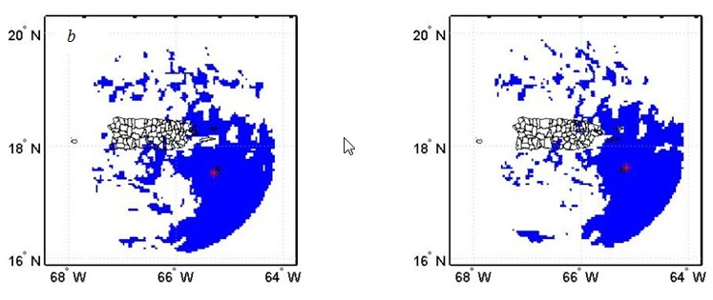
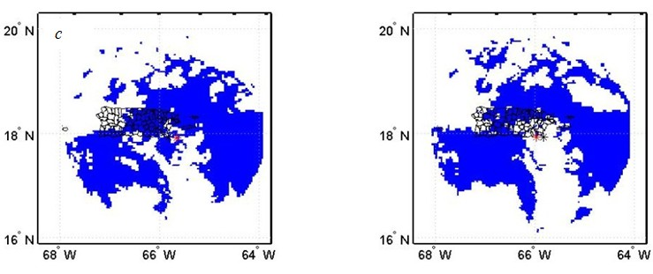
Prediction of rainy pixels
(only radar data)
60 min
Observed
Predicted
90 min

Slide 11
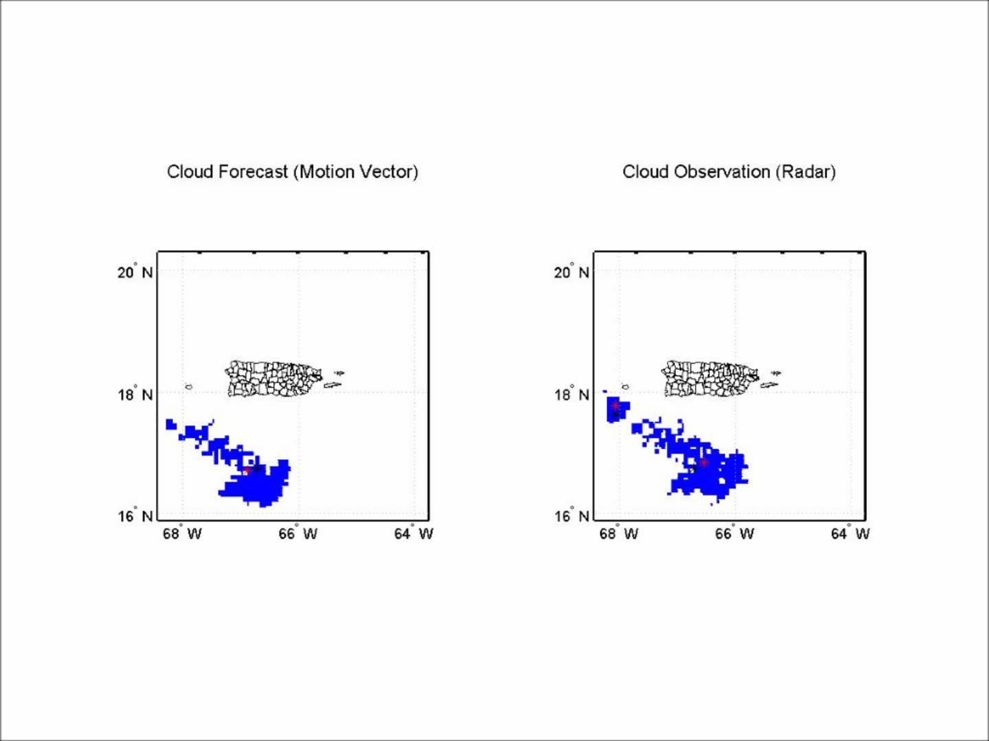
Rainfall event that occurred on April 17, 2003

Slide 12
Validation of rainy pixels (only radar data)

Slide 13
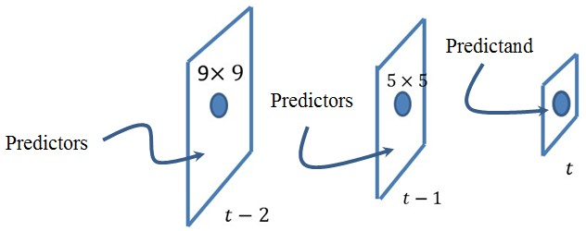
Rainfall prediction model

Slide 14

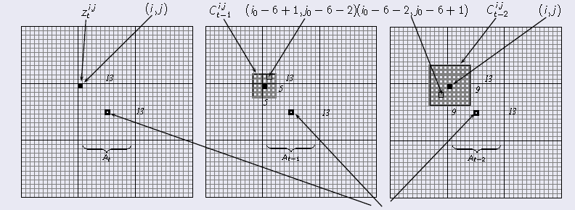
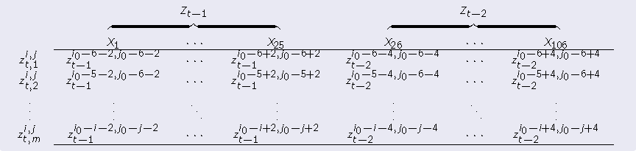
  Rainfall prediction model
Spatial and Temporal Predictors (Pixels)
169
Neighbor Rainfall Pixels Indicators with one and two lags (106 possible predictors)

Slide 15
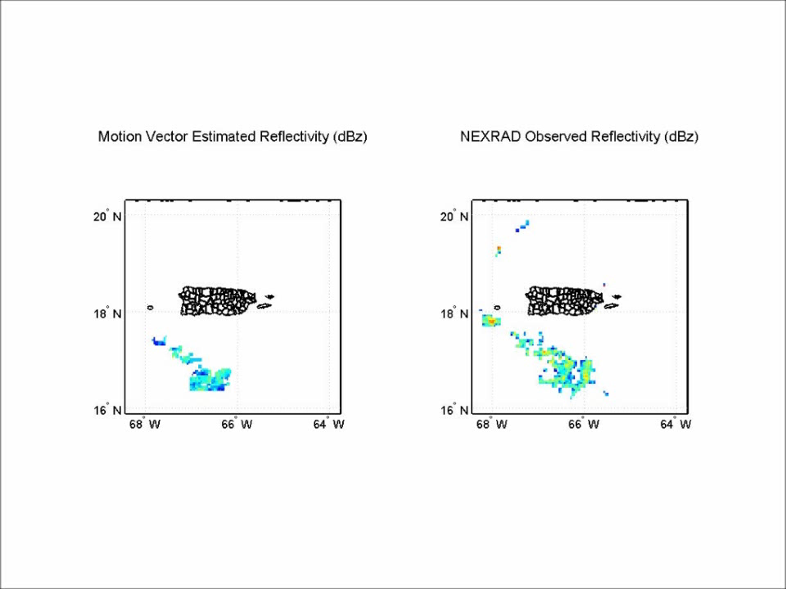
Rainfall event that occurred on April 17, 2003

Slide 16
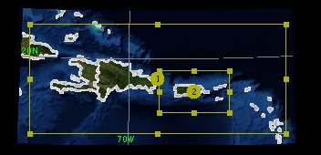
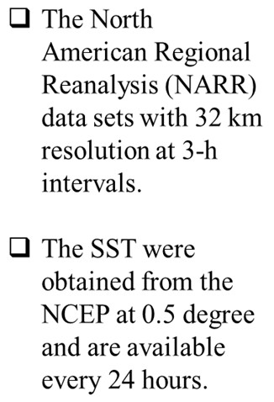
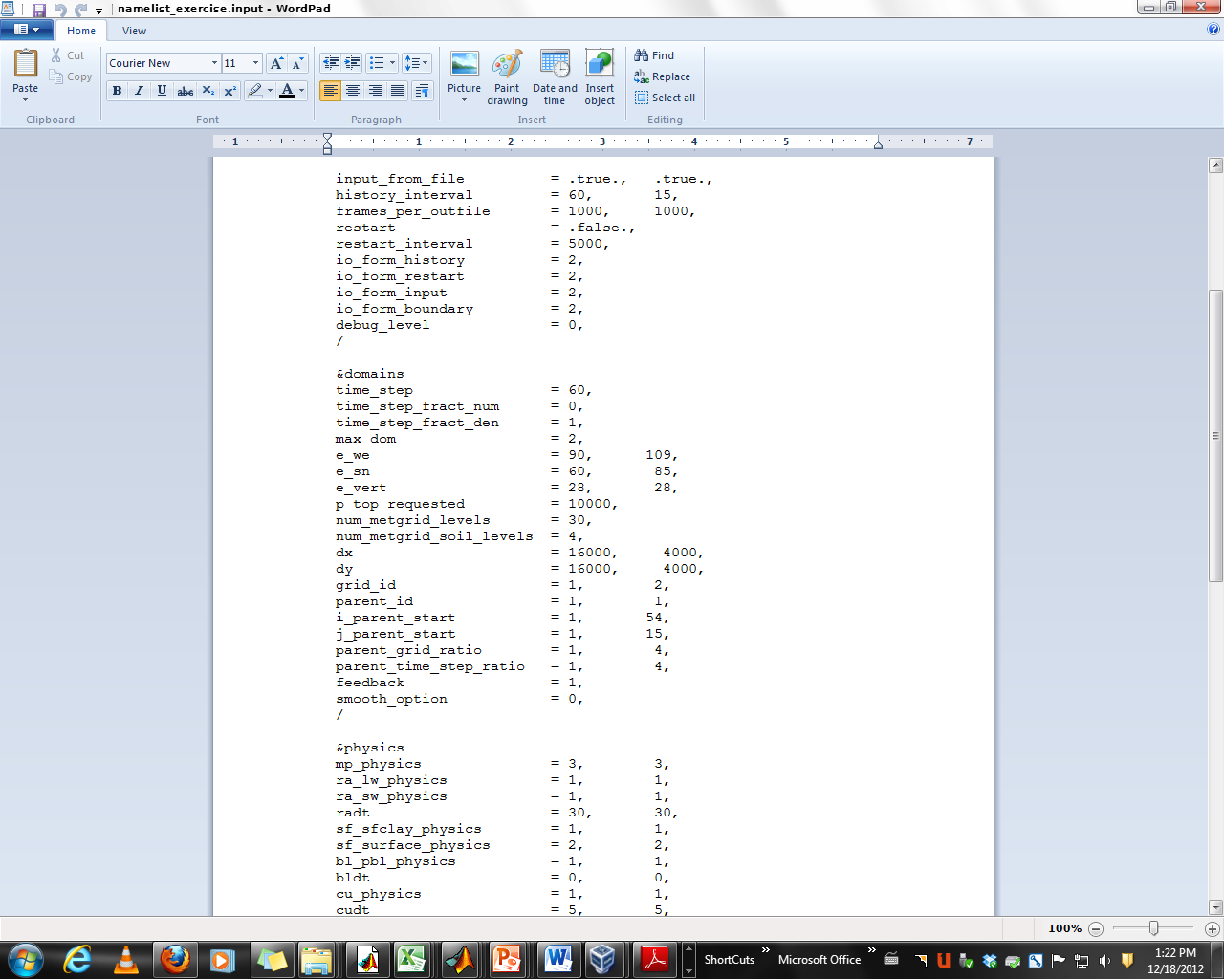
WRF Model Domain
to simulate Rainfall Events
Spatial Domains.
The Global Forecast System (GFS) is run four times a day and produces forecasts up to 16 days in advance, but with decreasing spatial and temporal resolution over time
WRF Domain Configuration

Slide 17
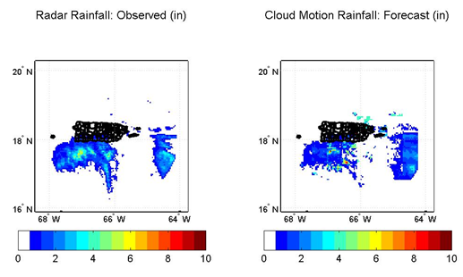
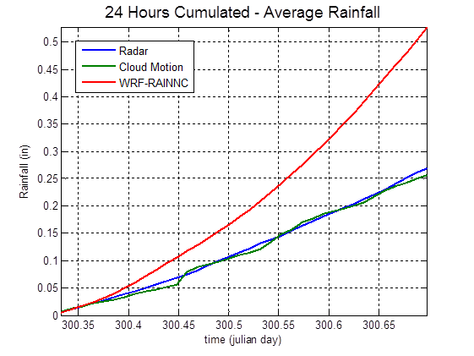
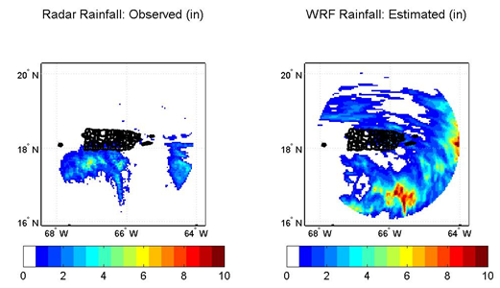
Results: 24 Hours Cumulated Rainfall

Slide 18
Summary and future work
Summary
  The algorithm includes a detection of rainy cloud cell and a cloud motion vector determination.
  The cloud motion vector is used to predict rainy pixels area.
  To properly represent the spatial variability the radar covered the radar area was divided into smaller regions and each region is used to develop a single regression model.
  The predictors are collected from the previous two rainfall images and forward selection algorithm is used to determine the best predictors in each region.
  The implemented lead time was 30, 60 and 90 minutes.
Future work
  Optimize WRF for the Puerto Rico climate conditions and
  Use a probabilistic approach to improve the detection of dissipating pixels

Slide 19
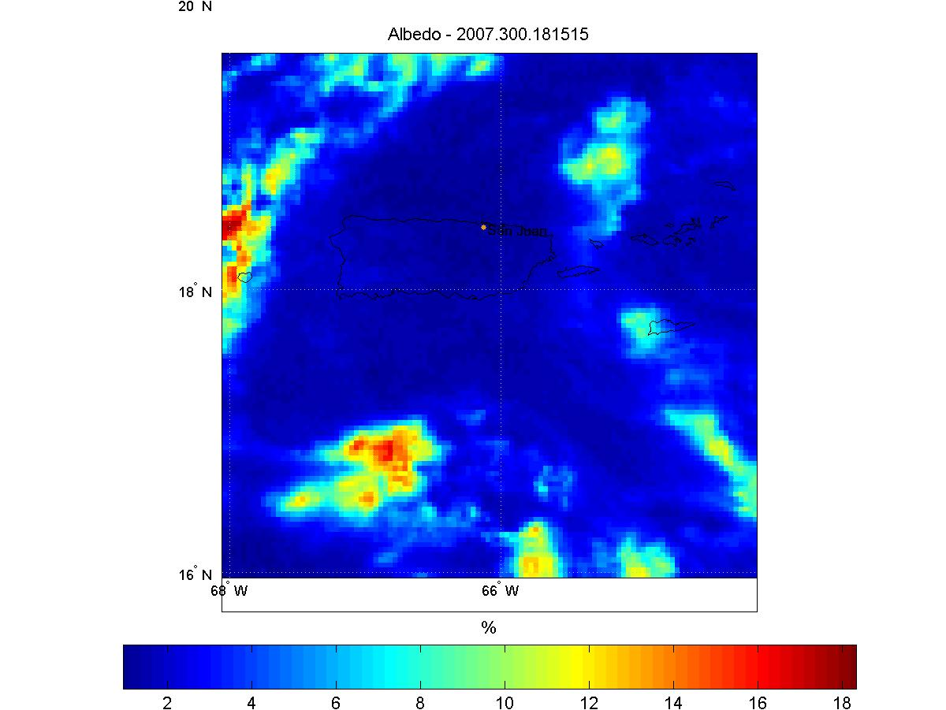
Albedo (3.9μm) (from GOES)
Albedo is estimated as follows:
  where:
    R_{3.9} is the observed radiance from band 2
    R_{e3.9} is the equivalent black body emitted thermal radiation at 3.9 microns for cloud at temperature T
    S is the solar irradiance of GOES 12
    α is the albedo at 3.9 microns
Albedo from
October 27, 2008 (18:35 UTC)

Slide 20
Effective radius and albedo computed from the lookup tables developed by Lindsey and Grass (2008).

Slide 21
Atmospheric instability
K-Index
$$k_{i,t−1}=\left(T_{850,i,t−1}−T_{500,i,t−1}\right)+T_{d850,i,t−1}−\left(T_{700,i,t−1}−T_{d700,i,t−1}\right)$$
K < 15 near 0% Air mass thunderstorm probability
15-20 <20% Air mass thunderstorm probability
21-25 20-40% Air mass thunderstorm probability
26-30 40-60% Air mass thunderstorm probability
31-35 60-80% Air mass thunderstorm probability
36-40 80-90% Air mass thunderstorm probability
K > 40 >90% Air mass thunderstorm probability

Slide 22
Acknowledgments
National Oceanic and Atmospheric Administration (NOAA)
  Grant # NA08NW54680043
  Grant #NA06OAR4810162

