Slide 1
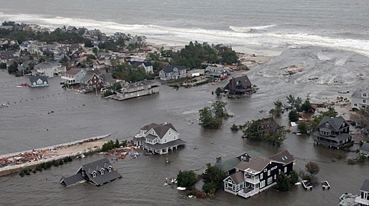
Preparation, Response, and Recovery – Early Lessons from the Response to Hurricane Sandy in New York City: From Climate Non-Stationarity to Policy Non-Stationarity
William Solecki, CUNY – Hunter College and co-Chair of NPCC
8th Annual NOAA‐CREST Symposium
Climate and Extreme Weather Impacts on Urban Coastal Communities
6 June 2013

Slide 2
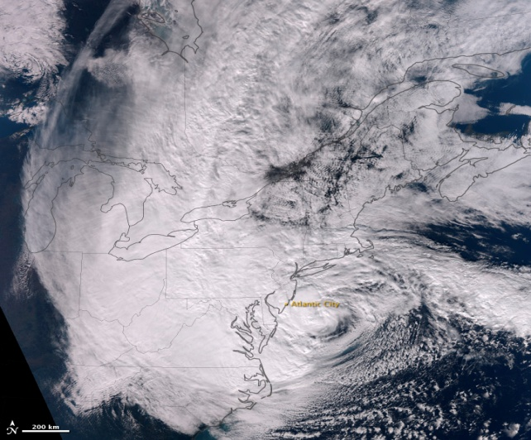
Hurricane Sandy, 28 October 2012
Source: NOAA

Slide 3
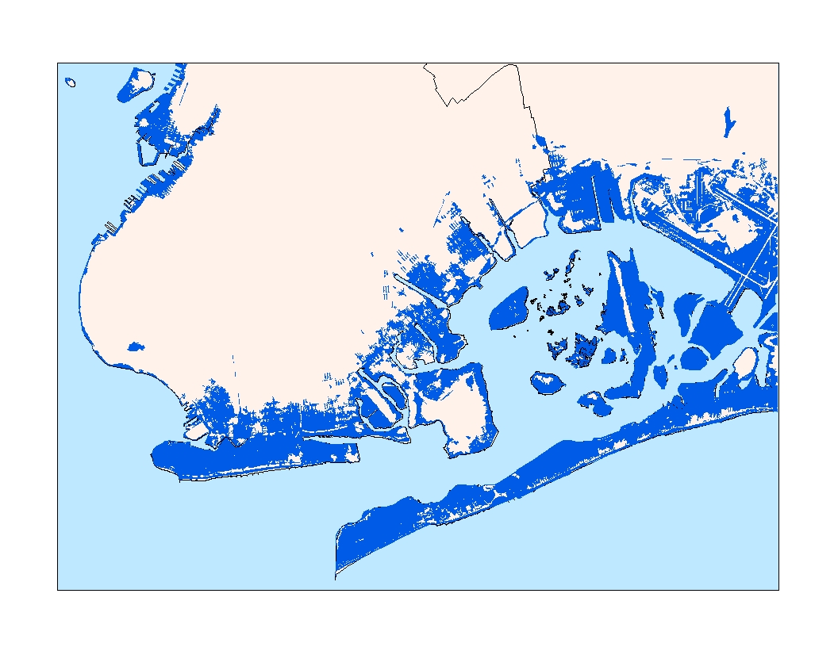
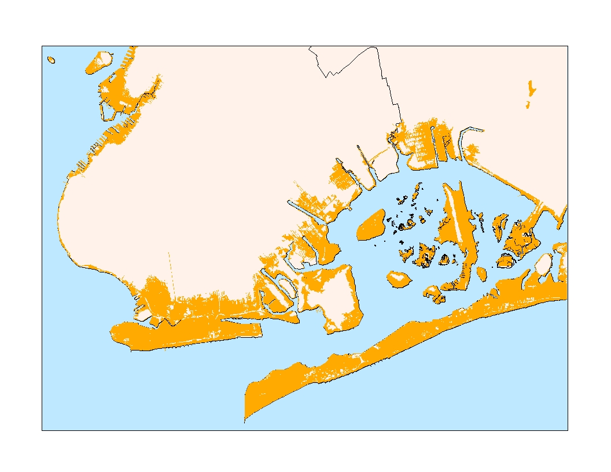
What Does Hurricane Sandy Mean?
New York City is prone to losses from weather-related disasters.
Top 10 in population vulnerable to coastal flooding
Second only to Miami in assets exposed to coastal flooding
What did it reveal about exposure and vulnerability?; What does it mean about disaster risk reduction and climate change adaptation?; Will it signal a change in policy?
Observed Inundation – Hurricane Sandy
NPCC RIM Scenario 2050s – 1% flood event with ~ two feet of sea level rise

Slide 4
Disaster Response and How Might Hurricane Sandy Points to Wider Transitions and Transformations
After a disaster, response typically is focused on addressing failures and cost-benefit calculations in the context of future risk probability
Hurricane Sandy response also is often discussed in the context of climate change
Movement from disaster recovery to disaster rebuilding and resilience
Change in conceptualization of extreme events
From discrete acute events to events as part of a chronic process
Looking into future dynamics as much as the present and past
The question is being asked whether climate change impacts will be like other urban environment-related crises

Slide 5
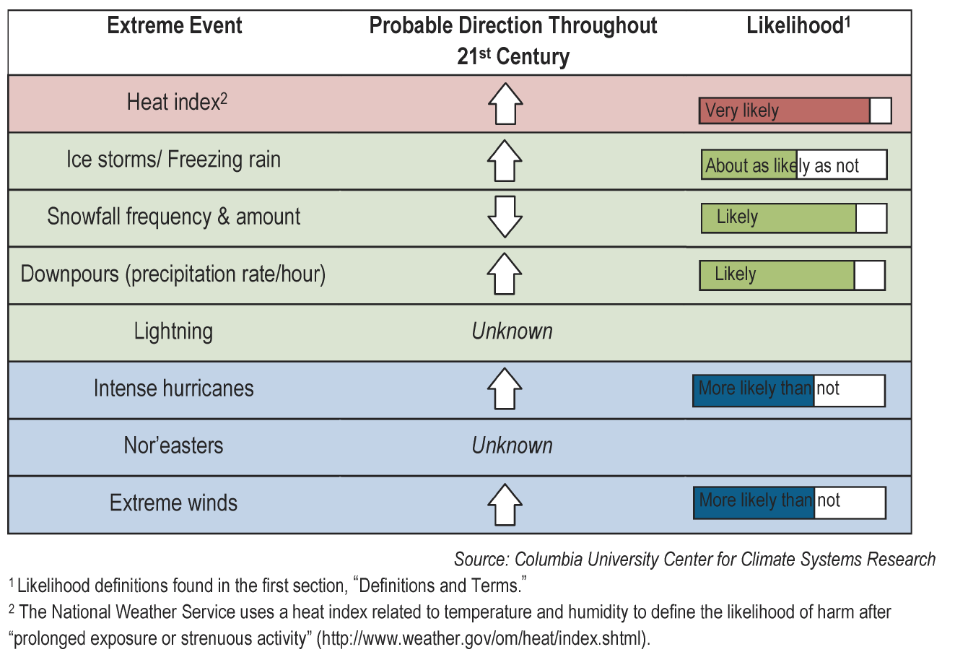
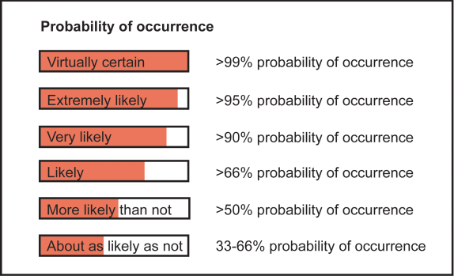
Extreme Events
New York City Infrastructure-shed
Quantitative Changes
The central range (middle 67% of values from model-based probabilities) across
the GCMs and greenhouse gas emissions scenarios is shown.
Qualitative Changes
Based on observations, model process studies, and expert judgment
 | Extreme Event | Baseline (1971- 2000) | 2020s | 2050s | 2080s
Heat waves & Cold Events | # of days/year with maximum temperature exceeding: 90°F | 14 | 23 to 29 | 29 to 45 | 37 to 64
 | # of days/year with minimum temperature at or below 32°F | 72 | 53 to 61 | 45 to 54 | 36 to 49
Intense Precipitation | # of days per year with rainfall exceeding: 1 inch | 13 | 13 to 14 | 13 to 15 | 14 to 16
Coastal Floods & Storms | 1-in-100 yr flood to reoccur, on average | ~once every 100 yrs | ~once every 65 to 80 yrs | ~once every 35 to 55 yrs | ~once every 15 to 35 yrs
 | Flood heights (in ft) associated with 1-in-100 yr flood | 8.6 | 8.8 to 9.0 | 9.2 to 9.6 | 9.6 to 10.5
Source: NPCC, 2010

Slide 6
More extreme events are going to occur in the future – How and what do we learn from them?; How can we encourage more profound learning?

Slide 7
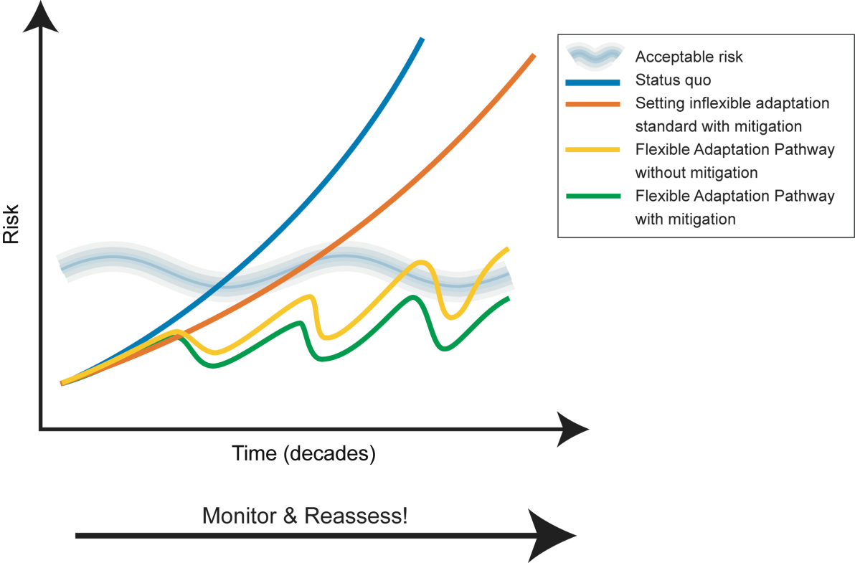
Flexible Adaptation Pathways
Role of extreme events forcing an exceedence of acceptable risk?
When does a risk become intolerable;
When does change exceed the adaptive capacity of the system
Graphic adapted from: Lowe, J., T. Reeder, K. Horsburgh, and V. Bell. "Using the new TE2100 science scenarios." UK Environment Agency.
Notes:
7

Slide 8
New York City Climate Adaptation Process
Mayor or City Official
High-Level
Buy-In
Critical Infrastructure
Coordinating Role
City-wide Sustainability Office
Stakeholders
City Agencies
Regional Authorities
Private Corporations
New York Panel on Climate Change
University scholars and private sector experts
Social, biological, and physical scientists
Legal and insurance experts
Risk management professionals
E
Stakeholder Task Force
T
Expert Panel
P
C
W
W
Climate Risk Information
Adaptation Assessment Guidelines
Climate Protection Levels
Integration across Sector-specific Working Groups
Energy (E) - Transportation (T)
Policy (P) -Water & Waste (WW)
- Communications (C)
Source: NPCC, 2010

Slide 9
Post Sandy - All Resilience (Adaptation) Approaches Reviewed
Large scale, hard infrastructure
Small scale, hard infrastructure
Large scale, soft infrastructure (ecosystem services)
Small scale, soft infrastructure (ecosystem services
Large scale policy shifts
Small scale policy shifts

Slide 10
NYC Special Initiative for Rebuilding and Resiliency
Addresses how to rebuild New York City to be more resilient in the wake of Sandy but with a long‐term focus on:
1) how to rebuild locally; and
2) how to improve citywide infrastructure and building resilience
A comprehensive report that will address these challenges by investigating three key questions:
What happened during and after Sandy and why?
What is the likely risk to NYC as the climate changes and the threat of future storms and severe weather increases?
What to do in the coastal neighborhoods and citywide infrastructure
Report to be released later this month

Slide 11
Post Hurricane Sandy Adaptation Emerging Challenges and Opportunities
Baseline climate science data (and modeling if possible)
Rapid assessment strategy of impacts, vulnerabilities, opportunities for increased resiliency
Long term goal (e.g. resilience) as frame for action
Interagency cooperation (within govt. and across governments)
Integrate new risk and hazard measures
Climate protection levels – access codes, standards, and regulations, and monitoring and indicators for climate change robustness
System perspective – identify tipping points/cascade impacts and vulnerabilities
Better understanding of the climate science data, mapping uncertainties, and cost estimates
Promote greater post extreme event learning – pushing open the policy window

Slide 12
Policy in a Post Sandy New York City
Transitions in Equilibrium State (Line) Response to Different Types of Perturbations
Affecting an almost linearly responding system
Across a non-catastrophic threshold
Across a catastrophic bifurcation threshold to alternative stable state (a critical transition)
Large external change
System State
a.
Conditions
Small forcing
System State
System State
F2
F1
b.
c.
Conditions
Conditions
Adapted from Scheffer 2009

Slide 13
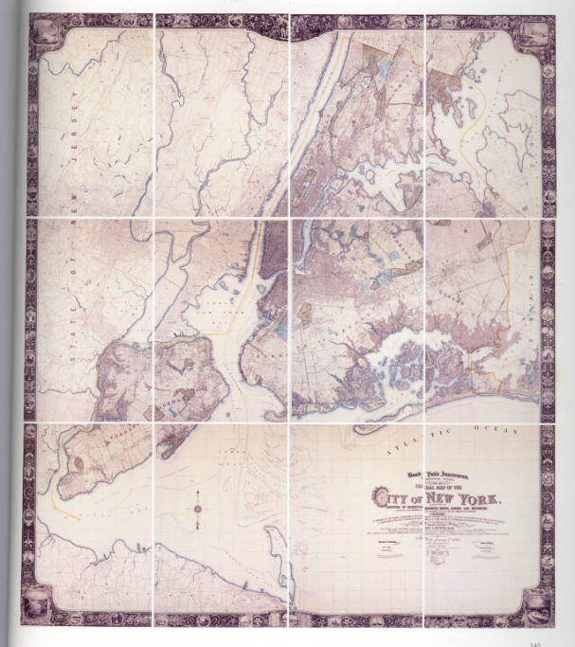
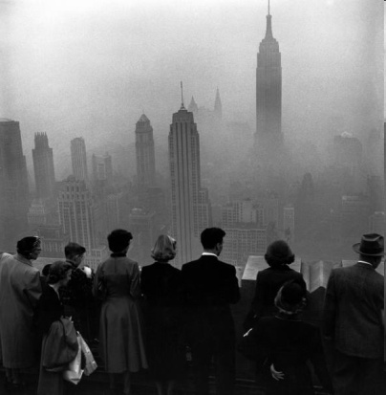
Environment Crises and Urban Transitions New York City Examples, Evidence, and Consequences
Water quality and supply - 1830s
Croton Reservoir System
Fostered rapid urbanization
Open Space and Recreation -1850s
Central Park and Playground Movement
Property value shifts/amenity sinks
Public Health and Sanitation – 1870s
Professional of waste and trash management
Pollution of waterways/distant dumping
Mobility and Congestion – 1910s
Regional Plan Association and Robert Moses Highways
Automobile dependency and sprawl
‘Urban Renewal’/Loss of Community – 1950s
Environmental impact statements and historic preservation
Property value shifts/investment delays
Air Pollution – 1960s
State, Federal Legislation
Transfer of polluting facilities out of region
Climate Change
2010s?
Looking south over Central Park in 1861
What evidence of a transition can be found
and warning signals
New York City Environs - 1900
Smog - November 1953

Slide 14
Some Conclusions
What Can We Learn from Urban Environmental Crises and Transitions?
Take a long time to time, define, and understand
Crises emerge from underlying tensions with society – poverty, lack of access to resources, pressures for economic development
Resolutions often push the problem away in time and space; foster the development of other crises in the future
Things frequently get worse before they get better

Slide 15
Year | Event | Knowledge | Action | Policy Shift
1996 |  | Baked Apple Report
1997
1998
1999 | Hurricane Floyd | Hot Nights in the City Report
2000
2001 | 9/11 | Climate Change in a Global City: MEC Report
2002
2003
2004
2005
2006 |  |  | PlaNYC 2030 released | Climate Change Mitigation
2007 | August 8 downpour ; other rain events | August 8 Storm Report |  | Include Climate Change Adaptation
2008 |  | Climate Change Program Assessment and Action Plan | Storm Water Management Plan released; NYC Panel on Climate Change created; NYC Adaptation Taskforce created | Risk-based management; flexible adaptation
2009
2010 |  | New York City Panel on Climate Change; NYS Sea Level Rise Taskforce Report | Green Infrastructure Plan Released; NYC Green Codes Taskforce report released | Climate Adaptation to Climate Resilience
2011 | Hurricane Irene | NYS ClimAID Report | PlaNYC 2.0 released; NYC Comprehensive Waterfront Plan released
2012 | Hurricane Sandy |  | Hazard Risk Model report to be released
2013 |  | NPCC2 CRI; SIRR Released
Climate Change Activities and Transitions in New York City

Slide 16
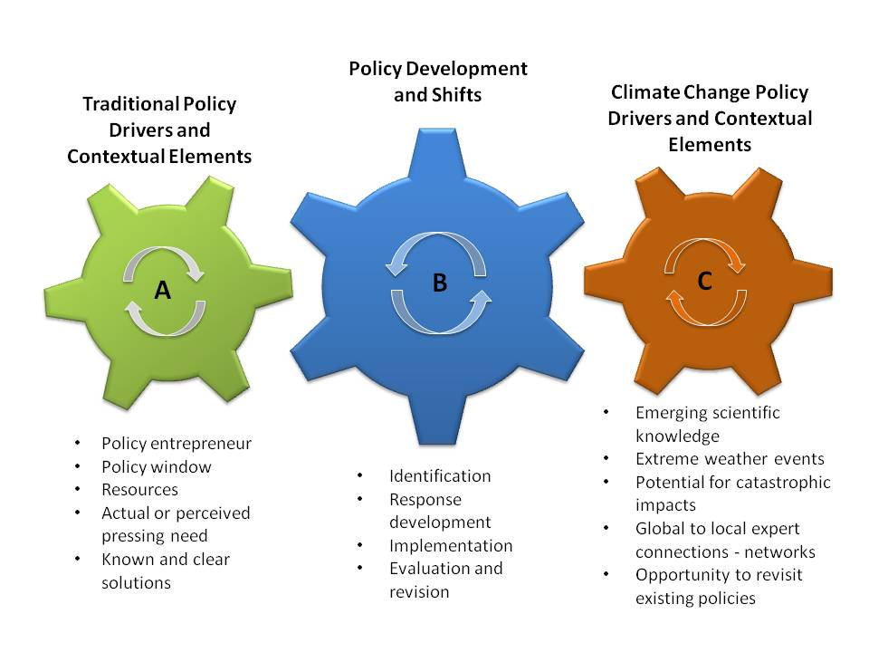
(Solecki et al. 2013)

Slide 17
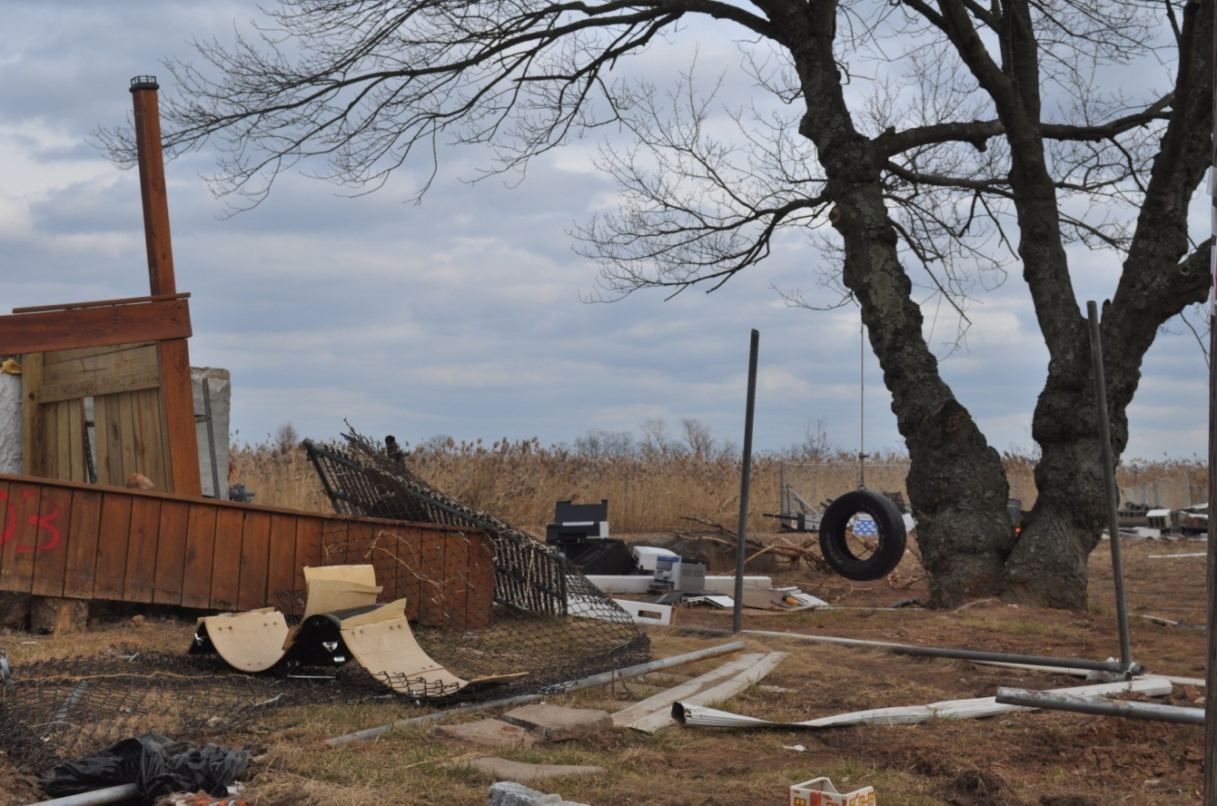
Conclusion – Hurricane Sandy Seems to be Ushering in a New Era of Disaster Risk Reduction-Climate Change Adaptation Dialogue. Many challenges lie ahead for a non-stationary climate policy
Hurricane Sandy Damage in Oakwood Neighborhood Staten Island (photo source F. Montalto)

Slide 18
Thank You.
Wsolecki@hunter.cuny.edu

