Slide 1
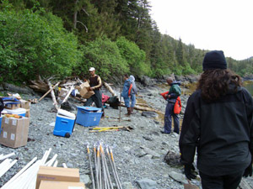
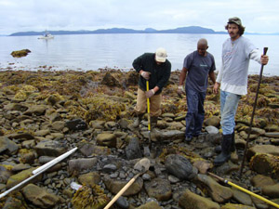
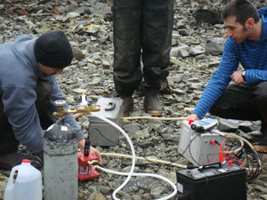
EVALUATING IMPACTS OF CLIMATE CHANGE AND HURRICANES ON SECONDARY PRODUCTION OF COASTAL EMBAYMENTS 8th Annual NOAA-CREST Symposium
Michael P. Weinstein
Center for Natural Resource Development and Protection
New Jersey Institute of Technology
Newark, NJ
5 June 2013
Center for Natural Resource Development and Protection

Slide 2
NRC Committee for U.S. ARMY CORPS OF ENGINEERS:
Reducing Coastal Risks from Climate Change Impacts
1. What RISK-REDUCTION STRATEGIES and DESIGN STANDARDS
have been Used?
Have they PROVEN EFFECTIVE in ECONOMIC, HUMAN
SAFETY, and ENVIRONMENTAL TERMS?
3. What are IMPLICATIONS OF EXPANDING THE EXTENT AND
LEVEL OF COASTAL STORM PROTECTION; e.g., Operations and
Maintenance Costs, Sediment Availability and Dynamics?
4 How do RISK-RELATED PRINCIPLES Contribute to Design
Standards for Coastal Risk Reduction?
Do these Principles Improve the ABILITY OF COASTAL
COMMUNITIES TO PREPARE for Coastal Storms and Sea Level Rise?
6. How might these Principles be used to GUIDE INVESTMENTS in U.S.
Coastal Risk Reduction?
Risk Assessment - Addresses the Likelihood and Magnitude of an Environmental Effects Event, Based on Vulnerabilities within the Boundaries of the Ecosystem and the Zone of Influence of the Drivers.
Also Identifies the Consequences of not Taking Appropriate Management Action to Avoid the Effects in Terms of Ecological, Social, Cultural, and Economic Impacts as well as Institutional Policy and Governance Repercussions.
Cormier et al. 2013

Slide 3
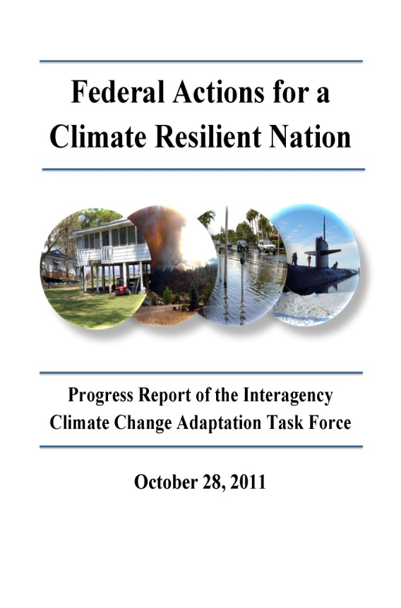
Federal Actions for a Climate Resilient Nation, Progress Report of the Interagency Climate Change Adaptation Task Force, October 28, 2011
Develop Strategies for Safeguarding our Nation’s Oceans,
Fish, Wildlife, and Plants
PROTECT WETLANDS from Sea Level Rise;
Use Coastal Wetlands, Shellfish Beds, etc as
“Green” Infrastructure Storm Buffers;
3. Inland Wetlands act as ‘Retention’ Basins.
Protect those HABITATS THAT CONTRIBUTE TO THE
SUCCESS OF NATION’S FISHERIES:
DISTRIBUTION AND PRODUCTIVITY OF FISH,
Invertebrate, and Plant Species are SHIFTING IN
RESPONSE TO WARMING Ocean Waters
Evaluate Impacts of Warming Temperatures and
FRESHWATER FLOW

Slide 4
In July 2010, President Obama signed Executive Order 13547, Established the National Policy for Stewardship of the Ocean and Coasts, as well as the National Ocean Council (NOC) to advance the Policy:
NOC is Currently Developing a Strategic Action Plan for Resiliency and Adaptation to Climate Change and Ocean Acidification:
Use the Best-available Science for the Development of Climate
Change VULNERABILITY ASSESSMENTS using ECOSYSTEM
BASED MANAGEMENT Strategies;
Ecosystems are Already Significantly Impacted by Climate
Change: Large-scale Shifts in SPECIES RANGES, INVASIVE
SPECIES, AND HABITAT LOSS.
Climate change Exacerbates Existing Stresses (e.g. Habitat Fragmentation and Pollution) and NEGATIVELY IMPACT COMMUNITIES THAT RELY ON NATURAL RESOURCES for their LIVELIHOOD AND ECONOMIC PROSPERITY. Some of these Impacts will be Irreversible, such as Species Extinctions and Loss of Coastal Land as Sea Levels Rise.
Federal Government is developing a National Fish, Wildlife, and Plants Climate Adaptation Strategy. Congress called for this Strategy in 2010; U.S. Fish and Wildlife Service (USFWS), NOAA, CEQ, and State Wildlife Agencies are Co-Leading the Development of the Strategy.

Slide 5
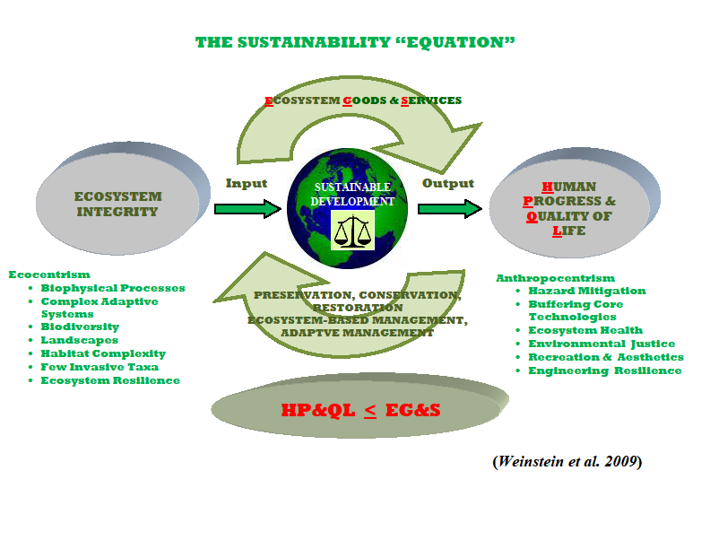

Slide 6
Equilibrium Attained Either by Increasing Goods and Services or by Reducing Consumption. In Today’s World, we must Do Both!
Increasing Goods and Services Reducing Human Demand (“Greening”)
Conservation & Preservation Land Use Planning
Ecosystem-Based Management Alterative Energy Development
Adaptive Management Energy Conservation and Efficiency
Habitat Restoration/Enhancement Reducing Greenhouse Gases
Stewardship (Social Learning) Recycling
Rebuilding Fisheries Sustainable Agriculture & Aquaculture
Invasive Species Management Ecosystem Rehab. (Contam. Reduct.)
Social and Environmental Justice

Slide 7
Ecosystem Goods and Services Derived from COASTAL Wetlands
Production of Harvestable Wildlife (Goods)
Waterfowl
Furbearers (e.g., muskrats)
Reptiles (e.g., alligators, turtles)
FISH and SHELLFISH
Water Resources (Services)
Water Quality Improvement (filtration)
Flood Mitigation and Abatement
Water Conservation (e.g., groundwater recharge)

Slide 8
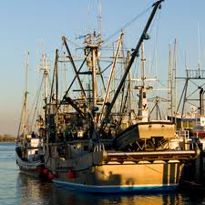
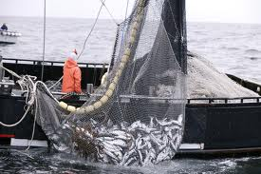
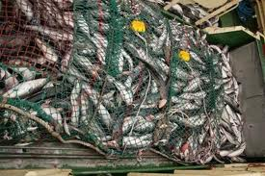
Coastal Wetlands -- Fish and Shellfish
Habitat for Commercial and Recreational
Species that Contribute to the Production
of More than 80% of Coastal Stocks
Critical Refuge for the Young of Species
that Support a $50 Billion Nation-Wide
Fishing Industry

Slide 9
The Effort to Protect Coastal WetlandsHas Been Wholly Bipartisan:
“[Coastal] Wetlands are Important Contributors to Commercial Fisheries Harvests …”
.....Congress (1987)
“The Economic Importance of Wetlands to Commercial and Recreational Fishing is also Enormous…the Effect of Wetland Loss is Reflected in Declining Populations of Fish…”
.....President Clinton (1993)
Protecting our natural infrastructure—our global life support systems—is vital to protecting our communities and their economies as well as fisheries and recreational opportunities along our coasts. With continued widespread loss and deterioration of coastal and marine habitats, we are in danger of losing this infrastructure. Congress has charged the National Oceanic and Atmospheric Administration (NOAA) with protecting habitat for fish, threatened and endangered species, marine mammals, and other natural resources within the coastal zone.
NOAA “Habitat Blueprint”

Slide 10
CRN Report: Protect Those Habitats that Contribute to the Success of the Nation’s Fisheries ISSUE: Distribution and Productivity of Fish are Shifting in Response to Warming Ocean Waters GOAL: Evaluate Impacts of Warming Temperatures and Freshwater Flow
Weinstein, MP, SY Litvin, VG Guida and RC Chambers. 2009. Is global climate change influencing the overwintering distribution of weakfish Cynoscion regalis? J. Fish. Biol. 75:693-698

Slide 11
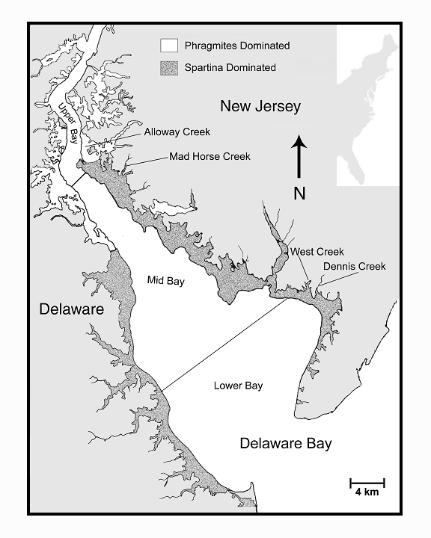
USA
39º20’
39º00’
75º40’
75º20’
75º00’
74º40’

Slide 12
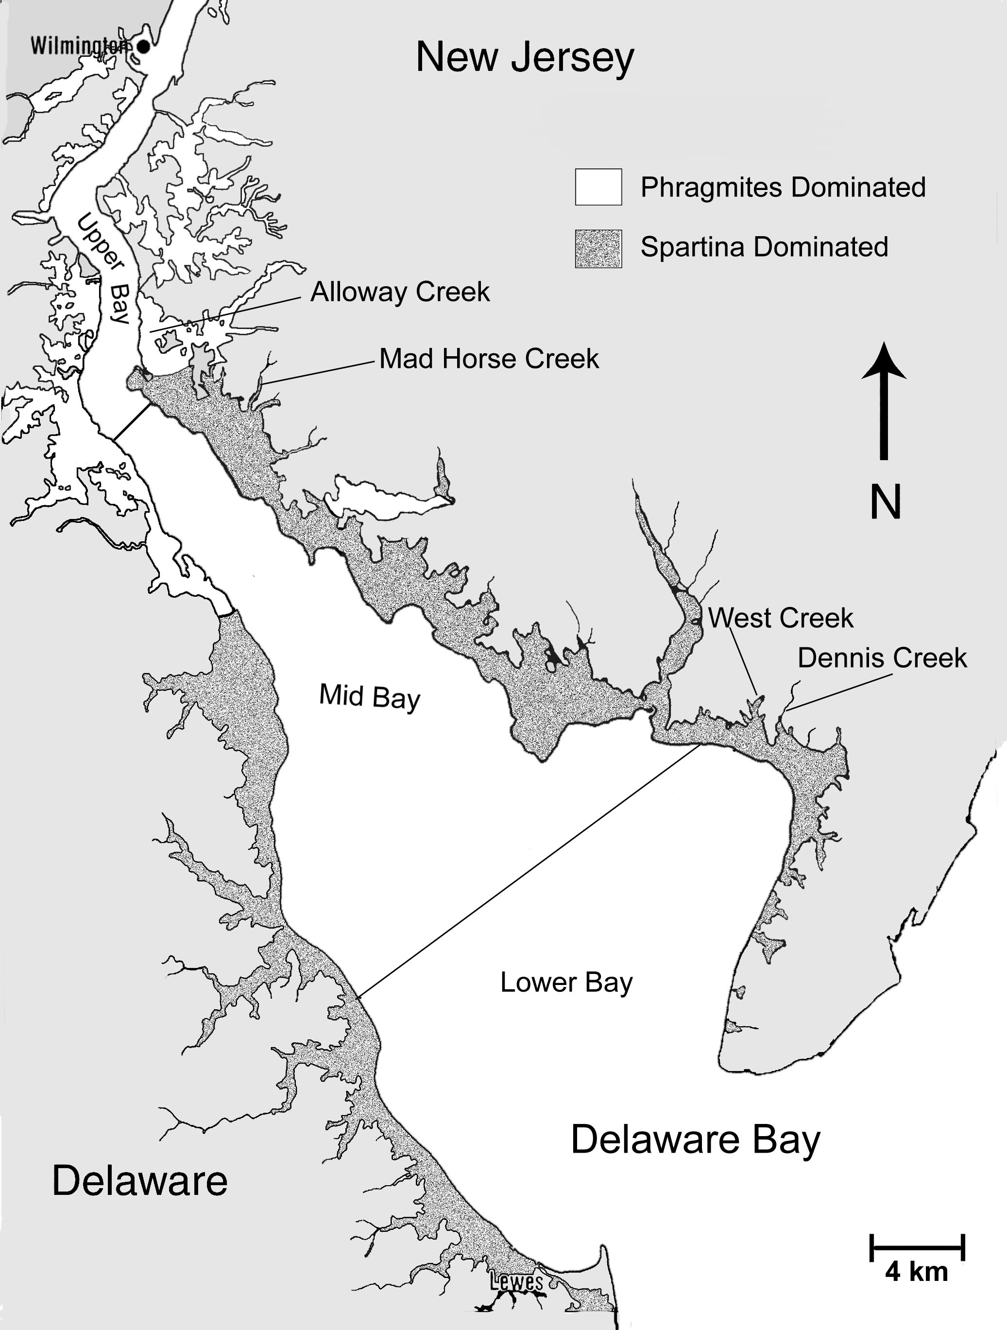
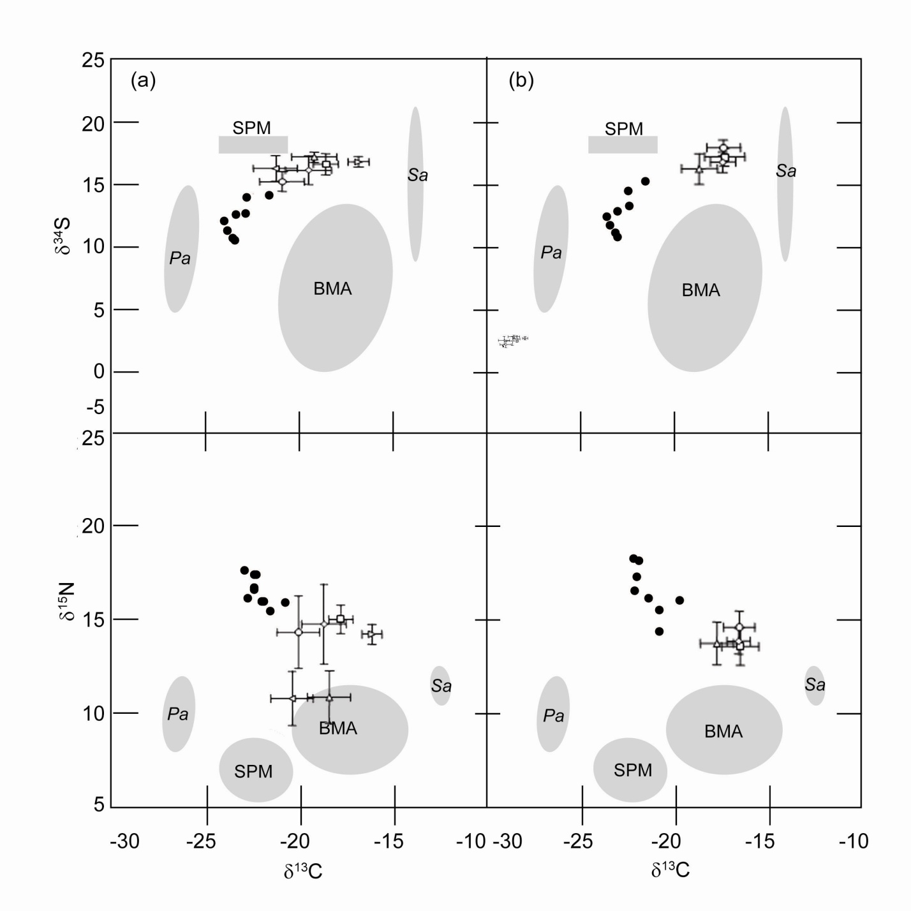
Christina River

Slide 13
5
0.4
0.2
0
0.0
TAG Energy Residuals
-0.2
Total Energy Residuals
Year
-0.4
-5
1999
-0.6
2001
2002
-0.8
-10
-1.0
-1.0
-0.5
0.0
0.5
1999
2001
2002
Protein Energy Residuals

Slide 14
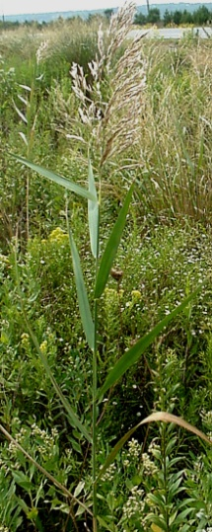
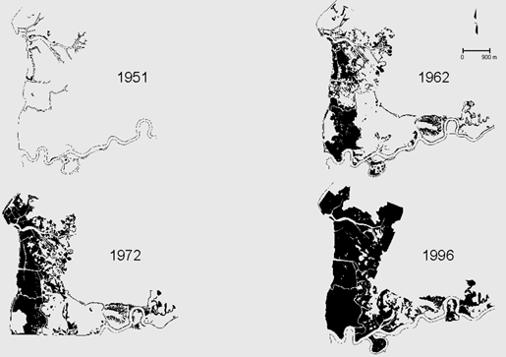
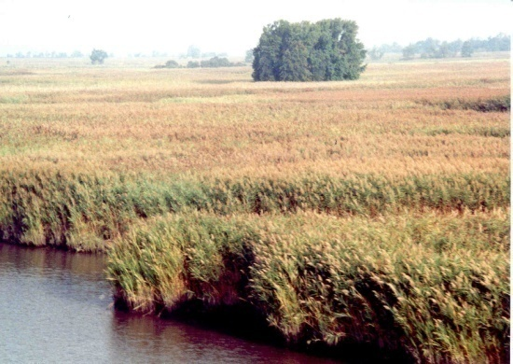
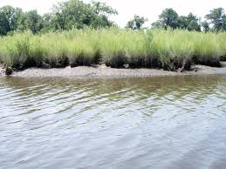
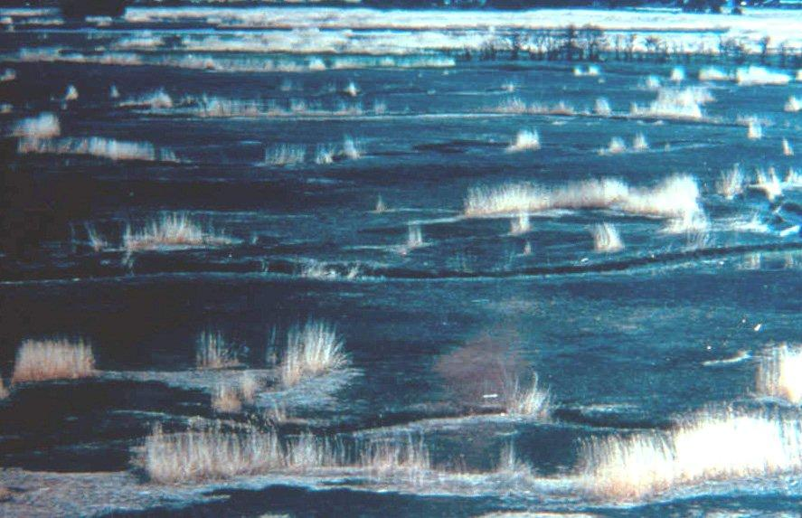
CRN Report: Protect Those Habitats that Contribute to the Success of the Nation’s Fisheries ISSUE: Ecosystems are Already Significantly
Impacted by Climate Change: Large-scale
Shifts in the Success of INVASIVE SPECIES, and
Habitat Loss
GOAL: Evaluate Impacts of Invasive Species on
Marsh Processes and Function that Support
Secondary Production of Fish and Shellfish

Slide 15
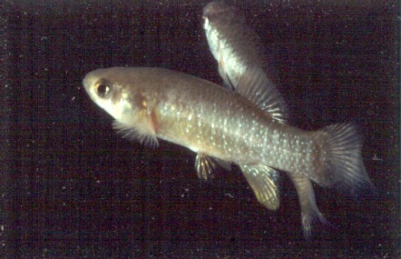
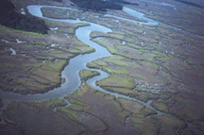
Dry Weight by Location
3
Location
Horseshoe Cove
Piermont Marsh
BIOCHEMICAL CONDITION
Biochemical Condition of Predators Integrates Environmental and Biotic Interactions at Lower Trophic Levels and Reflects the Value of Habitats in Their Production and Survival.
Premise
Levels of Fat and Protein Reserves Reflect the “Well Being” of Individuals, and May Infer Overall Value of Habitats in Secondary Production.
2
Dry Weight
1
0
20
30
40
50
60
70
80
Standard Length

Slide 16
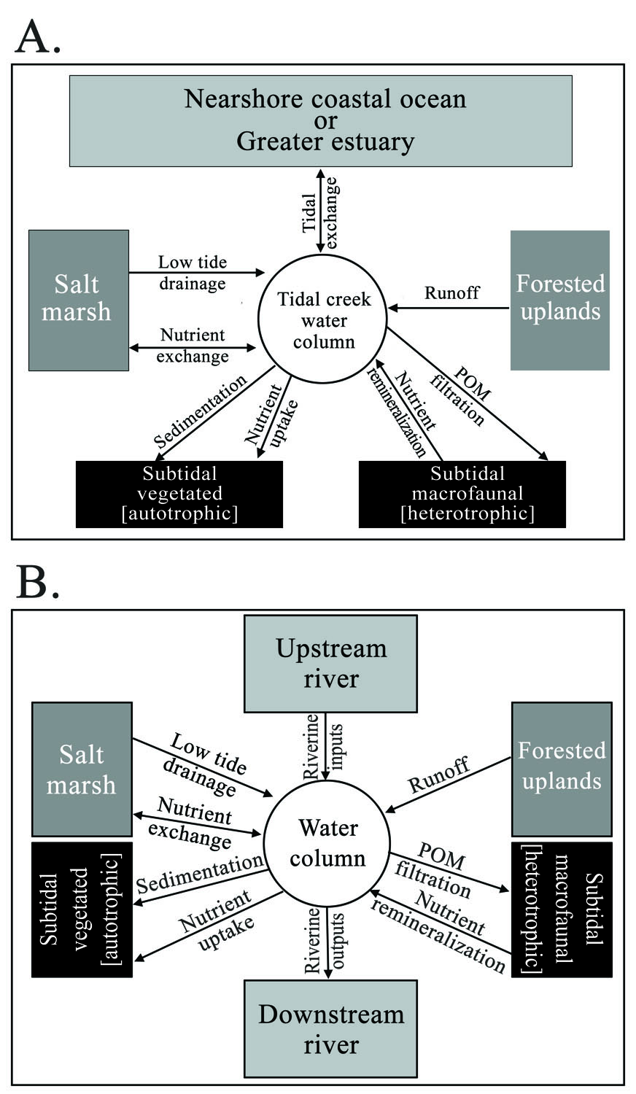
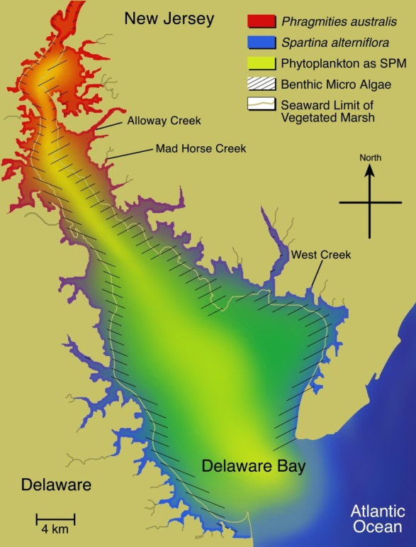
The Entire estuary is “programmed to produce fish and shellfish
Coastal Habitats Including Salt marshes do
not Function in Isolation when Supporting
Estuarine Secondary Production, but
Rather are Integrated Components of
Larger Systems
Estuary as a Whole is Characterized by
Gradients in Available Organic Matter, a
“Boundaryless” State, rather than Sharp
Transitions from One Food Source to the
Next

Slide 17
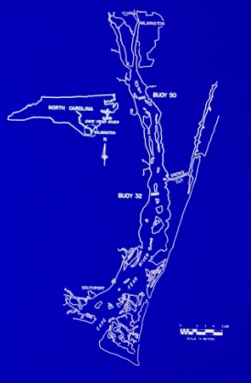
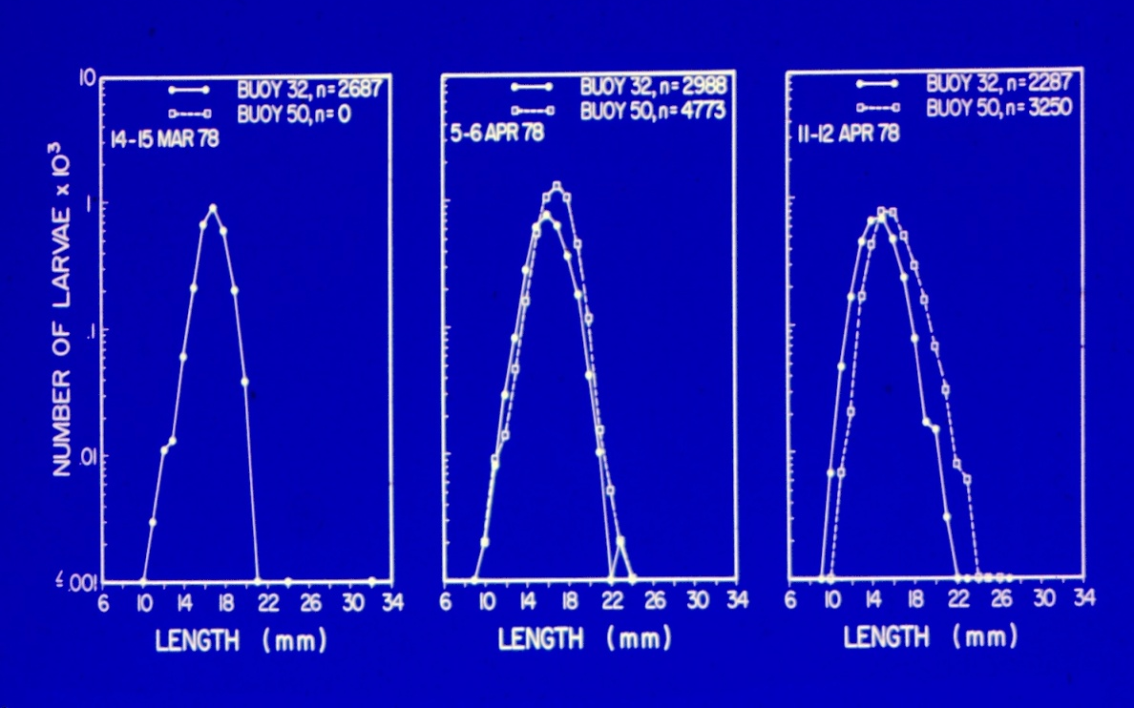
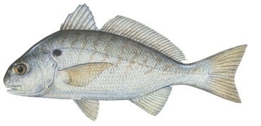
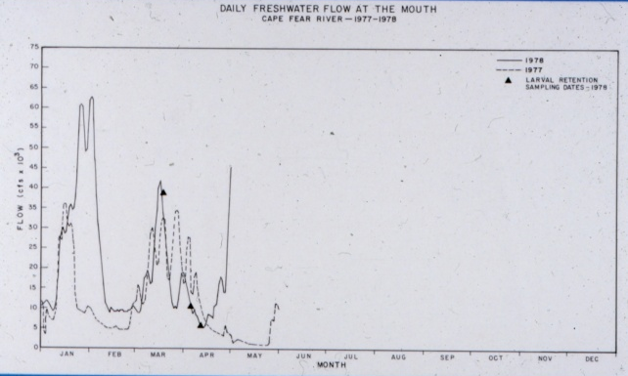
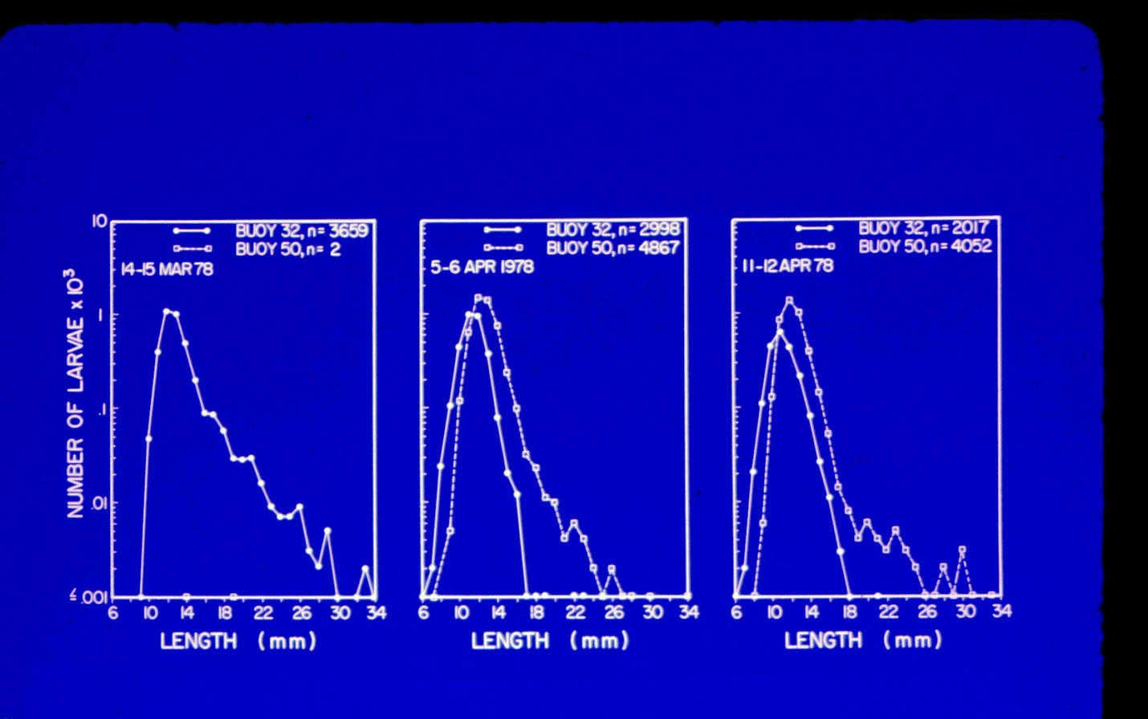

Slide 18
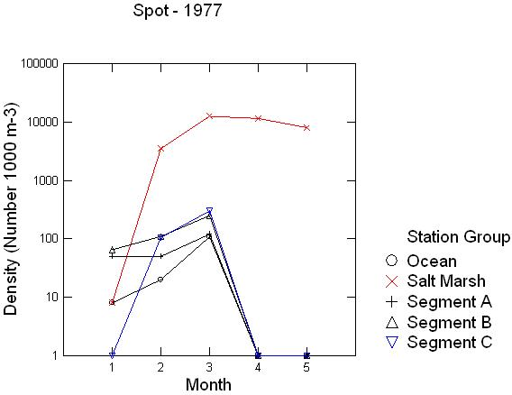
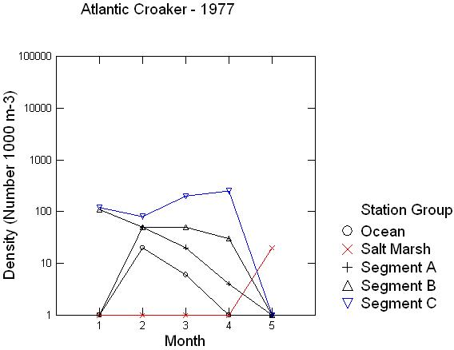
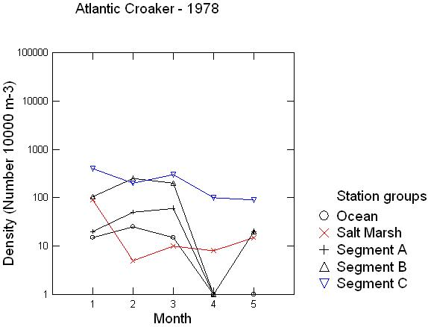
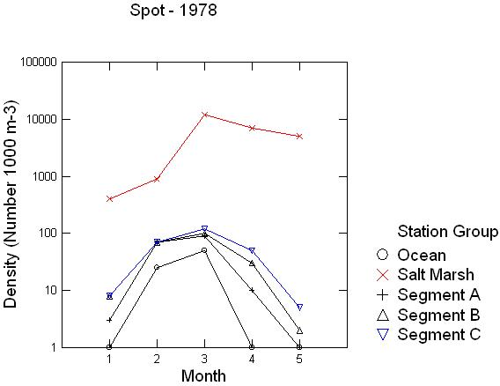

Slide 19
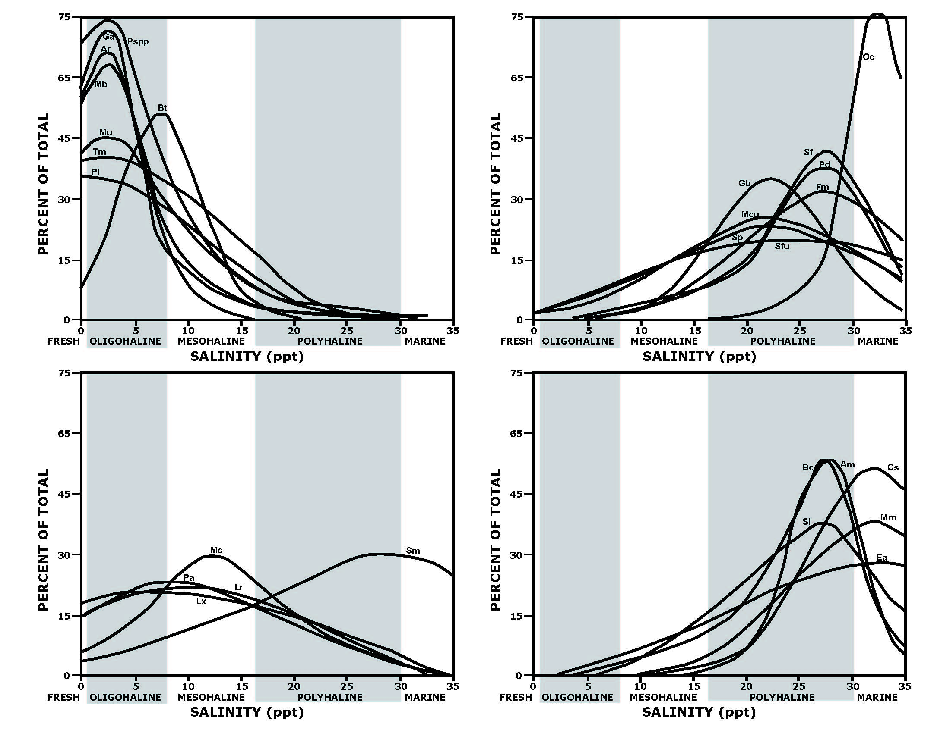
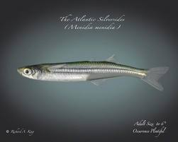
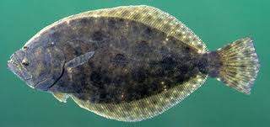
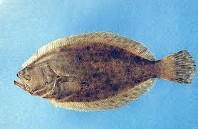
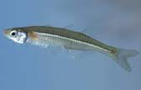

Slide 20
Task Force
Climate Resilient Nation
USACOE
NRC
EO 13547
National Ocean Council
Ecology Economy

Slide 21
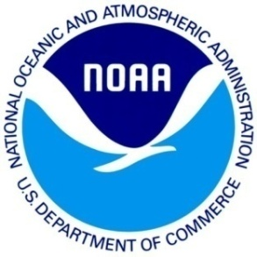
“It is an Open Question whether Ecosystem Management will become a Passing Fad, an Expansion of Rigid Bureaucratic Procedures, or a Sustaining Foundation for Learning to Deal with Interactions between People, Nature, and Economic Activities.”
Holling and Meffe (1996)

