Slide 1
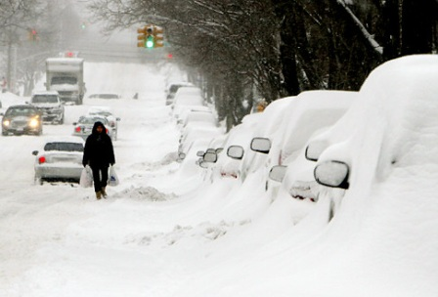
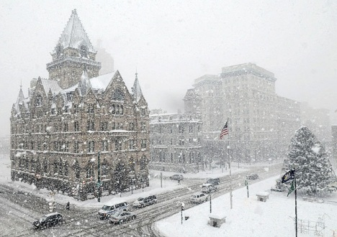
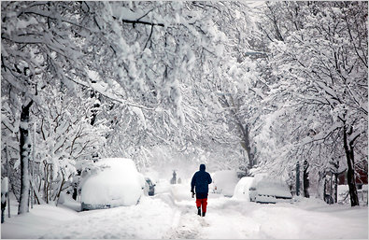
Microwave-based Snowfall Rate Estimation, Artificial Neural Network Approach
Ali Zahraei
Shayesteh Mahani, Cecilia Hernandez, and Reza Khanbilvardi
NOAA-CREST and CCNY
Crest Symposium 2013, 6th June 2013
Notes:
1

Slide 2
Outline:
SnowFall Rate Estimation (SFRE) Goals
Current Project
Case Study and Data Set
Preliminary Result
Conclusion and Future Work
Notes:
2

Slide 3
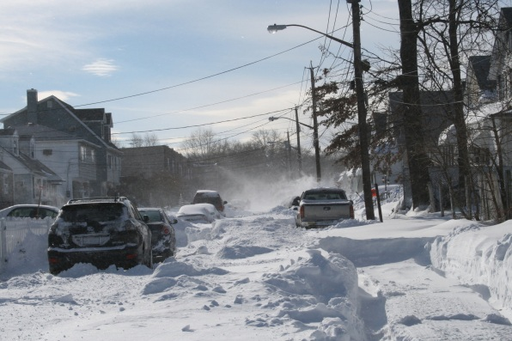
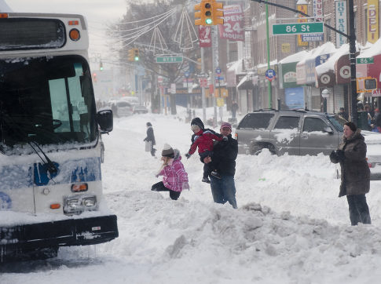
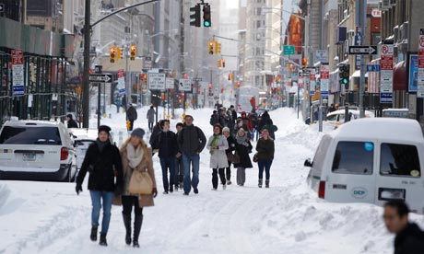
Snowfall Rate Estimation Study : Objectives
Global estimates of precipitation rate and distribution will lead to a better understanding of atmospheric circulation and to improve climatology, climate change studies, and weather and flood forecasting.
Can robust relationships be established that relate snowfall to observations at broad range of MW frequencies?
We develop a SnowFall Rate Estimation (SFRE) model rate using multi-sensor and multi-source of snow related observations.
Calibrate and validate the SFRE model using gauges and in future CREST in-situ snow measurement,
Notes:
3

Slide 4
SnowFall Rate Estimation Algorithms (SFRE)
Challenges:
Satellite-MW bands retrieve signal of ground, hydrometeors, water vapor, …
Over land is more complex.
detection of snowfall
Snowfall Retrieval Model
Snowfall Rate
Model
Physical Model
Mesoscale model (MM5)
Radioactive transfer Models
Statistical /Empirical Model
Mostly over-land models.
Usually devolved for ground-based radar
Notes:
4

Slide 5
Three Snow Storms
MM5 March 2001 blizzard
20 January 2007 lake effect snow storm
22 January 2007 synoptic event
The ice water path (IWP) in kg m²
Notes:
5

Slide 6
High-Frequency MW Retrievals: Combination of Different Physical Parameters
Percentage major contributions from:
Surface (green),
Hydrometeors (red),
Relative humidity (light blue),
The resultant nadir‐viewed brightness temperatures for the maximum (a) blizzard, (b) lake effect, and (c) synoptic falling snow profiles.
Skofronick and Johnson 2011
Notes:
6

Slide 7
High-Frequency MW Retrievals: Clear Sky (CA) and Snow Storm Anomalies
 | Blizzard |  | Lake Effect |  | Synoptic
Frequency | All | CA | All | CA | All | CA
89 | 228.8 | 260.7 | 237 | 238 | 201 | 196
166 | 206 | 263 | 227.9 | 252.2 | 247.8 | 242.8
183±1 | 240.8 | 242.8 | 245.1 | 245.2 | 243.7 | 243.7
183±3 | 238.9 | 252.3 | 249.6 | 250.9 | 250.9 | 251.2
183±7 | 225.1 | 261.3 | 244.8 | 254.8 | 256.2 | 256.4
Notes:
7

Slide 8
Proposed Model Structure
Emissivity
Hydrometeors
Water Vapor
AMSU
Water Vapor Impact:
Case Study I:
Coastal
Northeastern U.S
Cold & Humid
Case Study II:
Central U.S
Cold & Dry
non-precipitating
pixel
No
Precipitation
Ground-Based Observation
yes
Snow
No
Rain
yes
Temp < 30° F
No
Mixed rain-snow
Validation
yes
ANN Model (CAL)
yes
LZA < 30°
No
Discard
LZA: Local Zenith Angel
Notes:
8

Slide 9
Areas of Study:
Central Domain
Coastal Domain
Mid-west U.S
Northeastern U.S
Latitude: 37º N to 49º N
Longitude: 93º W to 100º W
Latitude: 41º N to 47º N
Longitude: 68º W to 74º W
3 Winter (December and January)
Winter Cold and Humid.
Flat Area (~ 400 ft)
Far Enough From Lake Effect
6 Winter (December and January)
Winter Cold and Dry
Average Elevation (~ 2000 ft)
Notes:
9

Slide 10
Data Sets:
Case 1: NCDC Stations
Case II: NCDC Stations
AMSU-B
169 stations
Quality Controlled Gauges
45 stations
Quality Controlled Gauges
5 channel cross-track,
continuous line scanning,
total power microwave radiometer.
It completes one scan every 8/3 seconds.
Two channels are centered nominally at 89 and 150 GHz. Other three centered around the 183.31 GHz water vapor line.
Channel Number | Central Frequency (GHz)
16 | 89.0±0.9
17 | 150.0±0.9
18 | 183.31±1.00
19 | 183.31±3.00
20 | 183.31±7.00
Notes:
10

Slide 11
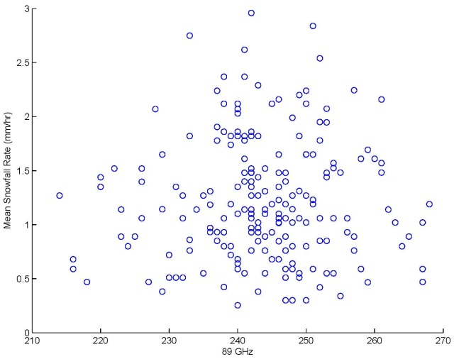
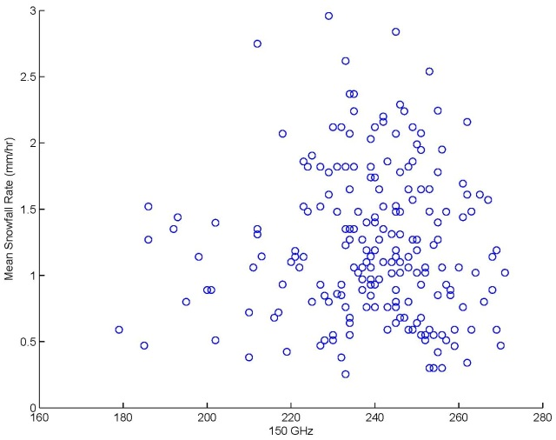
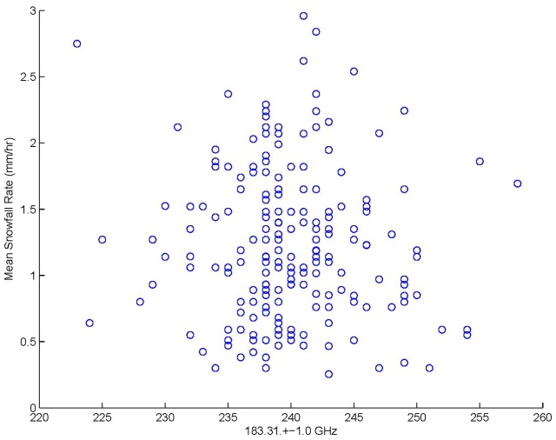
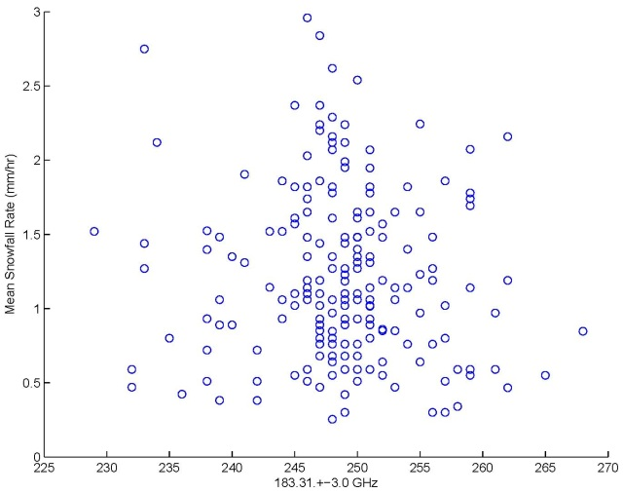
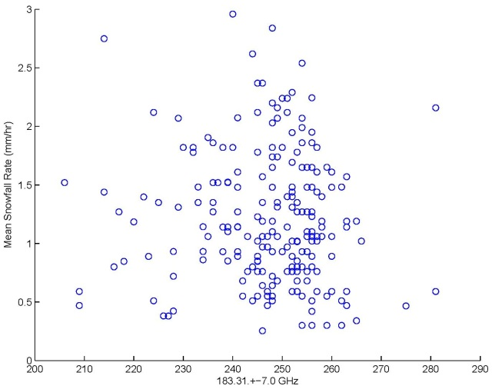
Coastal Case Study (Snowfall Rate Versus MW-Frequencies)
AMSU-B five bands, MW versus snowfall rate (Coastal) case study.
Snowfall rate (mm/hr)
89 GHz
150 GHz
Snowfall rate (mm/hr)
183.3 ±1.0 GHz
183.3 ±3.0 GHz
183.3 ±7.0 GHz
Notes:
11

Slide 12
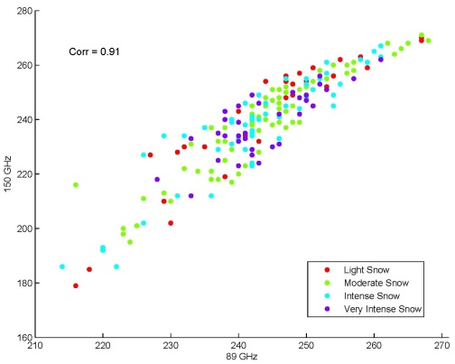
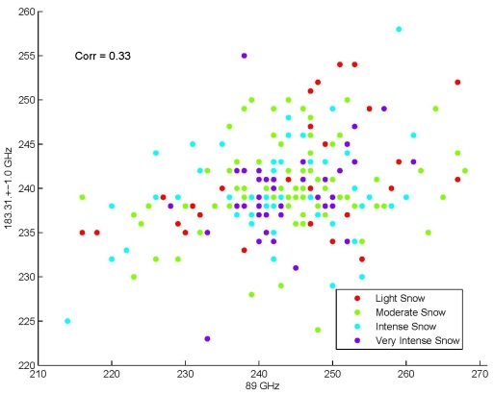
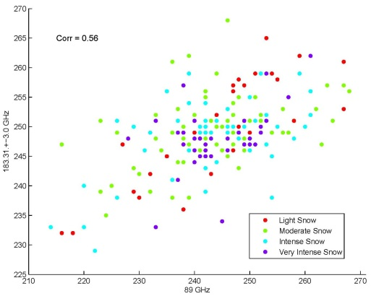
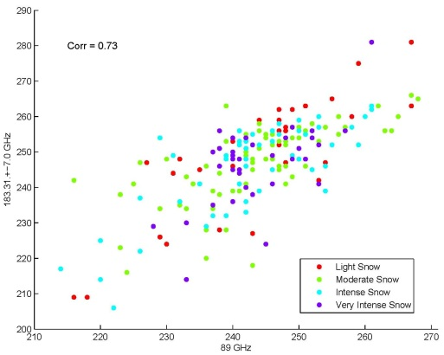
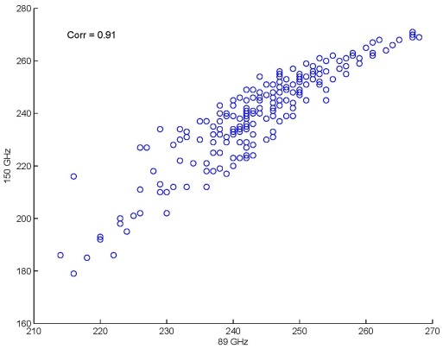
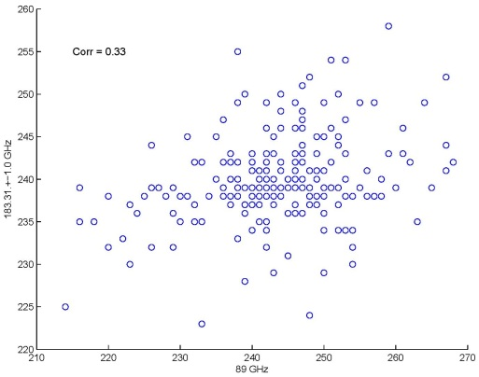
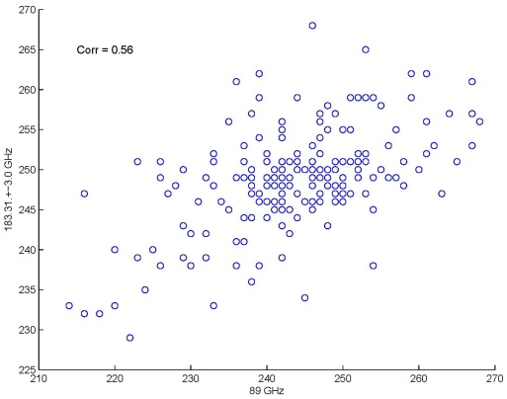
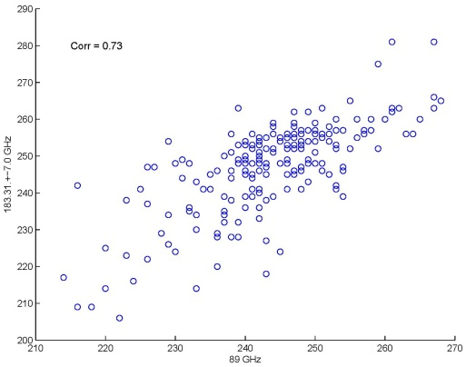
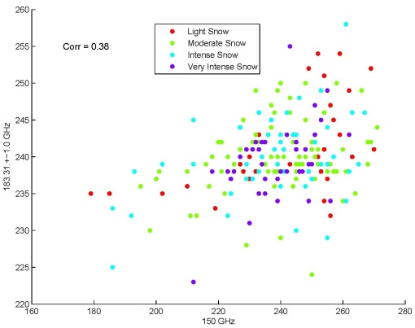
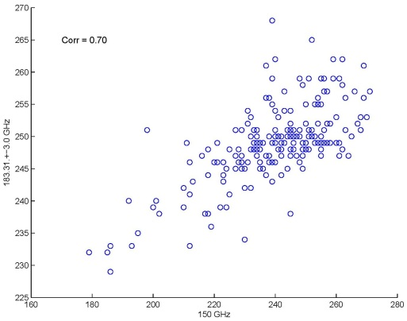
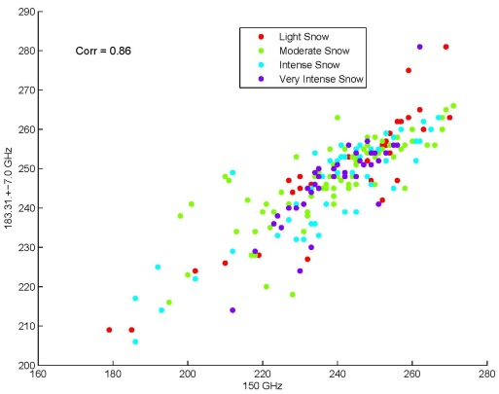
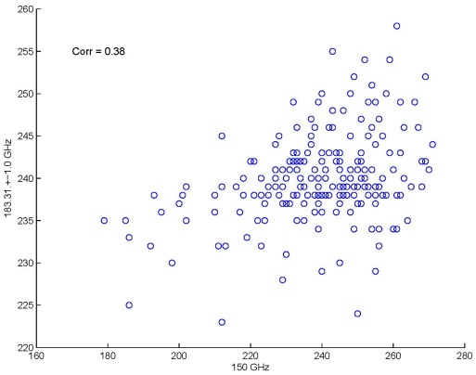
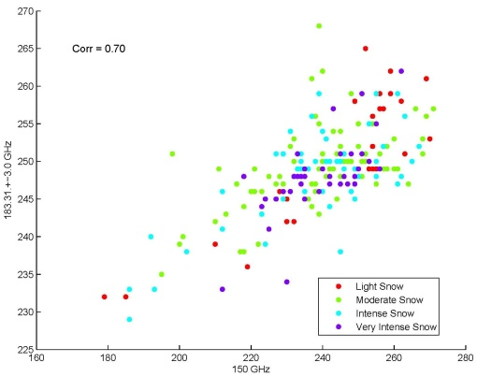
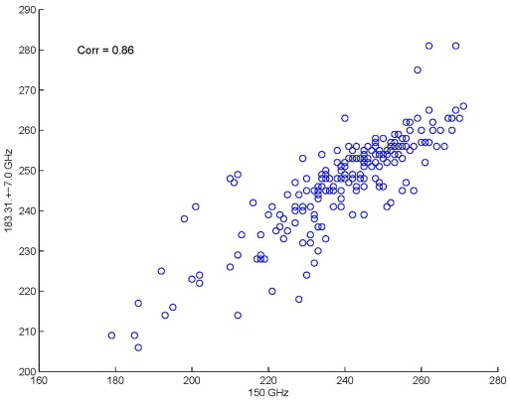
MW- High Frequency AMSU-B
Snowfall rate has been divided into four categories:
Light snow, Moderate snow, Intense snow, Very intense snow
150 GHz
183.3 ±1.0 GHz
183.3 ±3.0 GHz
183.3 ±7.0 GHz
89 GHz
89 GHz
89 GHz
89 GHz
183.3 ±1.0 GHz
183.3 ±3.0 GHz
183.3 ±7.0 GHz
150 GHz
150 GHz
150 GHz
Notes:
12

Slide 13
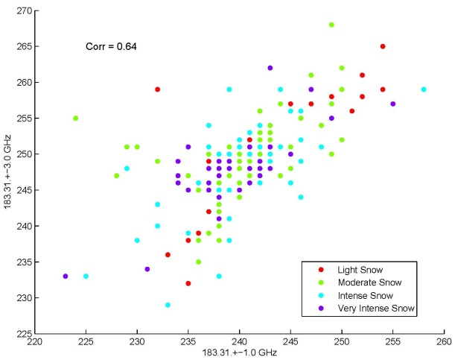
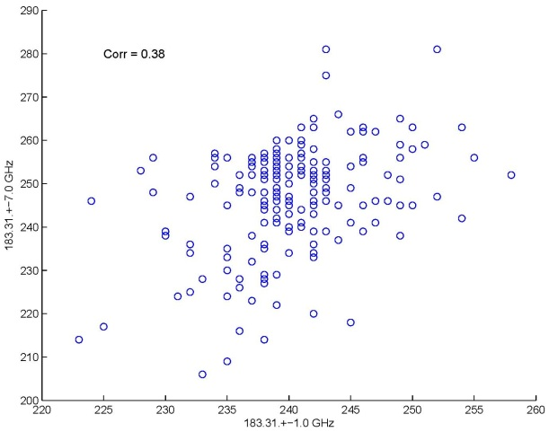
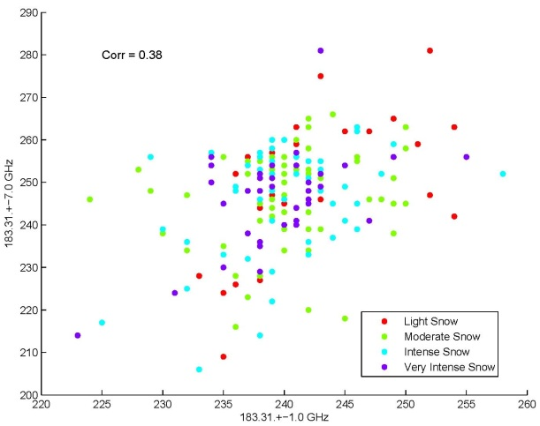
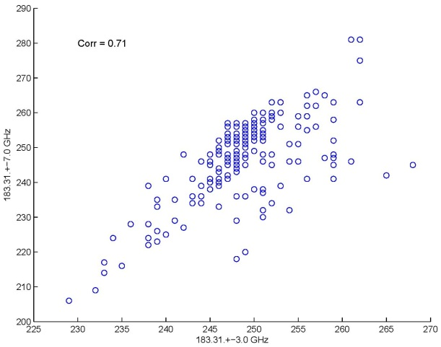
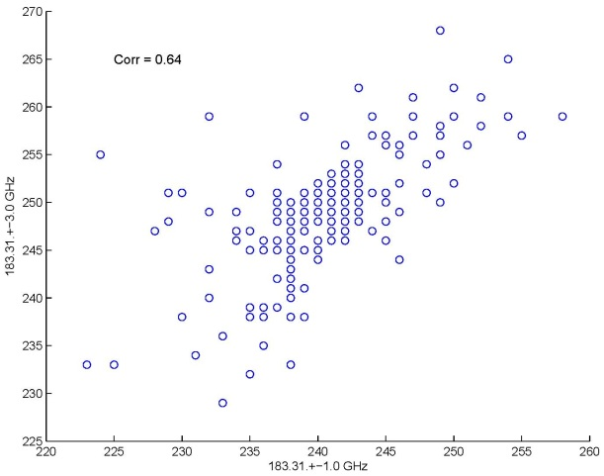
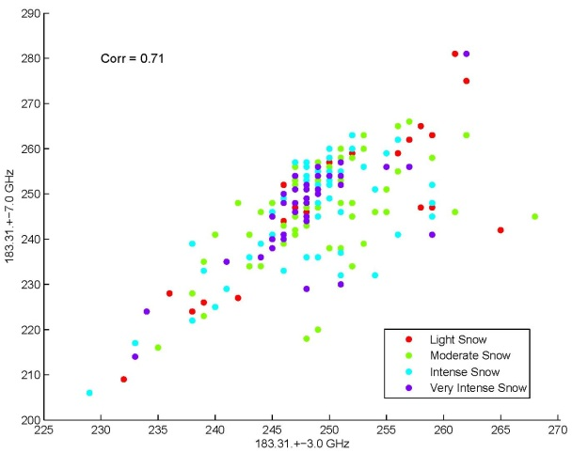
MW- High Frequency AMSU-B
183.3 ±3.0 GHz
183.3 ±7.0 GHz
183.3 ±7.0 GHz
183.3 ±1.0 GHz
183.3 ±1.0 GHz
183.3 ±3.0 GHz
There is no specific distribution pattern.
89 and 150 are well-correlated together and with 183.3 ±7 GHz.
183.3 ±7 GHz and 183.3 ±3 GHz are also well-correlated.
150 GHz
Notes:
13

Slide 14
Model Evaluation
Different ANN hidden-layer size have been tested (10-10, 20-20 ,…)
Two hidden layers (each 20 nodes) has shown best results.
The model performance in central region in relatively superior.
Bands with lower sensitivity to water vapor, model shows similar performance.
Average of 30 runs
Notes:
14

Slide 15
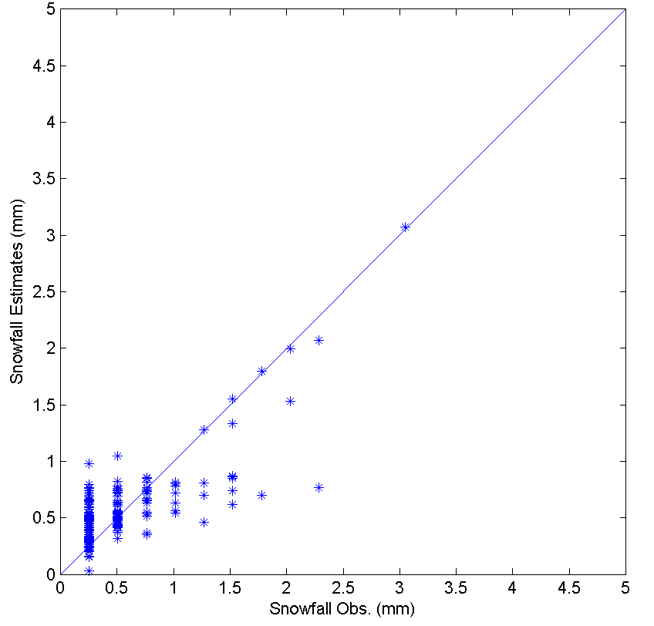
Validation
The ANN model has been evaluated for both case studies.
Best Result for the Central domain
Multi frequency 150 and 183±7 –GHz
150 and 183±7 –GHz
R=0.69
Simulated Snowfall VS.
Observed Snowfall
Notes:
15

Slide 16
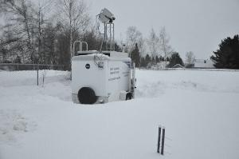
Conclusion and Future Wok:
Statistical SFR models can be used for snowfall rate estimation.
Statistical Models should be regionalized.
Statistical model have shown sensitivity to the physical parameters such as water vapor, hydrometeors, ground surface condition,…etc.
Comparing Coastal and Central case studies reveals that almost consistently model has relatively better performance in central region (probably negative impact of humidity).
The least water vapor sensitive MW- frequencies, has shown relatively similar performance in both case studies.
Enhance the accuracy of snowfall rate estimates by adding snow related information such as humidity and emissivity.
Altitude and lake effects are two important factor that should be taken into account.
CREST snow analysis and field experiment:
Located near the National Weather Service office and Caribou Municipal Airport at Caribou, Maine.
Dual polarized microwave (37 and 89GHz) observations and detailed synchronous observations of snowpack.
(b)
Notes:
16

Slide 17
Thank You!
Notes:
17

