Slide 1
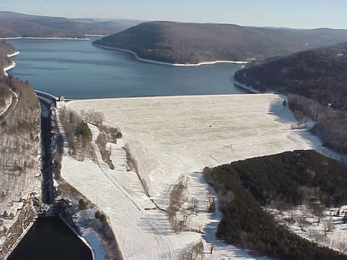

Delaware Reservoirs’ Drought Risk Assessment A Paleo View
Project Team
Columbia Water Center : Naresh Devineni, Upmanu Lall
Tree Ring Laboratory : Neil Pederson, Ed Cook
NOAA-CREST – 8th Annual Symposium – City College New York
June 5th and 6th , 2013

Slide 2
Overview
Part 2
Part 3
Part 1
New York City Water Supply System
Paleo Reconstruction of Streamflow – Hierarchical Model
Important Stakeholder Issues of Delaware Reservoirs
Research @ CWC and Tree Ring Laboratory
Reservoir Simulations
Drought Risk Assessment

Slide 3
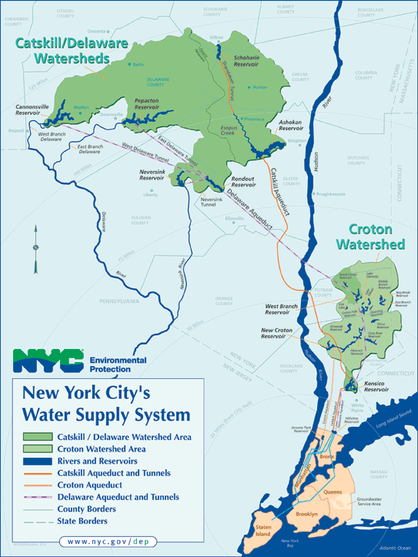
New York City Water Supply
  1700s – local dug wells and small reservoirs (population ~ 22000)
  Early 1800s – Manhattan Company (Chase Inc. Provided water to the city through owned wells.
  Late 1800s – Croton System
  Early 1900s – Expanded to Catskill/Delaware Watersheds
Complex System with competing stakeholders
NYC Current Consumption
>1000 Million Gallons per day (125 gallons per person)
Delaware System (50%)
4 Reservoirs
Catskill System (40%)
2 Reservoirs
Croton System (10%)
12 Reservoirs
1 year storage

Slide 4
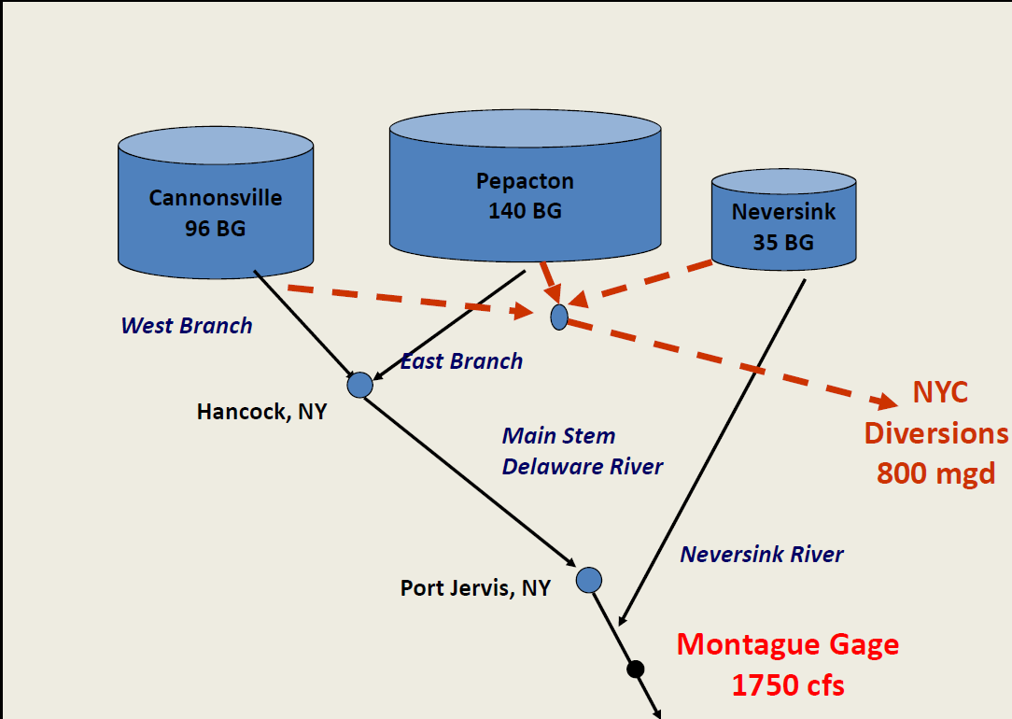
Stakeholders
  The Delaware River
    Originates in Catskill Mountains ; flows into the Delaware Bay.
    3 NYC Reservoirs supply upto 50% of water to the city.
    NY, NJ, PA and DE (decree parties) have entitlements to the waters.
  The 1931 and 1954 Supreme Court Decree
    NYC can divert upto 800 MGD per day.
    Montegue, NJ gage flows should be maintained at 1750 cfs.
    Any changes should have unanimous consent of the decree parties.
Kolesar and Serio, 2007

Slide 5
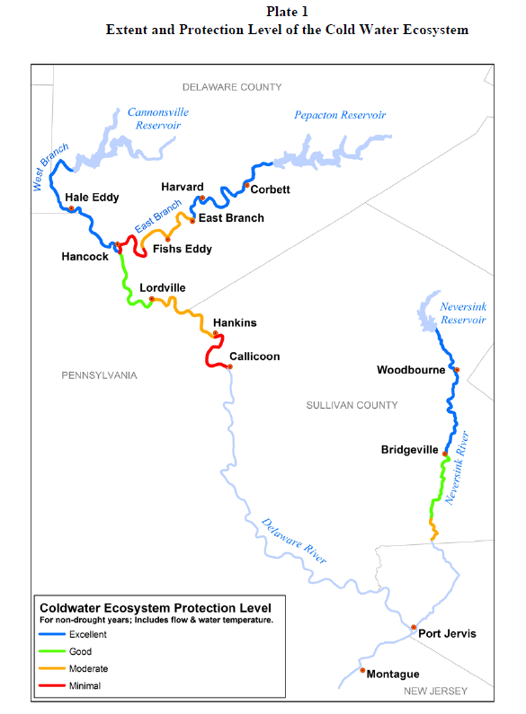
Stakeholders –
Competing Users
Above the Reservoirs
NYC wants to hold as much water as possible in anticipation of droughts.
Wants to ensure that the reservoirs refill by June 1.
Joint Fisheries White Paper, January 2010
Below the Reservoirs
The river is one of the finest wild trout fisheries habitat. It is dependent on cold water releases from the bottoms of the dams.
Conservationists want increased releases of cold water.
Communities want the NYC dams to be used for increased flood protection.

Slide 6
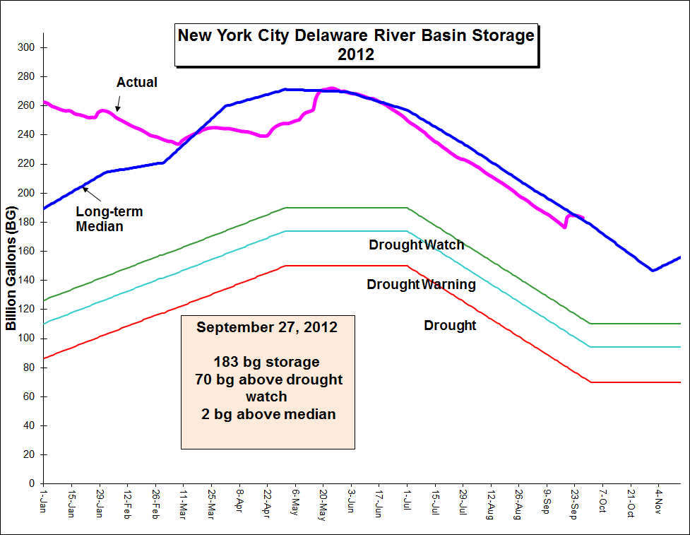
Reservoir storage over the summer 2012 was ‘typical’
Chart courtesy of Hernan Quinodoz DRBC

Slide 7
Columbia University Research
  Columbia Water Center and Tree Ring Lab
    Research on statistical methods for streamflow reconstruction.
    Analysis of drought risk for the NYC reservoirs based on Paleoclimate data.
    Professor Peter Kolesar conducted research on improving the water release policies for the Delaware. Instrumental in modifying the prior release rules to its current rules.
    Current research @ CBS explores the potential for relieving thermal stress on the trout in the upper Delaware during episodes of hot weather in the summer.

Slide 8
Paleo Reconstruction
  Understanding long term drought variations
    Design and operation for longest drought of record may under or overstate drought risk, depending on record length and climate modes sampled.
    Reservoir operating rules could be improved with better understanding of long term risks and methods to detect changes in climate/streamflow regime.
    Need characterisation of drought risk measure and its variation over decades.

Slide 9
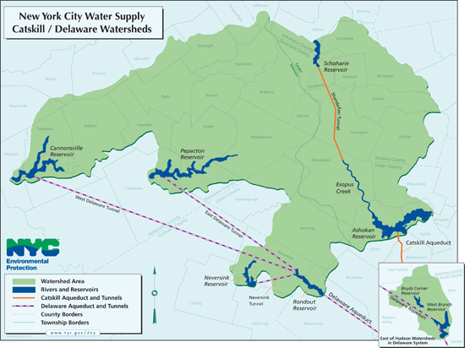

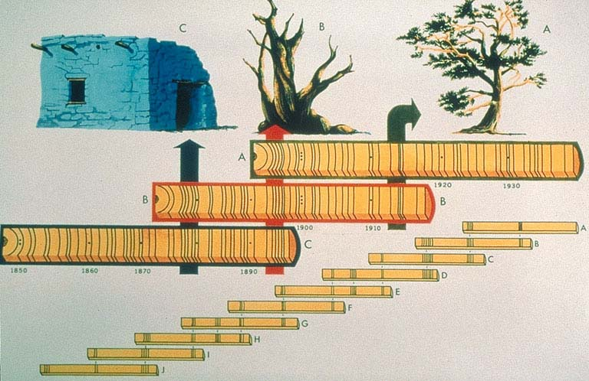
Paleo Reconstruction
Each chronology is an aggregate index from ~ 20 similar trees in that region.
1754
1999
246 years chronology (X_{t})
(8 tree ring chronologies)
streamflow record (Y_{t})
(5 sites)
1903
1999

Slide 10
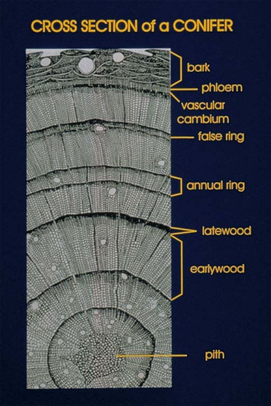
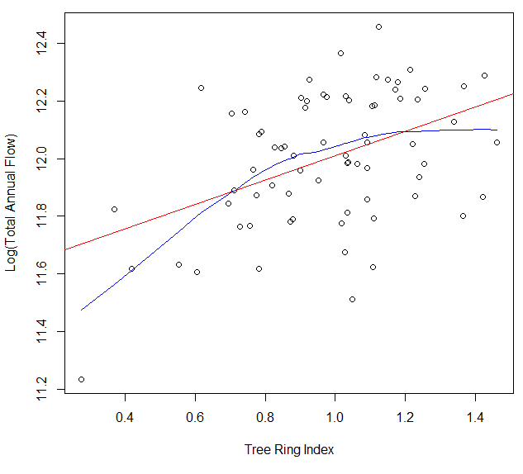
Tree Ring ~ Streamflow
For this study, we developed reconstructed seasonal and total annual flows for reservoir inflows using the predictors.

Slide 11
Bayesian Hierarchical Models
Partial Pooling – Hierarchical Model
Shrinkage on the coefficients to incorporate the predictive ability of each tree chronology on multiple stations
Key ideas:
Streamflow at each site comes from a pdf
Parameters of each pdf informed by each tree
Common multivariate distribution of parameters across trees
Noniformative prior for parameters of multivariate distribution
MCMC for parameter estimation

Slide 12
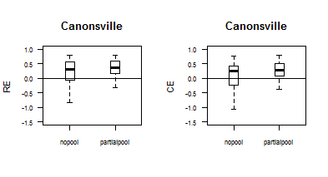
Delaware River Reconstruction and Performance
Cross Validated Performance Metrics
Reduction of Error (RE) and Coefficient of Efficiency
Notes:
For BS emphasize that often regression measures emphasize performance of the mean and we are interested more in the extremes hence measures that show how well the conditional distribution performs are of interest

Slide 13
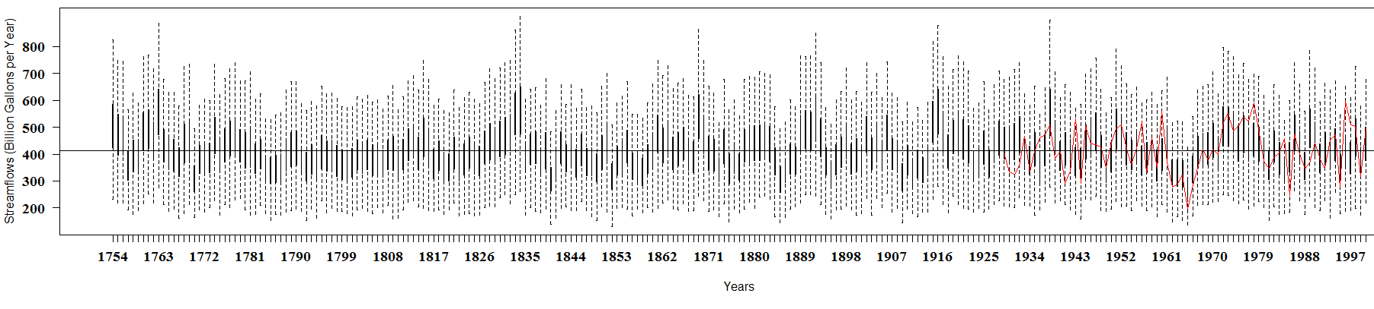
Reconstructed Flows
Posterior distribution of reconstructed streamflows are verified based on skill metrics such as Reduction of Error (RE), Coefficient of Efficiency (CE) and coverage rates.
Total annual flows are disaggregated into daily flows based on “k-nn” analog years.
Hence, we have 1000 simulations of 246 years of daily flows for the reservoir simulations and drought assessment.

Slide 14
Reservoir Simulation
Evaporation ~ f(Storage, Pan-evaporation)
Observed daily flows
Reconstructed daily flows
E_{t}
Inflow (Q_{t})
NYC (Div_{t})
Combined Storage
3 Reservoirs
Conservation (Con_{t})
+
Directed for Montegue (Dir_{t})

Slide 15
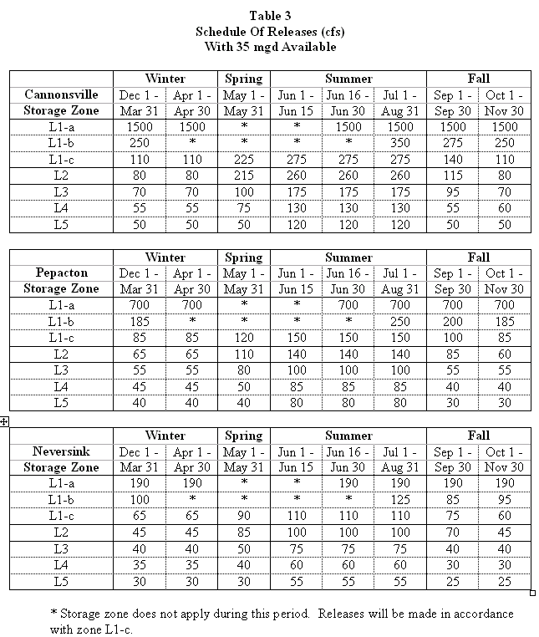
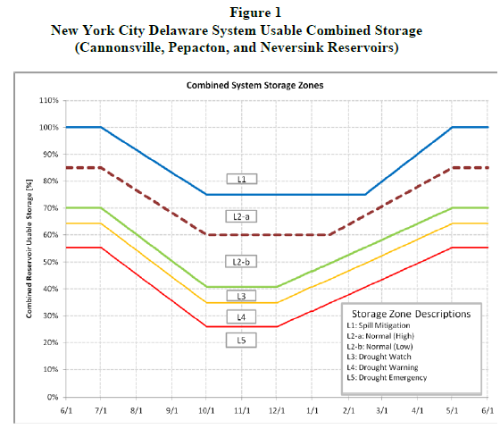
Reservoir Simulation – Defining Drought
Drought Curves as % combined storage
Daily releases are based on Flexible Flow Management Plan (FFMP) release matrix
Release based on daily storage levels…

Slide 16
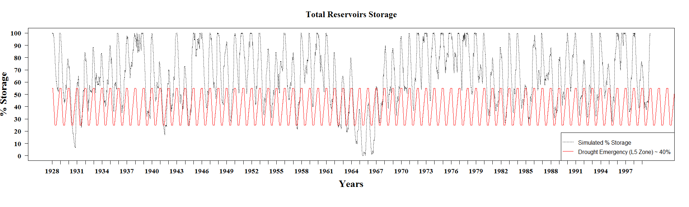
Reservoir Simulation – Baseline (observed inflows and FFMP plan)
Drought of the century
Questions
What is the probability the system approaches drought state based on the current FFMP plan?
Is the 1960s drought the worst?
Are the FFMP release rules overly conservative?

Slide 17
Reservoir Simulation
Questions
What is the probability the system approaches drought state based on the current FFMP plan?
Is the 1960s drought the worst?
Are the FFMP release rules overly conservative?
Analyses
For each of the 1000 simulations, we estimated the reservoir storages for 246 years (daily) based on reconstructed flows and current FFMP rules.
Based on these 1000 simulations of 246 years of daily storages, we compute the probability of the Storage being less than the Drought Curve for each day, i.e.
  P (S < L3)
  P (S < L4)
  P (S < L5)
Based on these probabilities, the reservoir drought risk over 246 years can be visualized.
If a similar drought such as the 1960s drought were to occur in the past, we can detect it from the increased probability of being in drought during that regime.

Slide 18
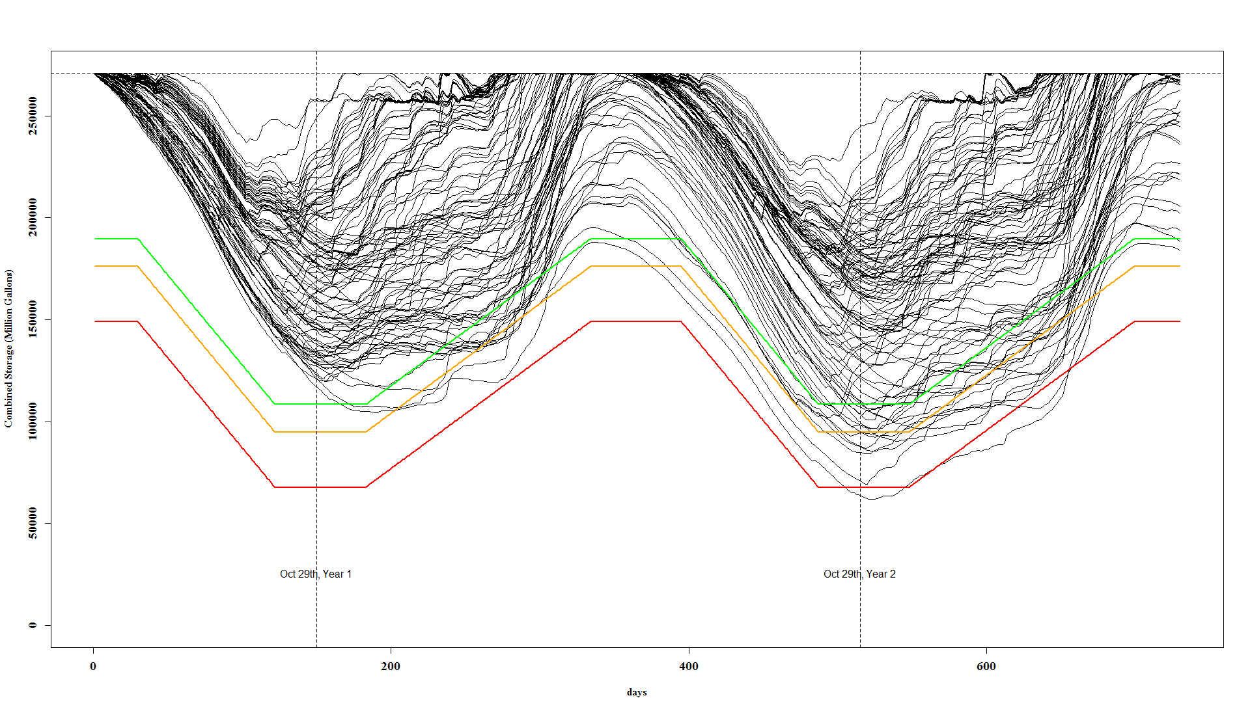
Reservoir Simulation

Slide 19
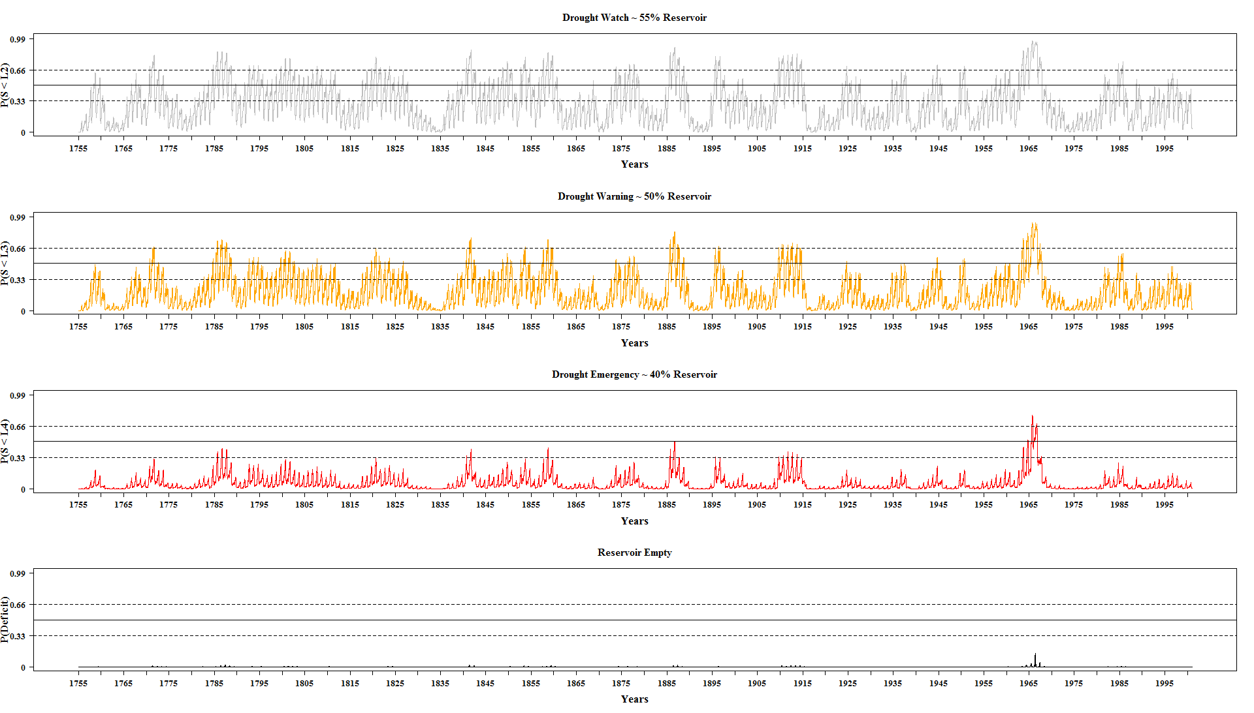
Drought Assessment
Probability of reservoir under extreme stress is very low over the 246 years.

Slide 20
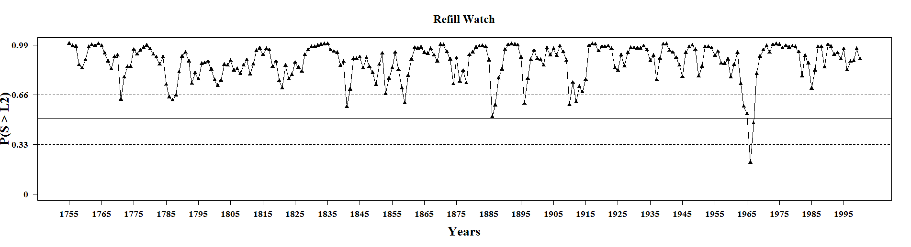
Drought Assessment
June 1st of every year, we compute the probability of reservoir being above the drought curves.

Slide 21
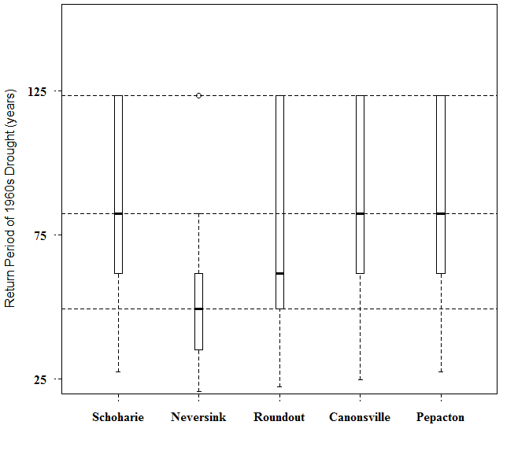
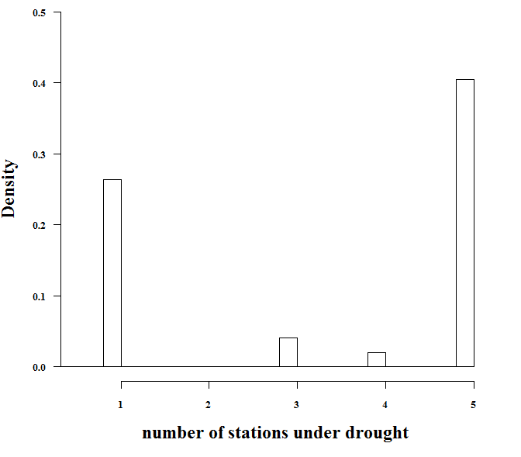
Drought Assessment

Slide 22
Summary
  The reconstructions allowed us insights in to the probability of moderate to severe sustained droughts in a region based on the current release plans.
  We observe that the 1960s drought is by far the worst drought based on 246 years of simulations (since 1754).
  There are intermediate drought warning periods; however, acute stress periods are rare. Proper adaptation would be sufficient during these periods.
  There is a high probability of reservoirs refilling to normal zones by June 1 during most of the years.
  Probability of spills over these periods reveal that the current FFMP releases can be understood as overly conservative.
  Modified release rules that aid thermal relief to wild trout in the upper Delaware can be explored without much stress to the system during most periods.

Slide 23
Acknowledgments
  NOAA, CCRUN
  NSF

